Slide 1
HEALTH HUMANITIES IN GLOBAL CONTEXT
Considering Ethnicity, Race, Color & Caste
March 23, 2018
Future Trends in Health Humanities Publishing & Pedagogy Workshop
Duke University Health Humanities Lab, Franklin Humanities Institute
Esther L. Jones, PhD

Slide 2
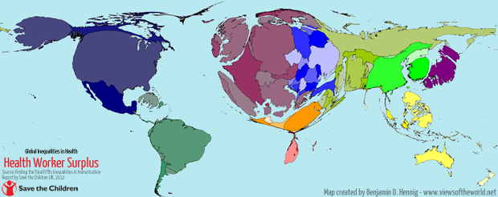
A View of the World According to Health Inequity: Health Worker Surplus

Slide 3
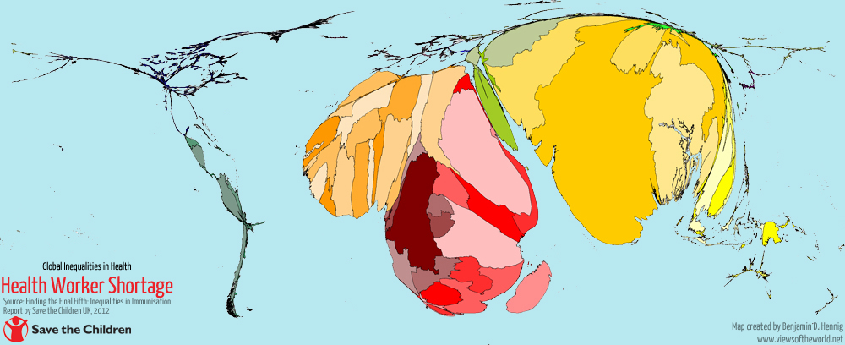
Health Worker Shortage

Slide 4
Mortality Under Age of 5
Notes:
Maps courtesy of Benjamin Hennig, www.viewsoftheworld.net

Slide 5
The Approach
Core Framing Concepts
Theoretical Underpinnings
Cross-Cutting Issues
Palgrave Handbook of
Health Humanities & Race

Slide 6
The Approach: Core Framing Concepts
How is Health Humanities defined, understood, enacted locally?
Complexities of ethnicity, race, color, caste, tribe
How does one capture the concept of marginalized and stigmatized phenotypic difference without privileging externally imposed conceptual frameworks?

Slide 7
The Approach: Theoretical Underpinnings
Intersectionality: engaging poverty simultaneously with other stigmatized identity markers, however they are locally defined
Interdisciplinarity: embracing how the multiple ways of knowing offered by the humanities enriches strategies for health equity
Interdependency: a world that can address health inequities of the most disadvantaged in the specificity of local contexts is a healthier world for all

Slide 8
The Approach: Cross-Cutting Issues
Socio-political landscape
Stigma
Transnational considerations
Immigration status
Refugee status
Colonial and post-colonial status
Diaspora

Slide 9
Content & structure
Audience, Purpose, Style
Publication Format
Chapter Content
Final Volume Structure
Challenges
Palgrave Handbook of Health Humanities & Race

Slide 10
Content & Structure: Audience, Purpose, Style
Audience
Purpose
Style

Slide 11
Content & Structure: Publication Formats
Online with dynamic content
E-book
Print book

Slide 12
Overall Book Structure (original concept)
Editor-in-Chief
Section Editor (Asia)
China
Myanmar
Section Editor (Africa)
Malawi
Broad theoretical framing essay and conclusion
Overview essays/regional crosscurrents
Commissioned nation/chapter author

Slide 13
Chapter content
Social and Historical Context
Health Humanities Approaches & Racialized Difference
Defining marginalized/stigmatized populations
Health Humanities Interventions
Further Recommended Reading
Palgrave Handbook of Health Humanities & Race

Slide 14
I. Social and Historical Context of the Nation
What are the greatest health risks and challenges in this nation according to governmental- and/or health sector-identified public health priorities?
Is the country represented in this data as a member state of WHO? If not, how is data about population health, marginality, and disparity captured?
Does poverty align with health inequity? What other key issues produce conditions of inequity?

Slide 15
II. Health Humanities Approaches & Racialized Difference
In this nation, to what degree are humanistic methodologies practiced in or applied to medicine?
How is “health humanities” defined in this locale?
What are those humanistic methods, and by whom are they practiced?
To what degree is there an intellectual and academic community to advance these approaches?
What community-based efforts, if any, exist that could be defined as health humanities?
What alternative health systems exist, if any, beyond the scientific medical paradigm?

Slide 16
III. Defining marginalized & stigmatized populations
What are the health issues plaguing historically marginalized and stigmatized populations in this nation? Which group(s) bear the risk of poor health outcomes and how, if at all, are they identified by the medical establishment?
How do these groups self-identify, and is there a disjuncture between self-identification and state naming? How has this disadvantage emerged over time?
What has been the process of racialization or ethnification that reduces these populations to status of disadvantage, stigma, and health disparity?
What has been the historical experience of these groups in relation to medical and health care establishments?

Slide 17
IV. Assessment of Health Humanities Interventions
Would ideally provide a brief review of centers, institutes, scholars, community groups, and so on advancing health humanities in the region, highlighting their methods, goals, and outcomes for alleviating health disparities.

Slide 18
V. Recommended Reading List
A bibliography of texts that cover historical, philosophical, literary, religious, and artistic approaches to understanding “race” and health disparities in the nation.

Slide 19
opportunities & challenges
Palgrave Handbook of Health Humanities & Race

Slide 20
Opportunities
Commissioned chapters that can be published shortly after peer-review (no waiting for all files to be submitted)
Each article reads as a stand-alone work, can be downloaded individually
Redundancy becomes a good and useful thing. Some groups will show up in multiple articles/chapters
Capacity for updates and revisions as new research emerges or as data changes

Slide 21
New Considerations/Challenges
“Searchability” concerns for online articles
Is nation-based structure no longer viable?
What happens to audience & purpose?
What might be alternate ways of structuring the text besides nation-based profiles?
Sacrifice the practical element (health care programs and delivery occur primarily within national constructions)?
How to reconcile first-round electronic publication concerns with final bound book product?

Slide 23
CASE STUDY: Myanmar and the Rohingya
Complex structures at the intersections:
Race v. ethnicity in local cultural/political constructions
Post-colonial political context and social structures
Marginalization: unrecognized by government as citizens
Religion: The Rohingya are also a religious minority (Muslim in a Buddhist-dominant society).
Poverty: reside in an extremely poor and unresourced region
Migration and refugee status: flee to nearby nations to survive (e.g., Bangladesh.
Is their stigmatized difference also thought to be phenotypic according to local perceptions?

Slide 24
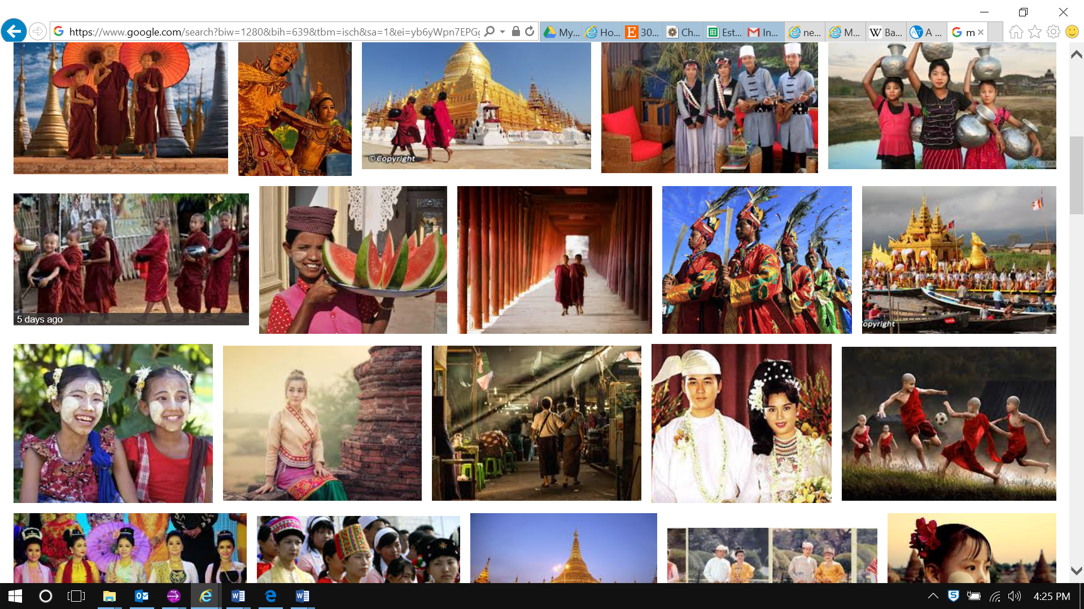
Google Image Search: Myanmar People

Slide 25
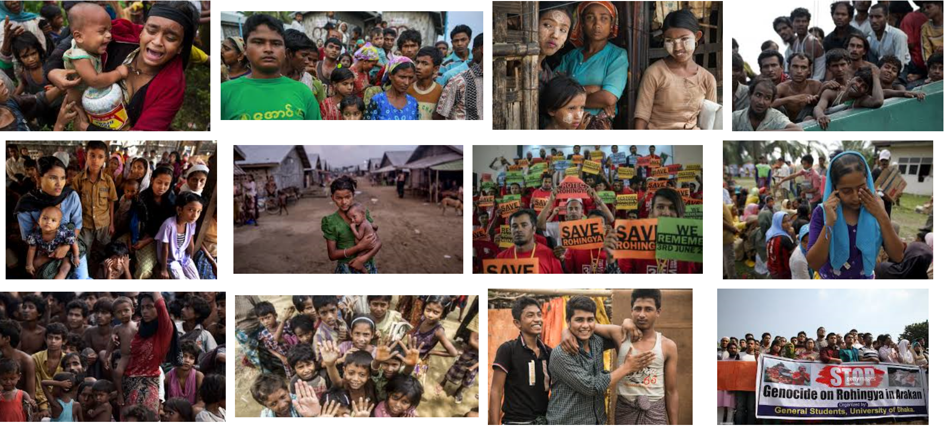
Google Image Search: Rohingya of Myanmar

Slide 26
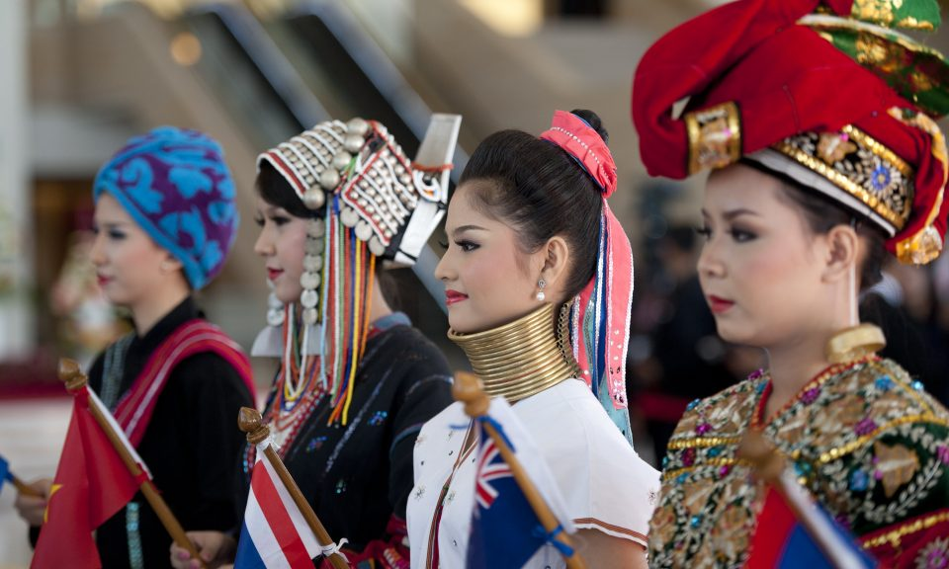
“A Question of Race in Myanmar”
Students wearing costumes representing Myanmar's different ethnic groups
Asia Times online, June 3 2017
Notes:
http://www.atimes.com/article/question-race-myanmar/ By Bertil Lintner Naypyitaw, June 3, 2017 2:02 PM (UTC+8)

Slide 27
Thank you!

