Slide 1
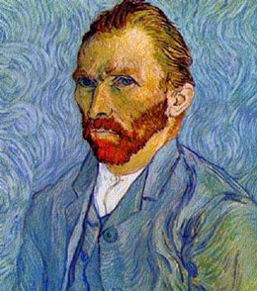
Vincent van Gogh
Life and Times

Slide 2
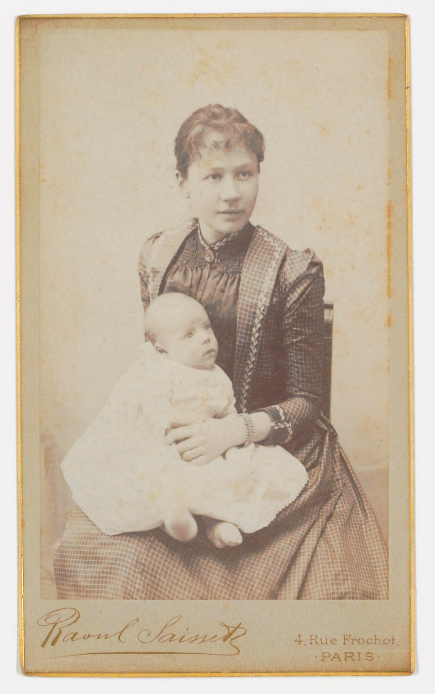
1853
Vincent van Gogh is born in the small village of Groot-Zundert, Holland.
van Gogh and his mom →

Slide 3
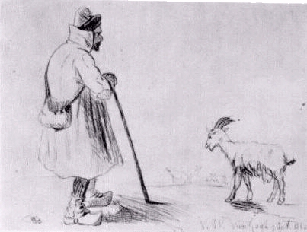
1862
van Gogh attempts his first drawings.
“The Goat Herd” →

Slide 4
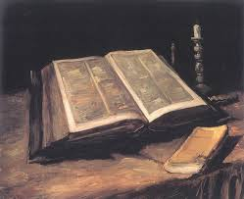
1875
van Gogh becomes obsessed with studying the Bible.
“Still Life with Bible” →
Notes:
van Gogh takes a new job as a teacher and works with a Methodist minister. He delivers his first Sunday sermon in October. As his religious fervor increases, his physical and mental state decreases.

Slide 5
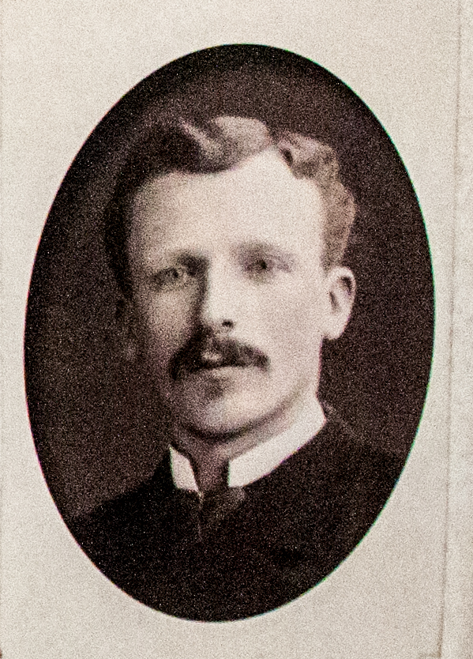
1880
van Gogh starts to suffer depression.
His brother (Theo) supports him financially.
Theo →
Notes:
van Gogh moves to Borinage, Belgium to help the coal-miners. He lives in extreme poverty. His superiors fire him because his religious and helping behavior is too extreme. Thus he suffers depression because he thinks he failed the miners.

Slide 6
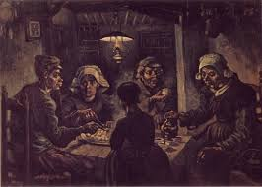
1885
van Gogh’s father dies in March. van Gogh paints his first great painting.
“The Potato Eaters” →
Notes:
van Gogh experiments more with colors and becomes extremely interested in Japanese woodcuts.

Slide 7
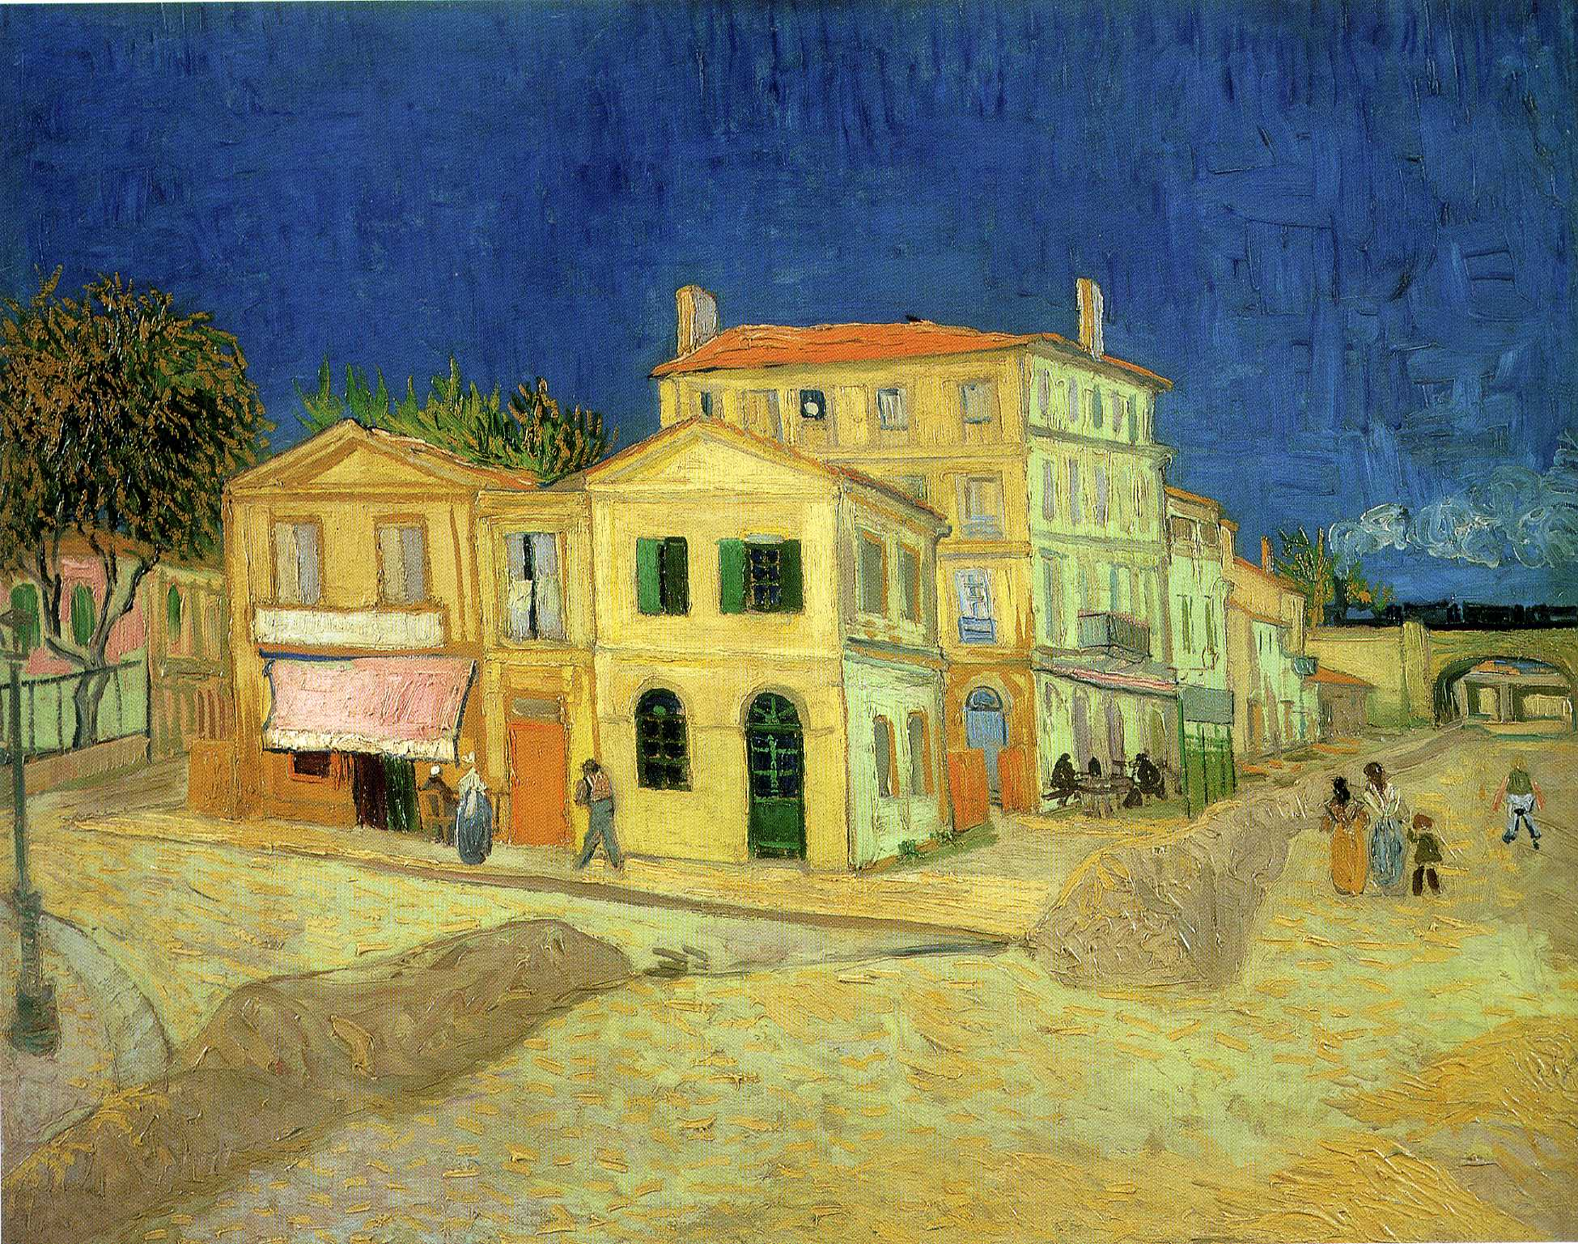
1888
van Gogh cuts off his left ear lobe and presents it to a prostitute.
“The Yellow House” →
Notes:
van Gogh moves into the “Yellow House” where he hopes to establish an artists’ community. He is extremely productive while living there and paints many of his most famous works. His friend Paul Gauguin comes to help build the artists’ community but they endlessly fight about art and Gauguin leaves. van Gogh loses his mind and cuts off his ear.

Slide 8
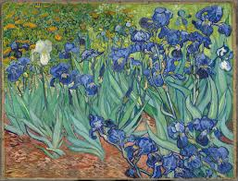
1889
van Gogh enters the Saint Paul-de-Mausole mental asylum.
His paintings are finally exhibited at the Salon des Indépendants.
“Irises” →
Notes:
van Gogh’s mental state fluctuates from being calm to hallucinating/delusional. He tries to poison himself by eating his own paints. He realizes he only gets mental attacks when he paints outside, so he confines himself to paint indoors.

Slide 9
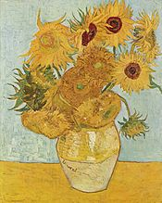
1890
van Gogh moves in with his brother (Theo).
van Gogh goes for a walk one day and shoots himself in the chest with a pistol.
“Sunflowers” →
Notes:
After a serious mental attack, van Gogh moves closer to his brother Theo so a doctor can watch over him. Theo’s wife has a new baby and van Gogh seems happy spending time with his brother and nephew. But Theo’s health is getting worse and he’s struggling with financial problems. van Gogh feels like he’s a burden to Theo and his family and feels responsible for the financial problems, so his mental state plummets. Then he tries to kill himself. He staggers home and tells no one of the bullet. Doctors say the bullet can’t be removed so van Gogh slowly dies while laying in bed and Theo cradling him. His coffin is covered in sunflowers that van Gogh loved so much.

Slide 10
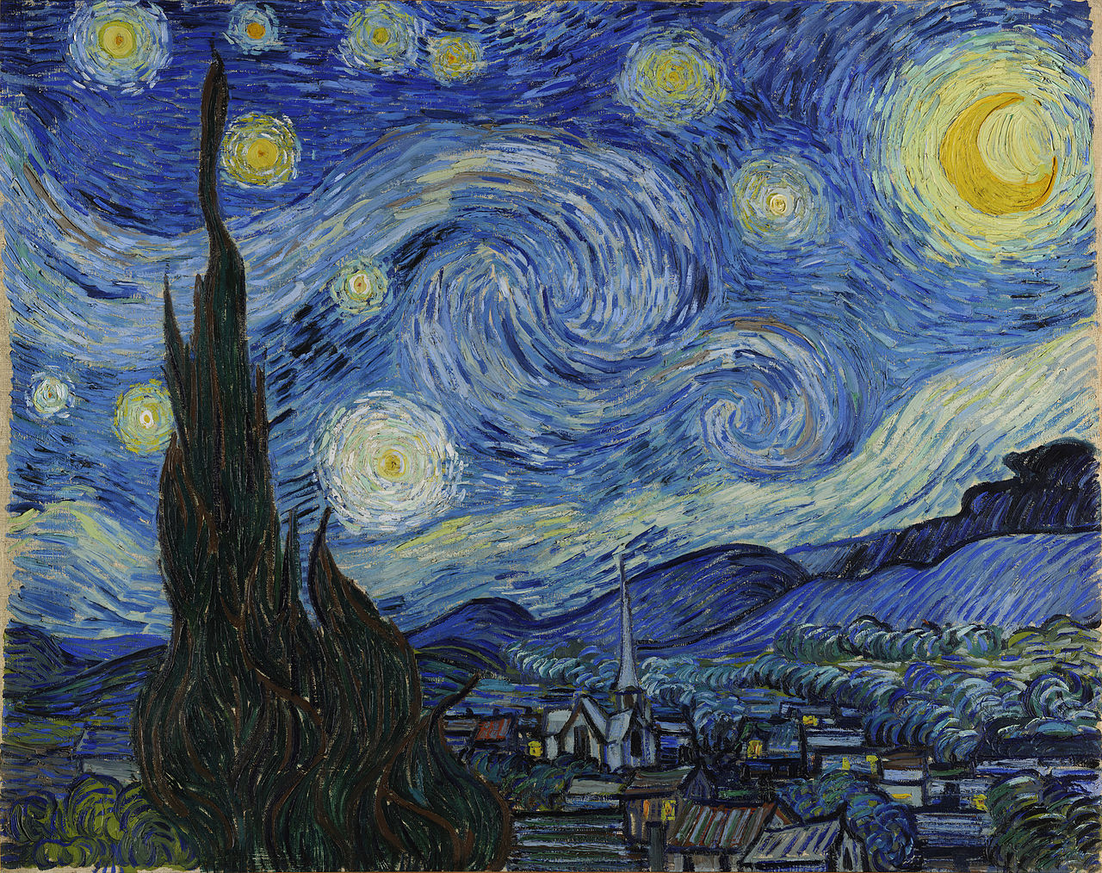
“The Starry Night”

Slide 11
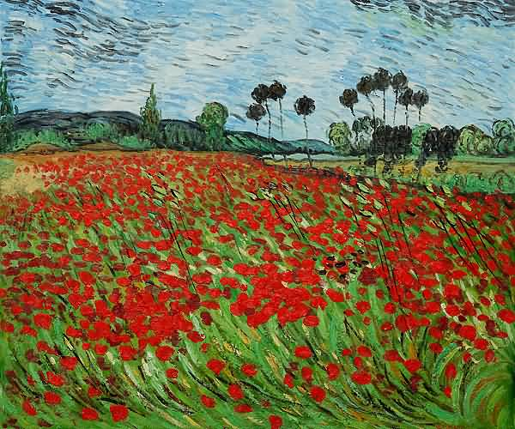
“Field of Poppies”

