Slide 1
Spatial variation among factors influencing social conflict in Peru: an analysis using geographically weighted regression
Thesis Defense
Clark Graduate School of Geography
2015
Zoe Ritter
John Rogan, Ph. D.
Anthony Bebbington, Ph. D.
Samuel Ratick, Ph. D.
Nicholas Cuba

Slide 2
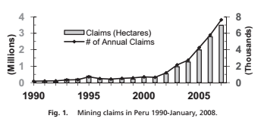
Expansion of mineral extraction in Peru
Extractive industry accounts for 4.8% of Peru’s GDP
Land area overlain by mineral concessions has grown from 11% (2009) to 17% (2013)
concessions overlap important watersheds, agricultural land, protected areas
Reduce and alter spatial extent of livelihood resource bases
  Deforestation, air/soil/water pollution
  Ecosystem imbalance, loss of biodiversity
  Increase in hunting of native wildlife
  Disturbance of indigenous communities
(Bebbington and Bury, 2009)

Slide 3
Expansion of mining has led to increases in conflict…
47 conflicts (February 2004) → 211 (February 2015)
Concentrated in areas of mineral extraction
  Realized or attempted appropriation of local resources
  Community attempts to resist expansion of mining operations
  Community attempts to gain compensation for social and environmental costs of extraction
Natural resource revenues allocated to subnational governments where resource was extracted

Slide 4
Previous research
Arellano-Yanguas (2011):
  Multivariate linear regression
  Canon Minero revenue relationship to conflict
  Annual conflict index
  departmental (regional) scale
Ponce and McClintock (2014):
  Logistic regression
  Included proportion Canon Minero revenue spent as variable measuring bureaucratic capacity to respond to community needs
Amount of Canon Minero revenue transferred to each department positively associated with conflict
Greater proportional spending of revenue by departmental governments reduced conflict

Slide 5
Research objectives
(1) determine factors that best explain social conflicts occurring in Peru between 2006 and 2014 using global ordinary least squares (OLS) regression
(2) using selected variables compare global OLS and geographically weighted regression (GWR) models to evaluate how relationships between social conflicts and explanatory factors vary over space
(3) compare results with ongoing debates in mining conflict literature

Slide 6
Study Area
Coast:
  11.7% of land area
  52.6% of population
  Deserts, arid climate
  Highest valued agriculture in irrigated valleys
Andean highlands
  28% of land area
  38% of population
  Temperate to frigid climate
  Headwaters of many rivers
Amazonian lowlands
  60.3% of land area
  9.4% of population
  Humid tropical climate
Figure 1. Map of study area in Peru

Slide 7
Dependent variable: social conflicts
“complex process in which sectors of society, the State and/or companies, perceive their positions, interests, objectives, values, beliefs, or needs are contradictory, creating a situation that could lead to violence” (Defensoría del Pueblo)
Active social conflicts 2006-2014
  Mineral extraction
  Corruption of provincial or district officials
Regional and national scale social conflicts excluded
14 provinces excluded due to lack of data
Figure 2. Spatial distribution of social conflicts
Notes:
Talk about spatial distribution of conflict

Slide 8
Independent variables: Mining revenue
Revenue transferred: sum of Canon Minero (2006-2014) and Regalía Minera (2008-2014) allocated
Proportion revenue spent: sum of Canon Minero (2006-2014) and Regalía Minera (2008-2014) allocated, divided by Revenue transferred
 | Canon Minero | Regalía Minera
 | 50% of profit tax | Production value:
 |  | up to $60 million: 1%
 |  | $60-$120 million: 2%
 |  | > $120 million: 3%
Specific municipalities where resource is extracted | 10% | 20%
Municipalities of the province where the resource was extracted | 25% | 20%
Provincial and district municipalities of the department where the resource was extracted | 40% | 40%
Departmental government where resource was extracted | 25% | 15%
State universities in the department where the resource was extracted |  | 5%
Notes:
Add table

Slide 9
Independent variables: geographic extent of mining
Extent of provincial area and natural resources comprised by mining operations
  proportion of the province covered by mineral concessions (February 2013, MEM)
  province proportion of agricultural lands inside mining concessions (2000, MDA)
  proportion of all areas within 1 km of rivers inside mining concessions (2010, MINAM)

Slide 10
Independent variables: demographic data
National Census of Population and Housing (2007, INEI)
  Illiteracy rate, education level, occupation, indigenous population, urban environment, sex, age
National Household Survey (2009, MEF)
  predict per capita expenditure for each household
  estimate the total population in each district living in poverty
  coefficient of variation: magnitude of economic inequality among the districts within each province

Slide 11
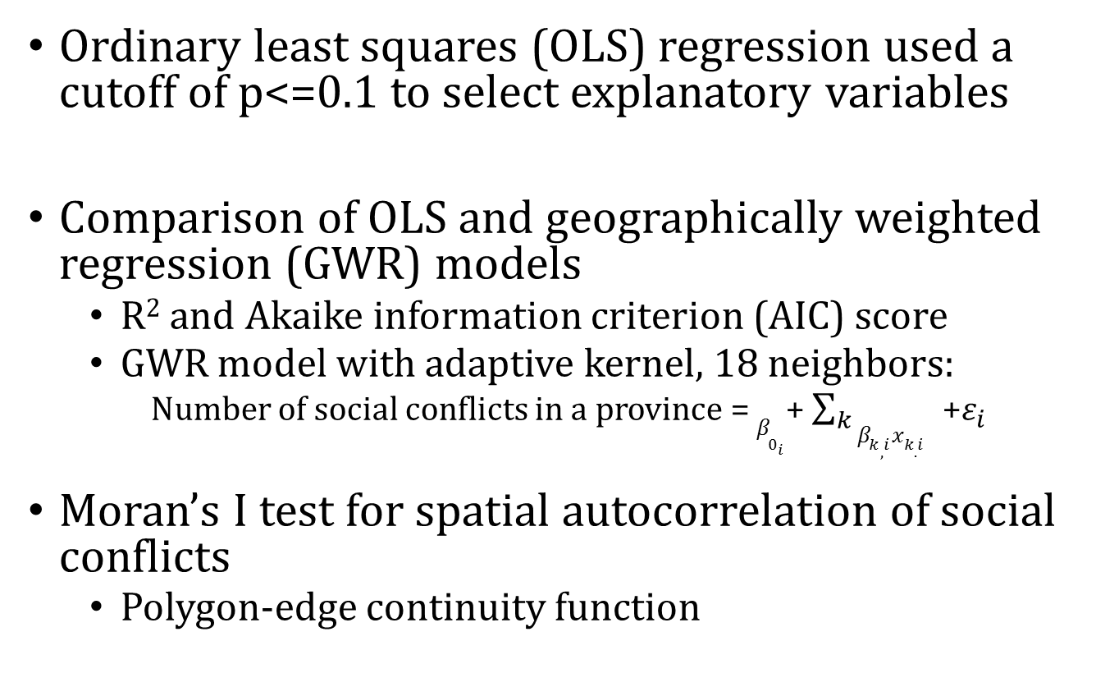
Methods
Ordinary least squares (OLS) regression used a cutoff of p<=0.1 to select explanatory variables
Comparison of OLS and geographically weighted regression (GWR) models
  R² and Akaike information criterion (AIC) score
  GWR model with adaptive kernel, 18 neighbors:
    Number of social conflicts in a province = $β_{0_{i}}$+ $\sum_{k}{{β_{k,i}x_{k.i}}_{}}$+$ε_{i}$
Moran’s I test for spatial autocorrelation of social conflicts
  Polygon-edge continuity function

Slide 12
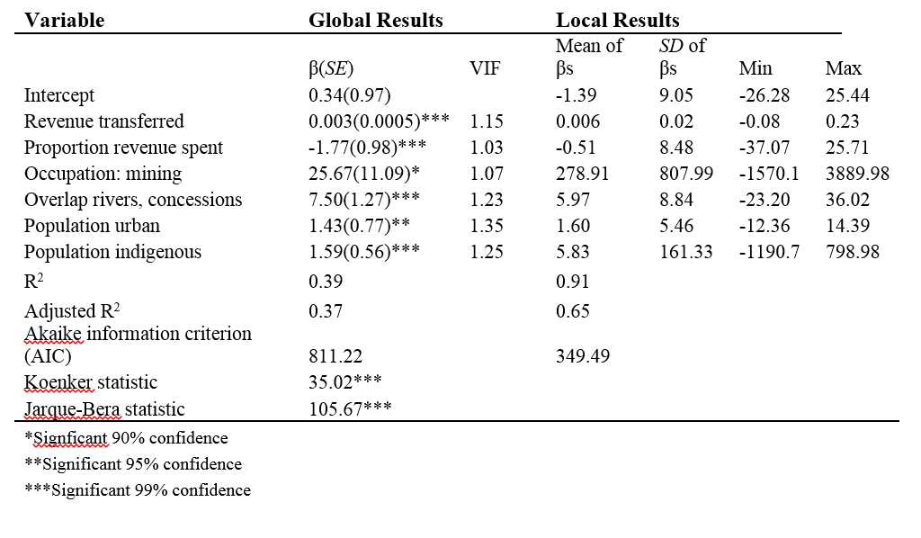
Results: model comparison
Moran’s I: 0.08 (p-value= 0.06)
  Social conflicts are significantly clustered → spatial dependence

Slide 13
Results: GWR model fit
Best model fit: central Andean highlands (3b)
Strong model fit: central Andean highland provinces bordering best model fit, southern Andean highlands, southern coast (3c)
Model fit declines: northern coast, southern Andean highlands, Amazonian lowlands
Figure 3: GWR local R²

Slide 14
Results: GWR condition number
Condition number: measure of local multicolinearity
Condition number <= 30 indicates reliable model predictions
Where model fit is strongest (central Andean highlands), condition numbers acceptable
> 30 in southern coast, Andean highlands, and Amazonian lowlands
Figure 4: GWR condition number

Slide 15
Results: spatial distribution of GWR coefficients
positively associated with social conflict throughout the study area
  Except provinces in southern Andean highlands
Consistent with previous literature on social conflicts
Revenue transfers are often “large and easily identifiable” (Bebbington et al., 2008b, p. 970)
Significant inequalities exist at the municipal level
Figure 5: Revenue transferred coefficient estimates

Slide 16
Results: spatial distribution of GWR coefficients
negatively associated with conflict throughout the eastern and southern Andean region, and Amazonian lowlands
many mining operations in southern Peru are currently in the exploration or expansion stage
exploration may be triggering conflict in the absence of revenue (projects at the exploratory stage are not yet generating taxes or royalties)
Amazon basin (except Madre de Dios) did not experience the rapid increase in mineral concessions that the Andean highlands did between 1992 and 2011
Figure 6: Proportion revenue spent coefficient estimates

Slide 17
Results: spatial distribution of GWR coefficients
positively associated with social conflict throughout most of the study area
negative relationship with social conflict is most consistent in provinces in the central northern Andean highlands
Many studies have documented how concerns about water quantity and quality trigger social conflict
  Mineral extraction and processing requires large amounts of water
  Acid mine drainage
  Environmental regulations are historically lax and incomplete
Figure 7: Overlap concessions, rivers coefficient estimates

Slide 18
Results: spatial distribution of GWR coefficients
positively associated with conflict throughout most of the study area
  mine workers’ exploitation by mining companies
  limited local employment opportunities by mining operations in the operation phase
  technological advances have replaced labor with capital and concentrated long-term employment opportunities on skilled workers
negative association with social conflict in northwest and southern Andean highlands
Figure 7: Employed by mining coefficient estimates

Slide 19
Results: spatial distribution of GWR coefficients
positive relationship between population indigenous and social conflict in the Andean highlands
Mining concessions are concentrated in the Andean highlands, where there are significant indigenous populations
  “free, prior and informed consent”
  national policies and regulations that favor business interests and seek to weaken rights of indigenous
positive relationship between population indigenous and social conflict is also present in provinces located in the Amazonian lowlands
  indigenous populations’ desires to reclaim territory and improve their autonomy
  May also capture conflicts within and near Madre de Dios: significant indigenous population and hotbed for ASM
Figure 8: Population indigenous coefficient estimates

Slide 20
Results: spatial distribution of GWR coefficients
negative relationship between population urban and social conflict is observed in some provinces in the northern, central, and southern Andes
  increases in rural Andean conflicts have been documented in the literature
  rural areas positive effects from mineral extraction on Peruvian livelihoods are especially lacking
positive relationship between population urban and social conflict in many provinces
  Possibly due to individual perception of “urban”
  May also indicate more urban concern about mining, more urban involvement in social conflicts
Figure 9: Population urban coefficient estimates

Slide 21
Limitations
GWR uses a local adaptation of linear regression, which is not ideal for dependent variable events which are relatively rare (i.e. the maximum of 16 social conflicts over an eight year period)
  a logistic spatial model, such as a geographically weighted logistic model, would be useful for comparison with global OLS and GWR models
Mapping provinces where explanatory variables were significant was not possible due to limitations of the software

Slide 22
Conclusions
Global OLS regression was required to evaluate which explanatory variables were most influential in predicting social conflict
once key variables were selected, GWR yielded a better model than the global OLS regression
  permitted mapping of model parameters
Results mostly consistent with previous literature on mining and conflict
  Provinces with lower model fit, and provinces where the observed relationships between social conflicts and explanatory variables are not consistent with current literature, indicate areas where further analysis of social conflict is needed

