Slide 1
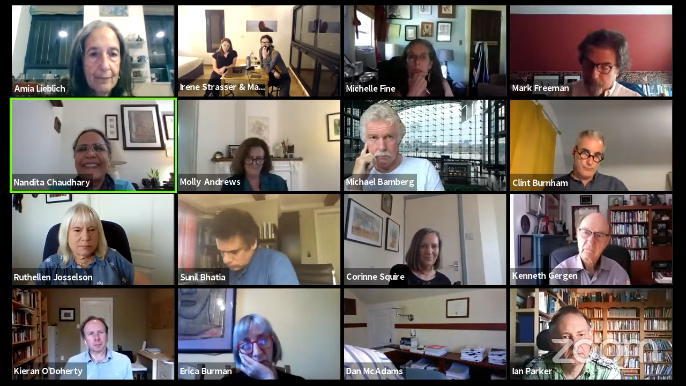
Out-take from Panel on
“Crisis, Psychology & Political Action”
THE PSYCHOLOGY OF
GLOBAL CRISES
May 20–30, 2020
#PGC2020 –
Virtual Conference

