Slide 1

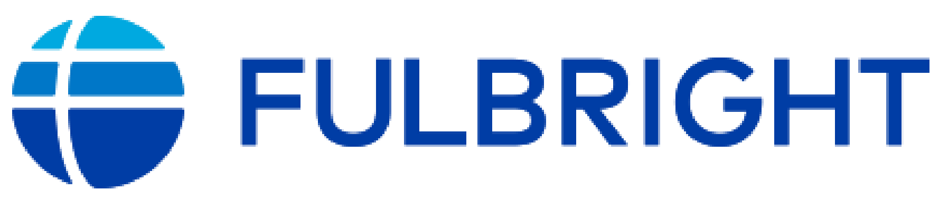





Evolution of methods and motivations in land change modeling
Robert Gilmore Pontius Jr
Dr. R Gil Pontius Jr is a Geography Professor at Clark University where he conducts research as an applied statistician and environmental scientist with expertise in GIS, modeling, and land change science.
https://wordpress.clarku.edu/rpontius/
rpontius@clarku.edu
22 September 2025

Slide 2

Main Points
After decades of predictive land change modeling, Pontius decided to develop better methods to compare maps and describe trajectories of land cover.
We have developed methods for you concerning:
  Trajectory Analysis to show temporal change
  Alternation for data quality assessment
  Total Operating Characteristic curves for model validation
  Flow Matrix as an alternative to the Markov matrix
  DynamicPATCH to describe change
Pontius invites you to contribute to a special issue of Land at https://www.mdpi.com/journal/land/special_issues/IND622A7L0
Get the Trajectory Analysis R package and documentation at this QR code

Slide 3
Authors submitted 13applications of land change models.
Haidian,China
Honduras
Cho Don, Vietnam
Perinet, Madagascar
Pontius Jr et al. 2018. Lessons and Challenges in Land Change Modeling Derived from Synthesis of Cross-Case Comparisons. Chapter 8 in Martin Behnisch and Gotthard Meine (eds.) Trends in Spatial Analysis and Modelling. Geotechnologies and the Environment 19: 143-164. Springer International Publishing: Cham, Germany.

Slide 4
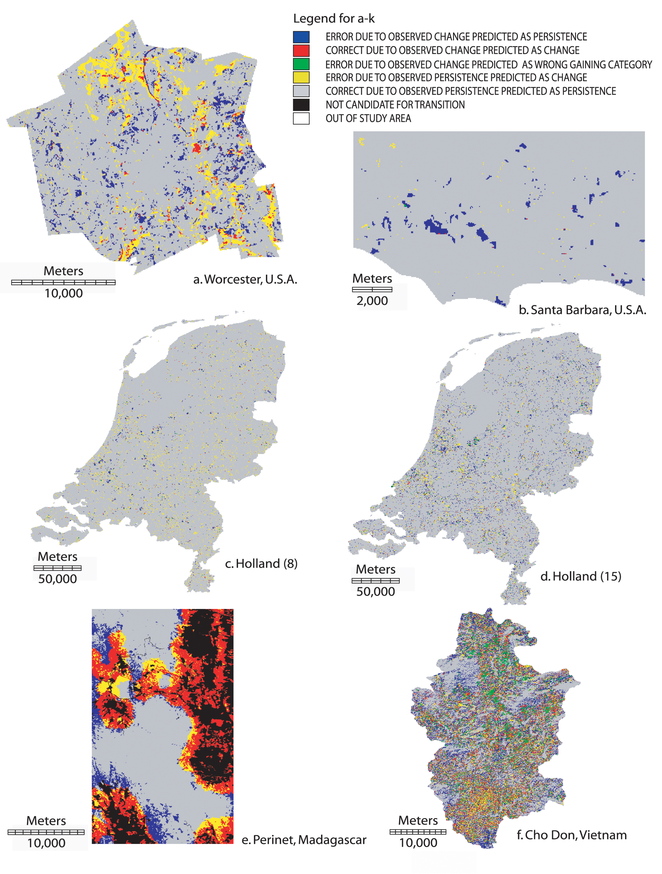

Geomod in Massachusetts, USA
Hits are less than error at the 30-meter resolution.
Misses
Hits
Wrong Hits
False Alarms
Correct Rejections

Slide 5
Geomod and Sleuth
Most of the error is due to predicting too little quantity of change.
Misses
Hits
Wrong Hits
False Alarms
Correct Rejections

Slide 6

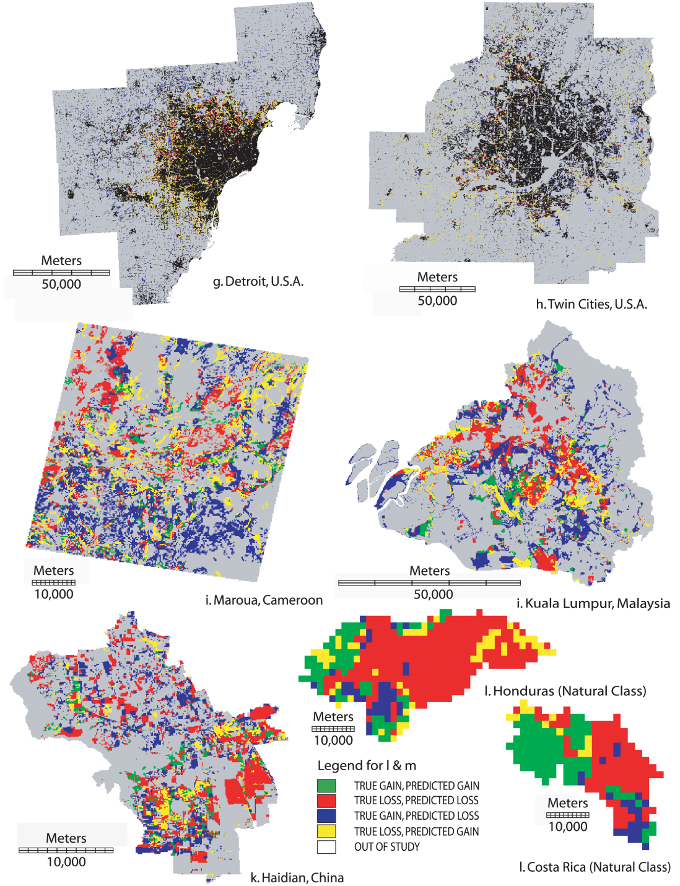
11 cases of pure pixels

Slide 7
Honduras and Costa Rica have mixed pixels

Slide 8
One application has more hits than error
Misses
Hits
Wrong Hits
False Alarms

Slide 9
Response from non-modelers
“Your colleagues must hate you!”

Slide 10
Response from modelers
“Thank you for exposing this,
because now I can publish any results!”

Slide 11
Flows of information in research
Landscape
Modeler
Mapping
Data Measurement
Data
Pontius Jr et al. 2018. Lessons and Challenges in Land Change Modeling Derived from Synthesis of Cross-Case Comparisons. Chapter 8 in Martin Behnisch and Gotthard Meine (eds.) Trends in Spatial Analysis and Modelling. Geotechnologies and the Environment 19: 143-164. Springer International Publishing: Cham, Germany.

Slide 12
We should revise how we map and measure land change.
Landscape
Modeler Learning
Mapping
Data Measurement
Data
Pontius Jr et al. 2018. Lessons and Challenges in Land Change Modeling Derived from Synthesis of Cross-Case Comparisons. Chapter 8 in Martin Behnisch and Gotthard Meine (eds.) Trends in Spatial Analysis and Modelling. Geotechnologies and the Environment 19: 143-164. Springer International Publishing: Cham, Germany.

Slide 13
We should revise how we model and measure models.
Landscape
Modeler Learning
Mapping
Data Measurement
Data
Modeling
Model Output Measurement
Model Output
Pontius Jr et al. 2018. Lessons and Challenges in Land Change Modeling Derived from Synthesis of Cross-Case Comparisons. Chapter 8 in Martin Behnisch and Gotthard Meine (eds.) Trends in Spatial Analysis and Modelling. Geotechnologies and the Environment 19: 143-164. Springer International Publishing: Cham, Germany.

Slide 14
Pontius learned that:
We should improve the metrics that we were using.

Slide 15
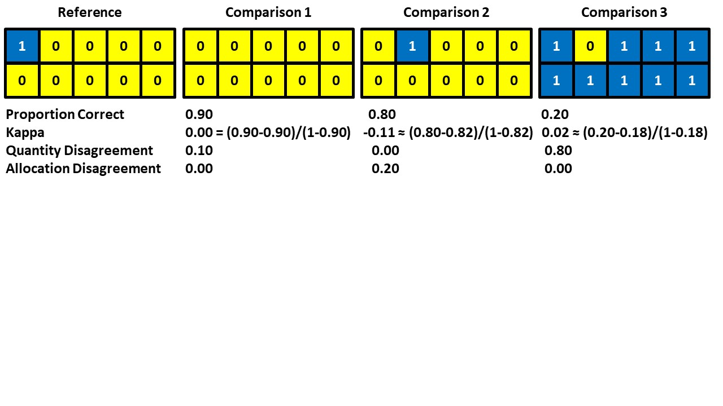
Which Comparison map is the best agreement with the Reference map?

Slide 16
Proportion Correct and Kappa are popular and misleading.
It is more helpful to compute quantity and allocation disagreement.
R G Pontius Jr, T Francis, M Millones. 2025. A call to interpret disagreement components during classification assessment. International Journal of Geographical Information Science

Slide 17
Pontius and Millones (2011) published the Death To Kappa paper, which had two messages:
Don’t use Kappa.
Use quantity and allocation disagreement.
The Death to Kappa paper has more than 2200 citations.
The first sentence of the Abstract says:
This article concludes that these Kappa indices are useless, misleading and/or flawed … .
Pontius and Millones (2011) Death to Kappa. International Journal of Remote Sensing.
https://www.tandfonline.com/doi/abs/10.1080/01431161.2011.552923

Slide 18
Here is an example of how some authors cited the Death To Kappa paper
“kappa coefficient … has proved to be an excellent statistical parameter for measuring consistency (Pontius and Millones 2011).”
cited in Gao et al. (2021) https://doi.org/10.1016/j.ijdrr.2020.101928

Slide 19
Pontius learned that:
If the temporal patterns are non-stationary, then any model that extrapolates historic patterns will not have predictive power.
Therefore, Pontius developed methods to examine the time series data for non-stationarity.

Slide 20
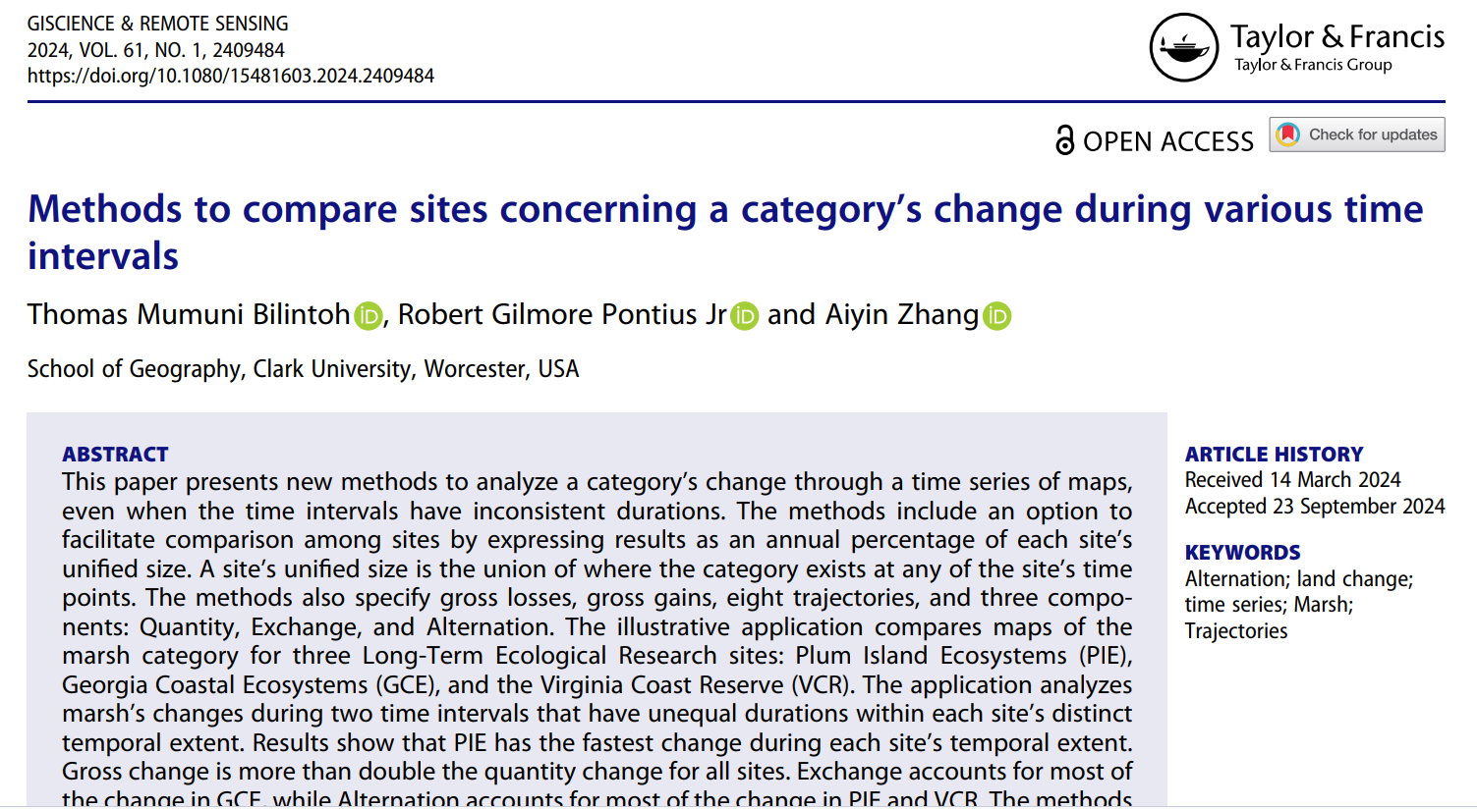
https://doi.org/10.1080/15481603.2024.2409484

Slide 21
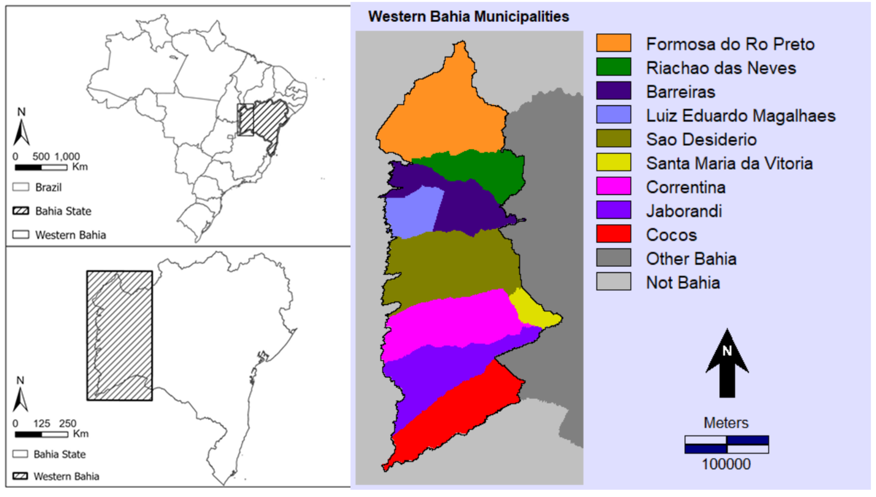

Western Bahia Brazil is a hotspot for soybean cultivation.
What patterns are in the MapBiomas time series?
Pontius Jr, Robert Gilmore, Thomas Bilintoh, Gustavo de L. T. Oliveira, Julia Z. Shimbo. 2023. Trajectories of losses and gains of soybean cultivation during multiple time intervals in western bahia, BRAZIL. Space Week Nordeste. Fortaleza, Brazil.

Slide 22
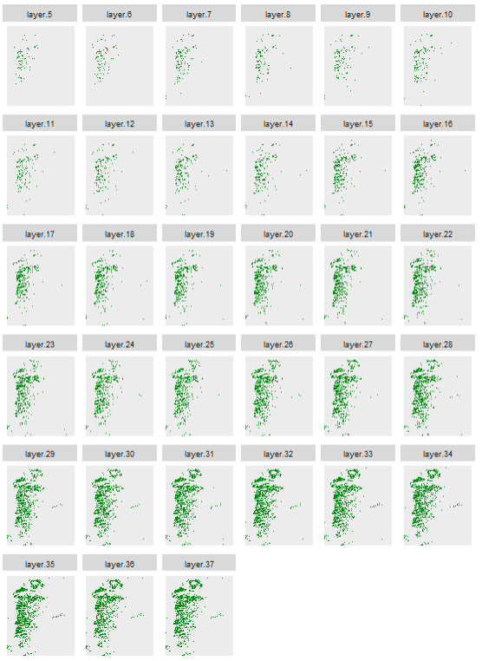
Maps show soybean at 33 years.
The extent has more than 200 million pixels.
Each pixel has more than 8 billion possible combinations of presence or absence of soybean.
We must have a method that focuses on the few broad patterns while directing attention to the places and times that have more interesting patterns.
1989
1990
1991
1992
1993
1994
1995
1996
1997
1998
1999
2000
2001
2002
2003
2004
2005
2006
2007
2008
2009
2010
2011
2012
2013
2014
2015
2016
2017
2018
Presence of soybean
Absence of soybean
2019
2020
2021

Slide 23

One map shows eight trajectories during 32 time intervals.
Get the code and documentation at the GitHub site of Thomas Bilintoh.

Slide 24
Gain is above and Loss below the time axis.

Slide 25
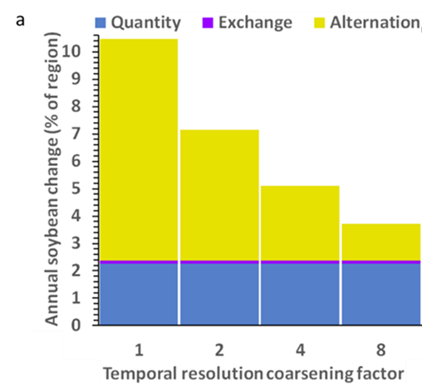
Half of change is alternation within 4 years.
Pontius does not know of models that simulate alternation.
Bars show soybean change during time intervals of one year, two years, four years, and eight years.

Slide 26
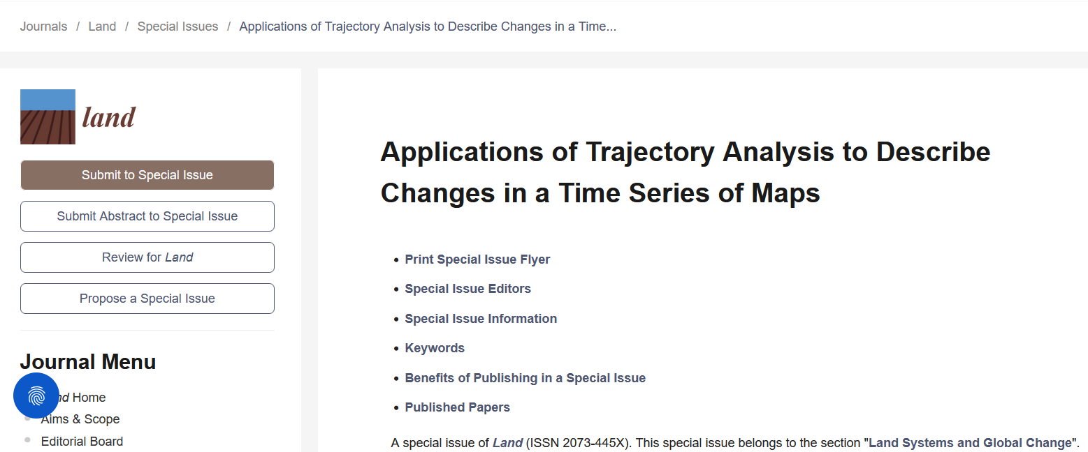
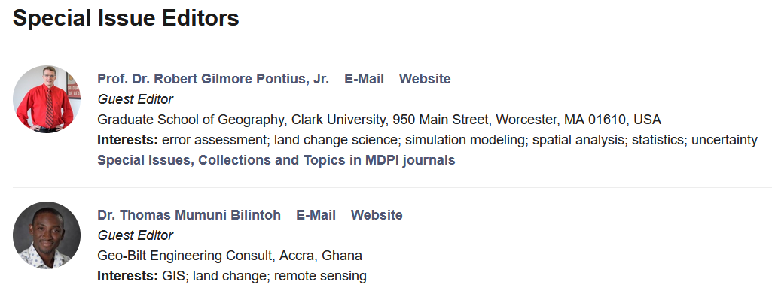
https://www.mdpi.com/journal/land/special_issues/IND622A7L0

Slide 27
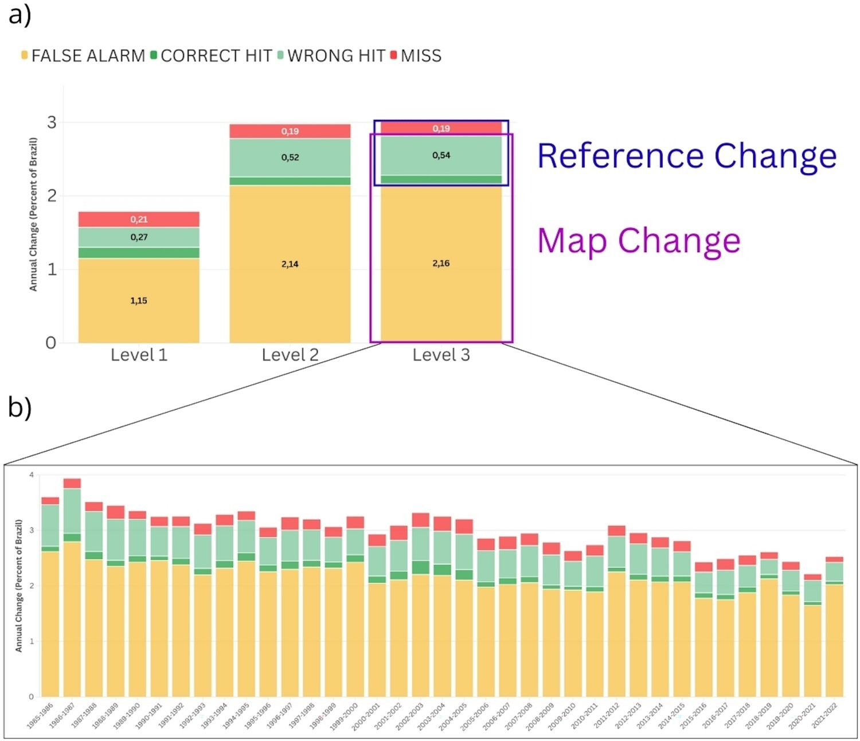
The MapBiomas data show more alternation than the ground reference data concerning change during time intervals
A P Matos, M Hunter, Robert G Pontius Jr, L R Baumann, L L Parente, L G Ferreira. 2025. Accounting for alternation in temporal quality analysis in MapBiomas Brazil. International Journal of Digital Earth 18(1).

Slide 28
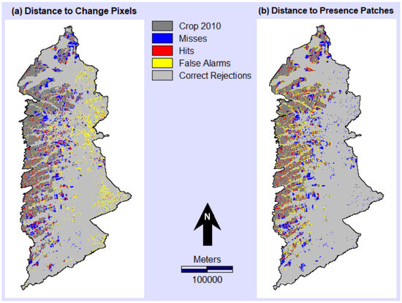
Distance to Change Pixels causes more predictive allocation error than distance to presence patches
T Honnef, R G Pontius Jr. 2025. Best practices for applying and interpreting the Total Operating Characteristic. International Journal of Geo-Information 14(4), 134.

Slide 29
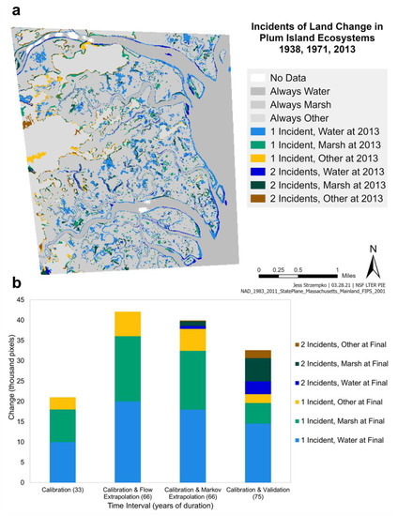
Why do so many models use the problematic Markov matrix to extrapolate the change among categories?
The Flow matrix uses linear extrapolation.
Validation shows that this wetland region follows neither Markov nor Flow matrix.
J Strzempko, R G Pontius Jr. 2023. The Flow matrix offers a straightforward alternative to the problematic Markov matrix. Land 12(7), 1471.

Slide 30
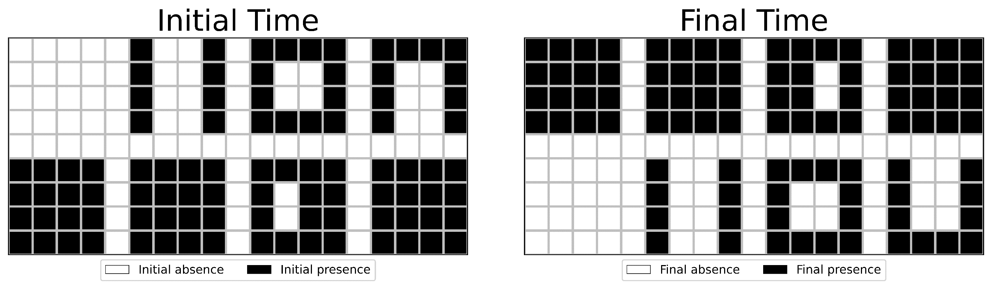
What are the changes in patches?
How many patches exist at the initial time?
How many patches exist at the initial time?
A Zhang, R G Pontius Jr, T M Bilintoh, F Sangermano, J Rogan. 2025. DynamicPATCH: Method and Software for Spatially Explicit Dynamic Patch Transition Characterization. Landscape Ecology 40(132)

Slide 31
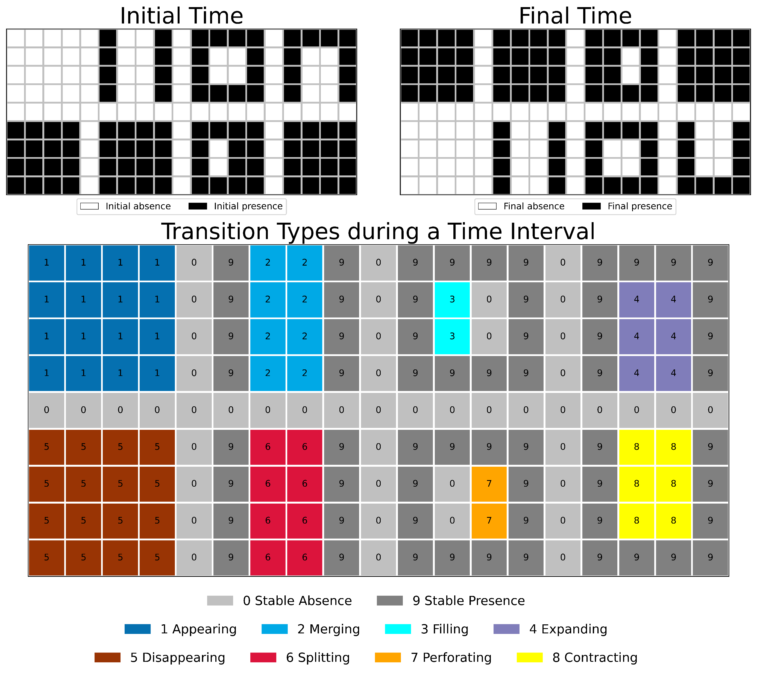
DynamicPATCH is new software for
Spatially Explicit Dynamic PAtch Transition Characterization.

Slide 32
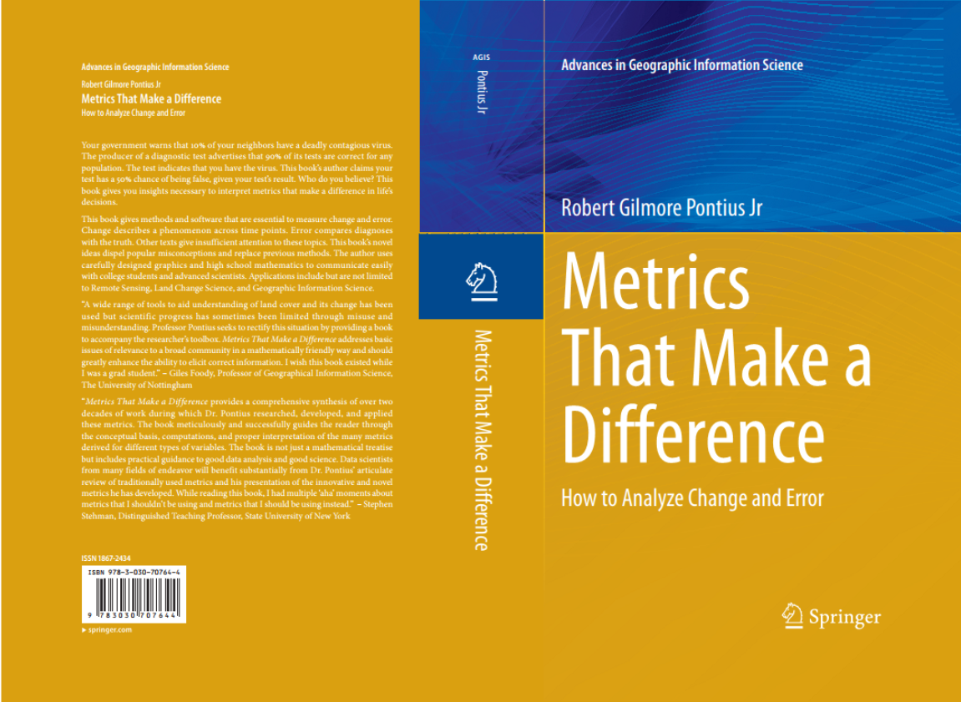
Get Pontius’ book and other literature at https://wordpress.clarku.edu/rpontius/

Slide 33
This presentation has presented this literature
T M Bilintoh, R G Pontius Jr, A Zhang. 2024. Methods to compare sites concerning a category’s change during various time intervals. GIScience and Remote Sensing 61(1), 2409484
T Honnef, R G Pontius Jr. 2025. Best practices for applying and interpreting the Total Operating Characteristic. ISPRS International Journal of Geo-Information 14(4), 134
R G Pontius Jr, T Francis, M Millones. 2025. A call to interpret disagreement components during classification assessment. International Journal of Geographical Information Science
T M Bilintoh, R G Pontius Jr, Z Liu. 2024. Analyzing the Losses and Gains of a Land Category: Insights from the Total Operating Characteristic. Land 13(8), 1177
C M Viana, R G Pontius Jr, J Rocha 2023. Four Fundamental Questions to Evaluate Land Change Models with an Illustration of a Cellular Automata–Markov Model. American Association of Geographers
J Strzempko, R G Pontius Jr. 2023. The Flow matrix offers a straightforward alternative to the problematic Markov matrix. Land 12(7), 1471
Matos, Ana Paula, Maria Hunter, Robert Gilmore Pontius Jr, Luis Rodrigo Baumann, Leandro Leal Parente, Laerte Guimarães Ferreira. 2025. Accounting for alternation in temporal quality analysis in MapBiomas Brazil. International Journal of Digital Earth 18(1). https://doi.org/10.1080/17538947.2025.2528604
Zhang, Aiyin, Robert Gilmore Pontius Jr, Thomas Mumuni Bilintoh, Florencia Sangermano, John Rogan. 2025. DynamicPATCH: Method and Software for Spatially Explicit Dynamic Patch Transition Characterization. Landscape Ecology 40(132). https://doi.org/10.1007/s10980-025-02120-1
Pontius Jr, Robert Gilmore, Jean-Christophe Castella, Ton de Nijs, Zengqiang Duan, Eric Fotsing, Noah Goldstein, Kasper Kok, Eric Koomen, Christopher D. Lippitt, William McConnell, Alias Mohd Sood, Bryan Pijanowski, Peter Verburg and A. Tom Veldkamp. 2018. Lessons and Challenges in Land Change Modeling Derived from Synthesis of Cross-Case Comparisons. Chapter 8 in Martin Behnisch and Gotthard Meine (eds.) Trends in Spatial Analysis and Modelling. Geotechnologies and the Environment 19: 143-164. Springer International Publishing: Cham. https://doi.org/10.1007/978-3-319-52522-8_8

Slide 34
Main Points
After decades of predictive land change modeling, Pontius decided to develop better methods to compare maps and describe trajectories of land cover.
We have developed methods for you concerning:
  Trajectory Analysis to show temporal change
  Alternation for data quality assessment
  Total Operating Characteristic curves for model validation
  Flow Matrix as an alternative to the Markov matrix
  DynamicPATCH to describe change
Pontius invites you to contribute to a special issue of Land at https://www.mdpi.com/journal/land/special_issues/IND622A7L0
Get the Trajectory Analysis R package and documentation at this QR code

Slide 35
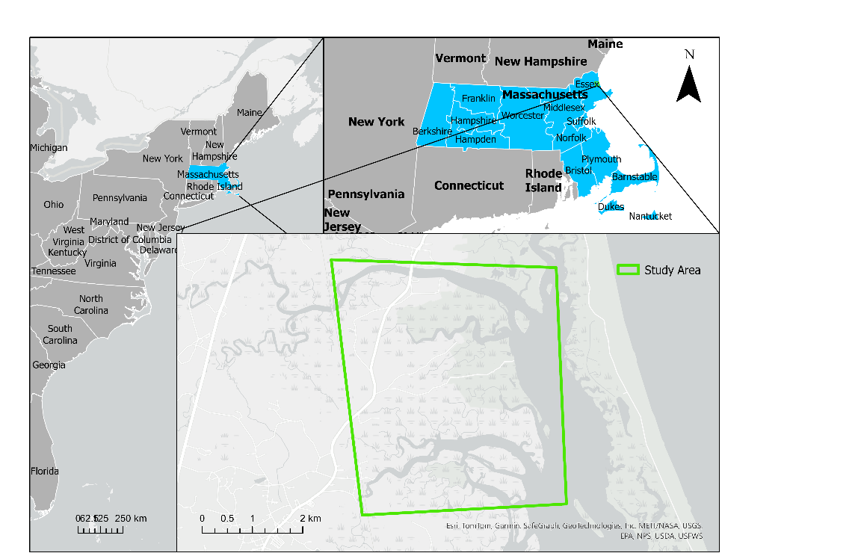
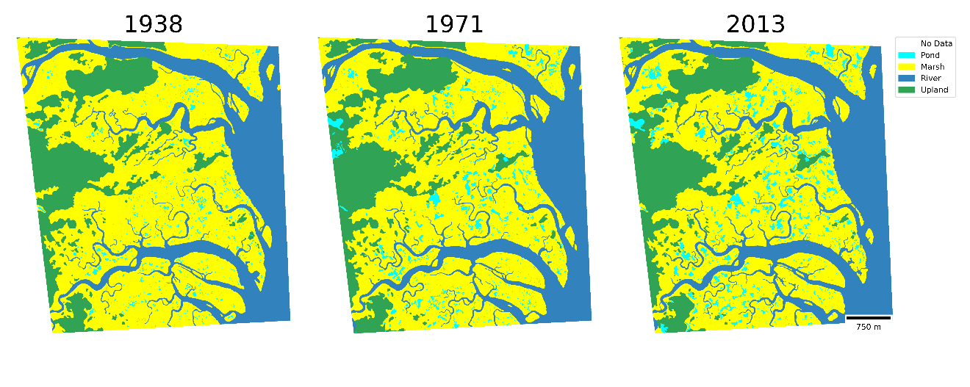
Case study at PIE-LTER
Study Area
Study area: Long Term Ecological Research Network’s Plum Island Ecosystems (PIE-LTER)

Slide 36
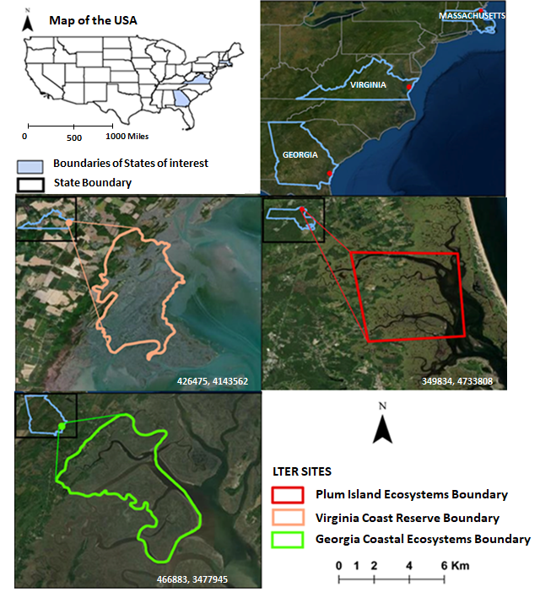
Bilintoh et al. (2024)

Slide 37
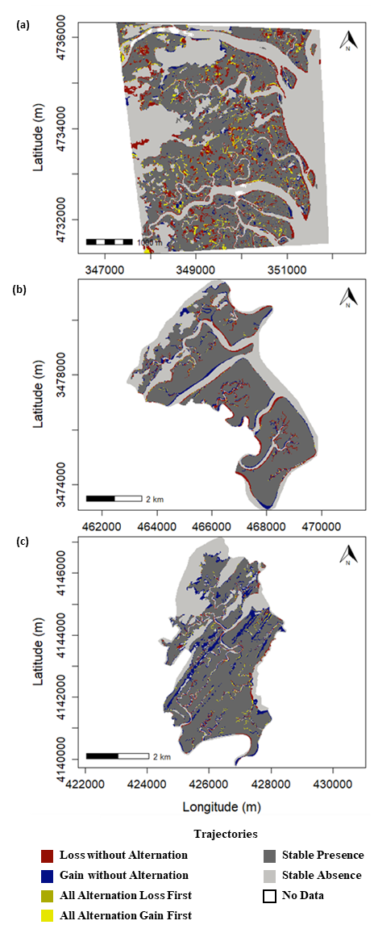
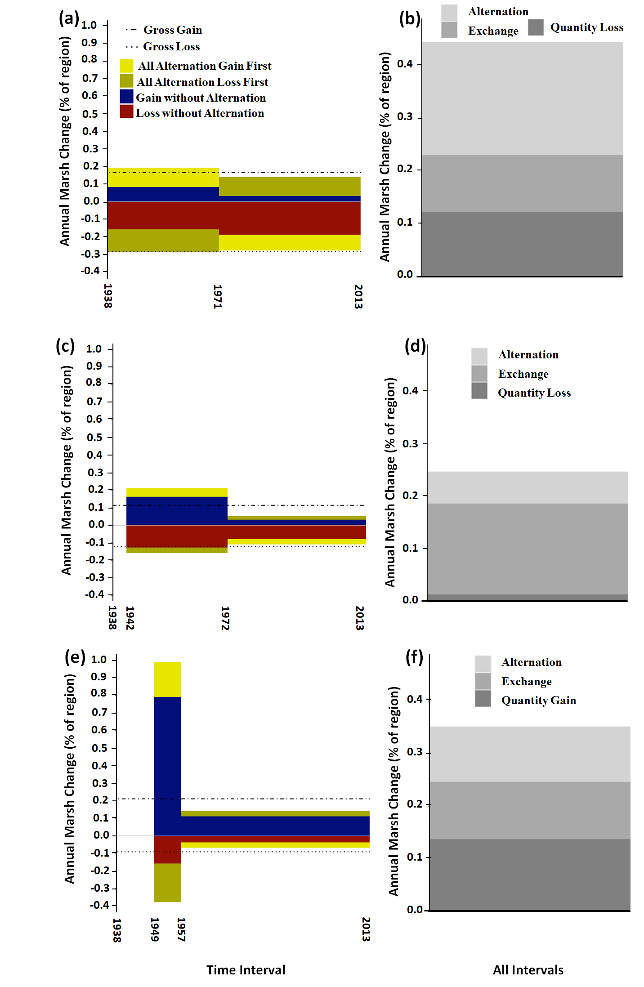
Bilintoh et al. (2024)
Plum Island Ecosystems
Georgia Coastal Ecosystems
Virginia Coast Reserve

Slide 38
Vertical axis is annual % of unified region to facilitate comparison.
Plum Island Ecosystems (PIE) Georgia Coastal Ecosystems (GCE) Virginia Coast Reserve (VCR)

Slide 39
Change is fastest in PIE where most change is alternation.
Change slowest in GCE where most change is exchange.
Plum Island Ecosystems (PIE) Georgia Coastal Ecosystems (GCE) Virginia Coast Reserve (VCR)

Slide 40
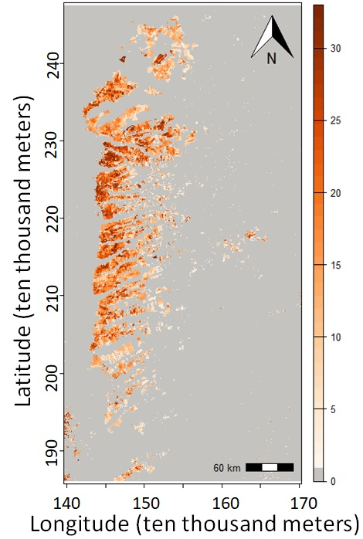
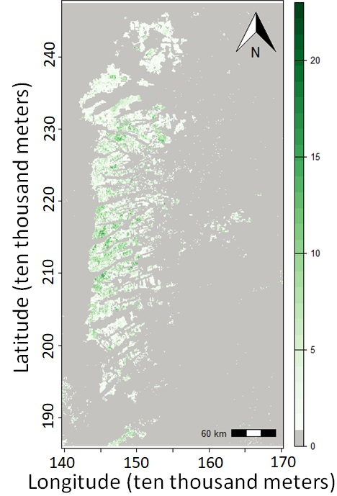
Number of years of presence is on the left and number of changes is on the right.
The unified region is the union of pixels that have at least one year of presence.

Slide 41
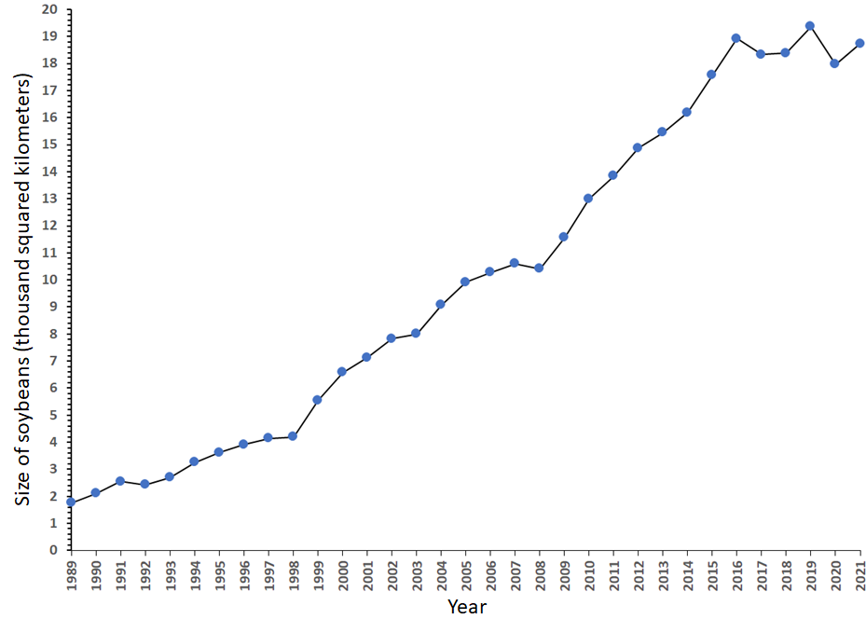
Gross Gain and Gross Loss explain the line graph.
Net change is steep during 1998-1999 because gross gain spikes.
Net change is steep during 1999-2000 because gross loss shrinks.
Area of soybeans versus time

Slide 42
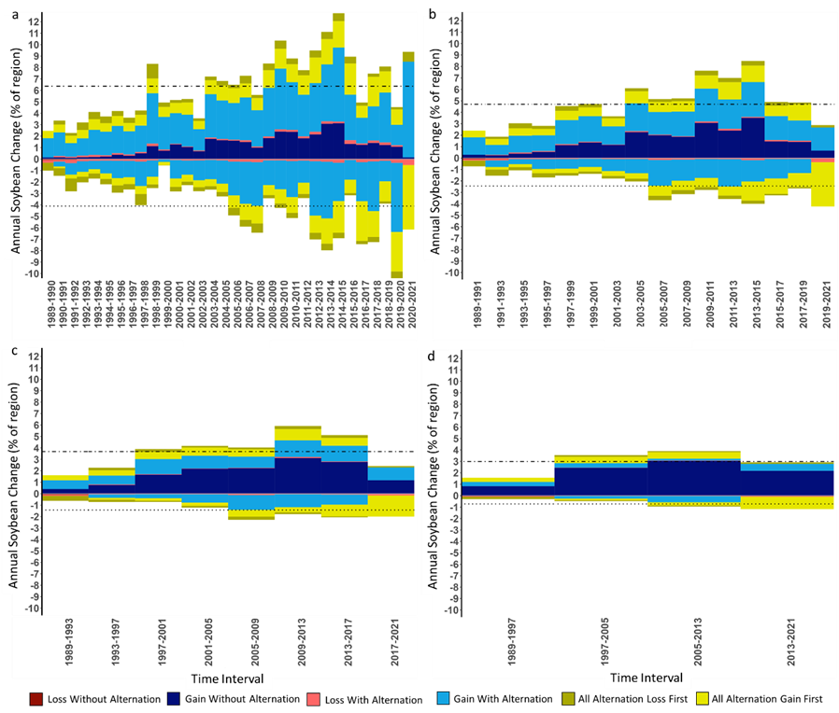
Alternation shrinks as temporal resolution coarsens.
Loss and Gain of soybean cultivation during time intervals of a) one year and b) two years, c) four years, and d) eight years.

Slide 43
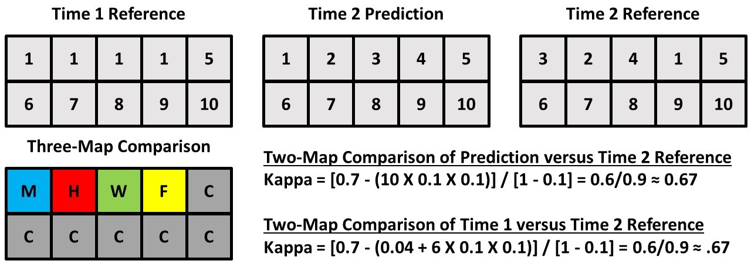
Two-map validation of a land change prediction shows proportion correct is 0.70 but this fails to show temporal change.
Each number 1 through 10 indicates a category.
X
X
X

Slide 44
Change occurs on three pixels.
Three-map validation of a prediction of change shows more error than hits.
Figure of Merit = Jaccard = IoU = 1 / 4
The three-map comparison shows helpful assessment in terms of Misses (M), Hits (H), Wrong Hits (W), False Alarms (F), and Correct Rejections (C).

Slide 45
Nine Challenges
Mapping
  To select relevant resolutions
  To prepare data appropriately
  To differentiate types of land change
Modeling
  To separate calibration from validation
  To predict small amounts of change
  To interpret the influence of quantity error
Learning
  To use appropriate map comparison measurements
  To learn about land change processes
  To collaborate openly
Pontius Jr et al. 2018. Lessons and Challenges in Land Change Modeling Derived from Synthesis of Cross-Case Comparisons. Chapter 8 in Martin Behnisch and Gotthard Meine (eds.) Trends in Spatial Analysis and Modelling. Geotechnologies and the Environment 19: 143-164. Springer International Publishing: Cham, Germany.

Slide 46
The MapBiomas data show more alternation than the ground reference data concerning change during time intervals
A P Matos, M Hunter, Robert G Pontius Jr, L R Baumann, L L Parente, L G Ferreira. 2025. Accounting for alternation in temporal quality analysis in MapBiomas Brazil. International Journal of Digital Earth 18(1).

Slide 47
Rare events are difficult to predict accurately at a fine resolution.
This graphic was the basis to use Figure of Merit for REDD projects.
Cases with less than 15% figure of merit have less than 10% observed net change.

Slide 48
Literature Review
We sampled 200 articles that cited the Death to Kappa paper.
We tagged each article concerning whether it adopted the first recommendation to abandon kappa and whether it adopted the second recommendation to use difference components.

Slide 49
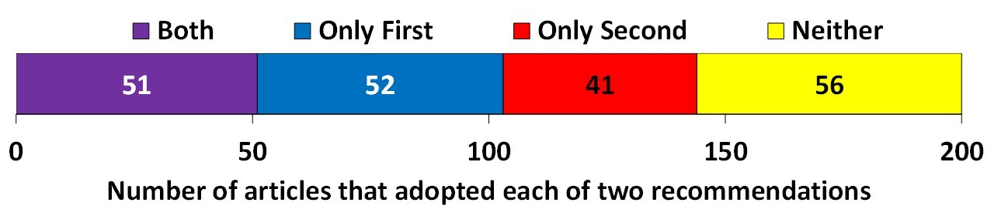
A quarter of the citations fall into each of the four combinations of whether the authors followed each of the two recommendations of Death to Kappa.
Both indicates the authors abandoned Kappa and adopted disagreement components.
Only First means authors abandoned Kappa but did not adopt disagreement components.
Only Second means authors used Kappa and adopted disagreement components.
Neither means authors used Kappa and did not adopt disagreement components.

