Slide 1

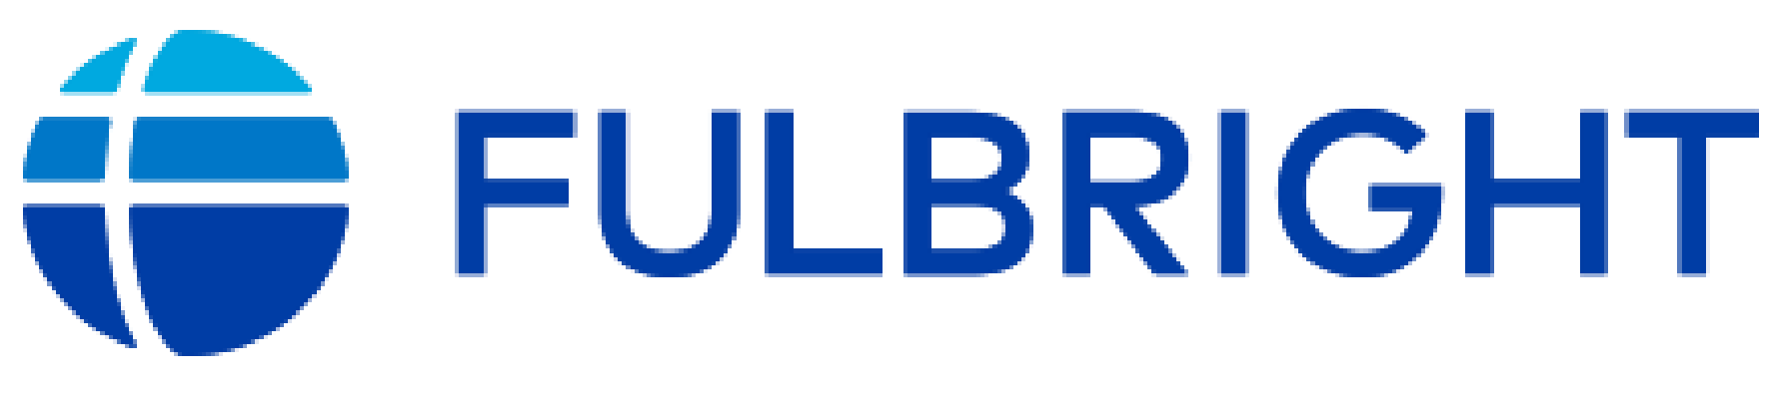




Strategies for Evaluating the Spatial and Temporal Distribution of Land Characteristics
Robert Gilmore Pontius Jr
Dr. R Gil Pontius Jr is a Geography Professor at Clark University where he conducts research as an applied statistician and environmental scientist with expertise in GIS, ecological modeling, and land change science.
https://wordpress.clarku.edu/rpontius/
rpontius@clarku.edu
24 September 2025

Slide 2

Main Points
You must align your evaluation metric with your particular research question, which is obvious but challenging.
Take Pontius’ workshop Thursday 25 September 17:00-19:00.
Use new methods of land change and contribute to a special issue of the journal Land using Trajectory Analysis at https://www.mdpi.com/journal/land/special_issues/IND622A7L0
Get the R package and documentation at this QR code

Slide 3
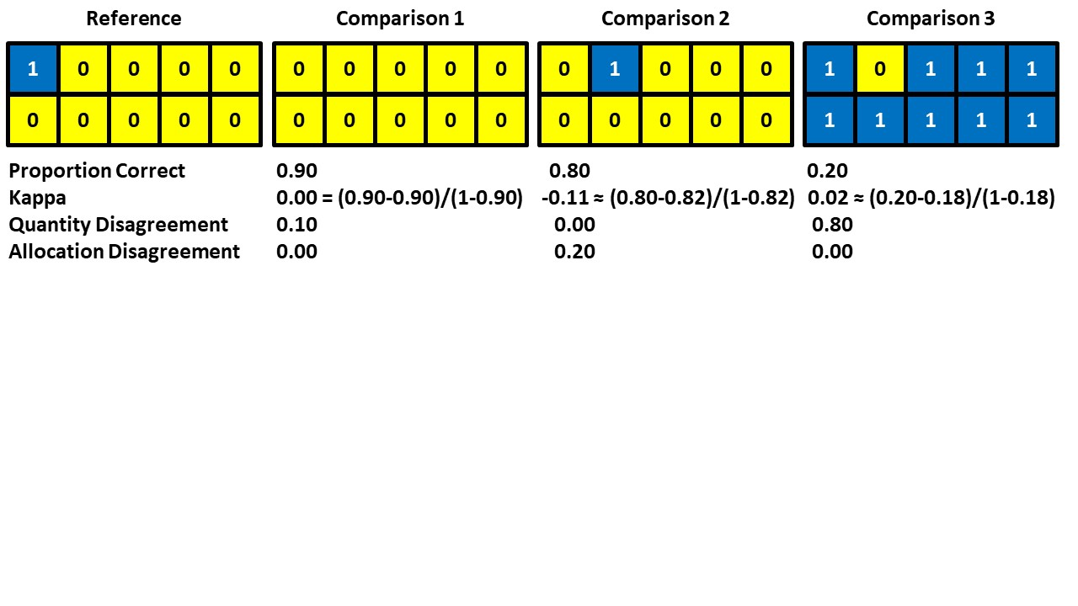
Which Comparison map is the best agreement with the Reference map?

Slide 4
Proportion Correct and Kappa are popular and problematic.
Proportion Correct can be maximized by underestimating the size of the smaller classes.
Kappa is an index that uses a convoluted and irrelevant baseline concerning random allocation.
R G Pontius Jr, T Francis, M Millones. 2025. A call to interpret disagreement components during classification assessment. International Journal of Geographical Information Science

Slide 5
It is more helpful to compute quantity and allocation disagreement.
R G Pontius Jr, T Francis, M Millones. 2025. A call to interpret disagreement components during classification assessment. International Journal of Geographical Information Science

Slide 6
Pontius and Millones (2011) published the Death To Kappa paper, which had two messages:
Don’t use Kappa.
Use quantity and allocation disagreement.
The Death to Kappa paper has more than 2200 citations.
The first sentence of the Abstract says:
This article concludes that these Kappa indices are useless, misleading and/or flawed … .
Pontius and Millones (2011) Death to Kappa. International Journal of Remote Sensing.
https://www.tandfonline.com/doi/abs/10.1080/01431161.2011.552923

Slide 7
Here is an example of how some authors cited the Death To Kappa paper
“kappa coefficient … has proved to be an excellent statistical parameter for measuring consistency (Pontius and Millones 2011).”
cited in Gao et al. (2021) https://doi.org/10.1016/j.ijdrr.2020.101928

Slide 8
Literature Review
We sampled 200 articles that cited the Death to Kappa paper.
We tagged each article concerning whether it adopted the first recommendation to abandon kappa and whether it adopted the second recommendation to use difference components.

Slide 9
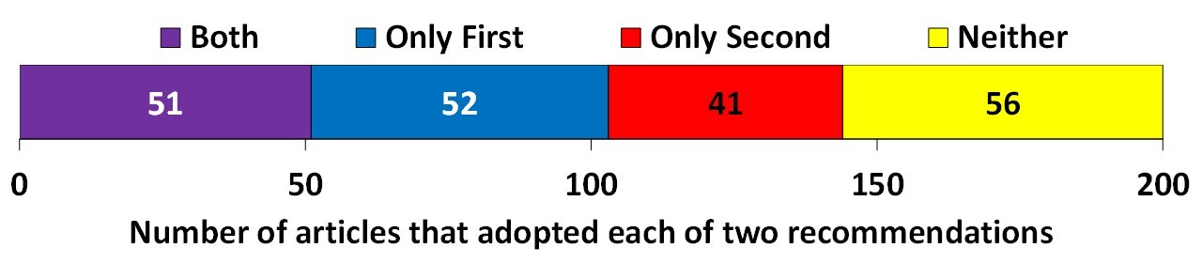
A quarter of the citations fall into each of the four combinations of whether the authors followed each of the two recommendations of Death to Kappa.
Both indicates the authors abandoned Kappa and adopted disagreement components.
Only First means authors abandoned Kappa but did not adopt disagreement components.
Only Second means authors used Kappa and adopted disagreement components.
Neither means authors used Kappa and did not adopt disagreement components.

Slide 10
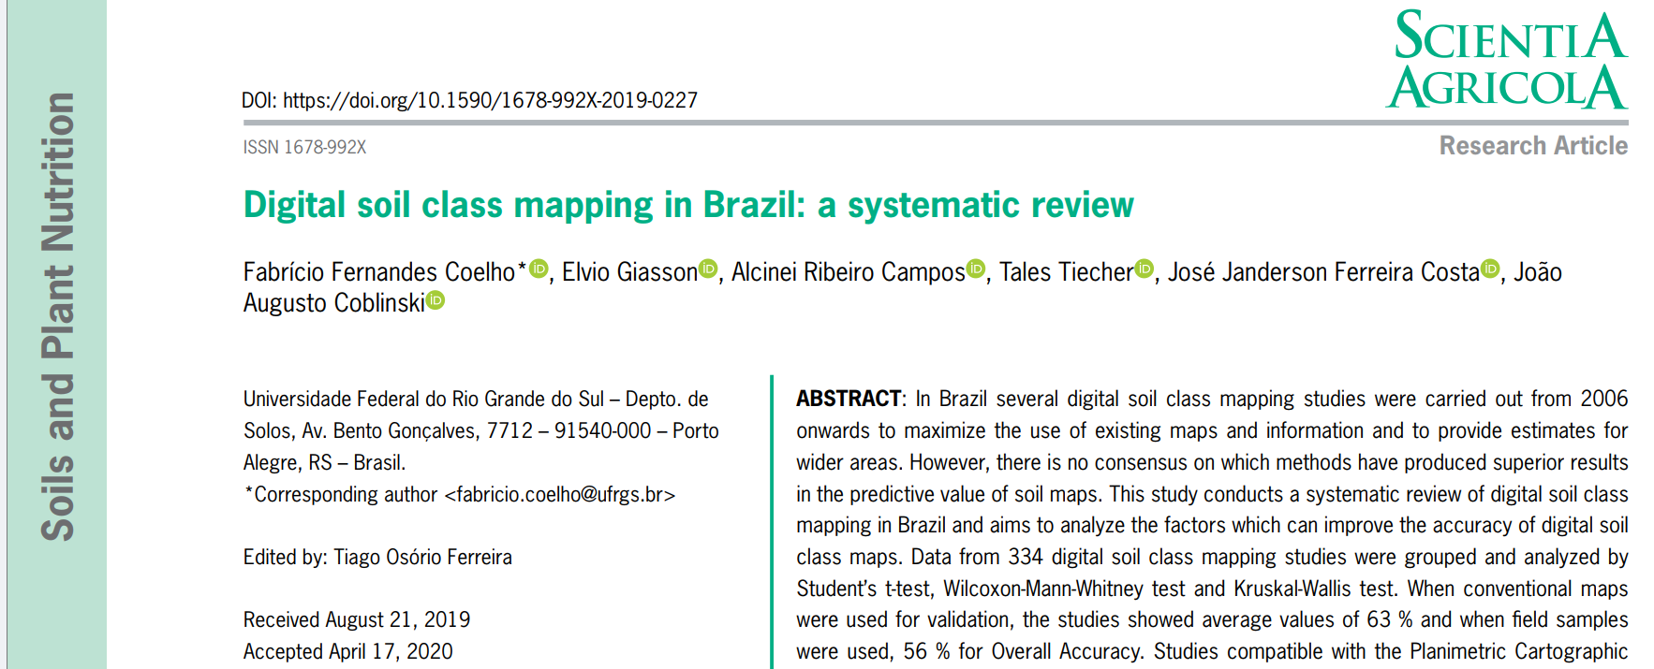
This review reported on Overall Accuracy and Kappa because those are the two most common metrics

Slide 11
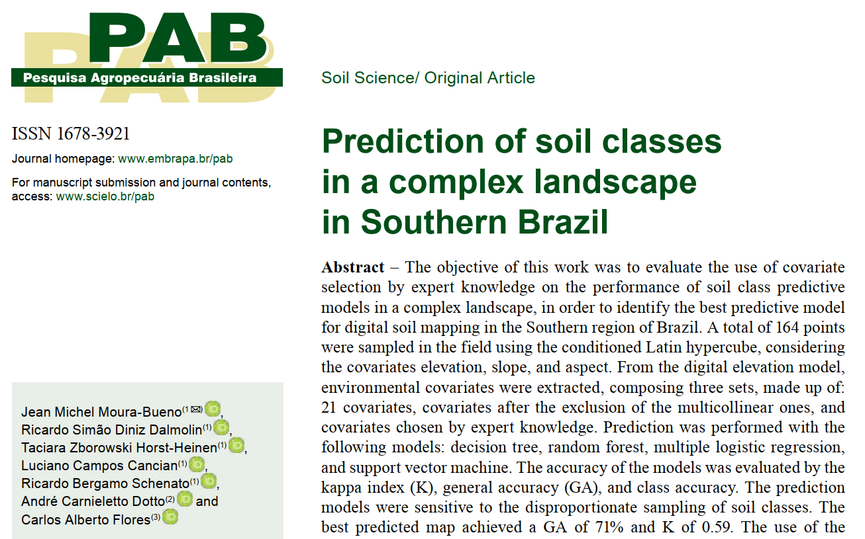
Moura-Bueno et al. (2019) used General Accuracy, class accuracy, and Kappa

Slide 12
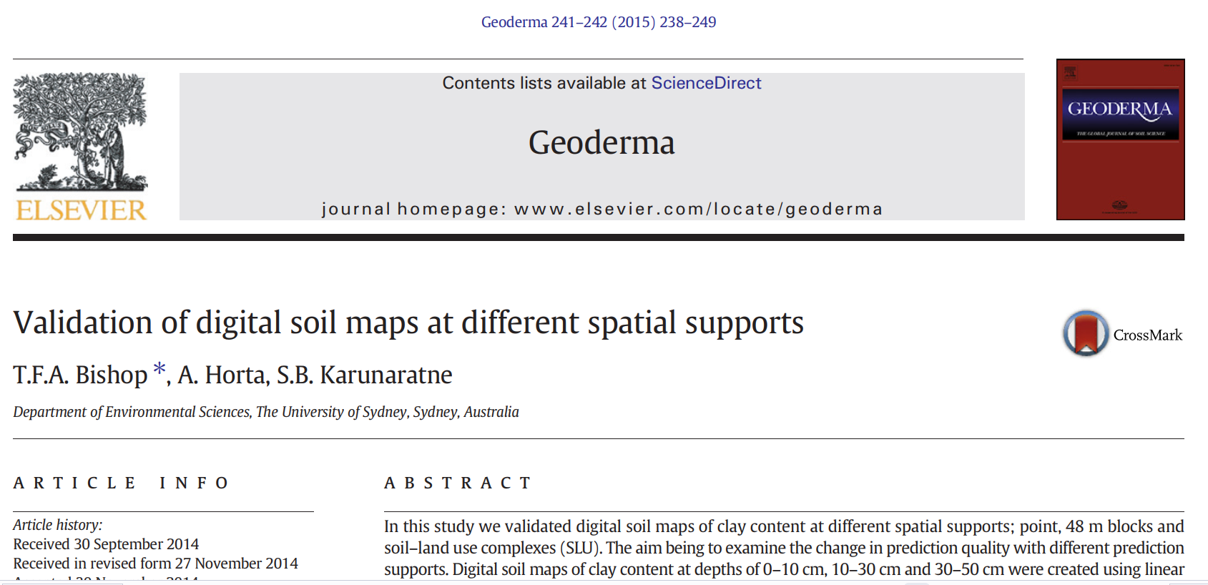
Bishop et al. (2015) assess a continuous variable

Slide 13
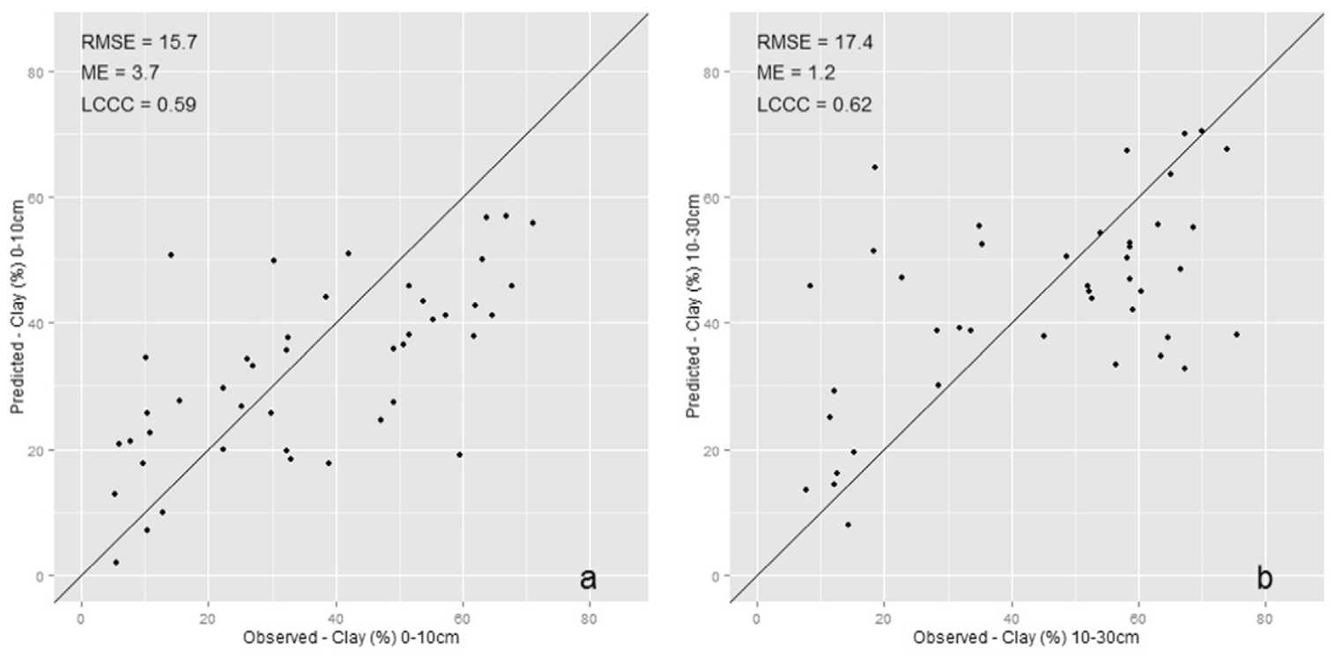
Figure 4 from Bishop et al. (2015)
This excellent figure is square and shows the Y=X line.
RMSE = Root Mean Squared Error, which is more difficult to interpret than Mean Absolute Error
ME = Mean Error, which is mean predicted minus mean observed
LCCC = Lin’s Concordance Correlation Coefficient, which combines correlation with Mean Error

Slide 14
Figure 4 from Bishop et al. (2015)
Pontius prefers four summary metrics:
Mean Error, Mean Absolute Error, Pearson’s Correlation, Slope of the least squares line

Slide 15
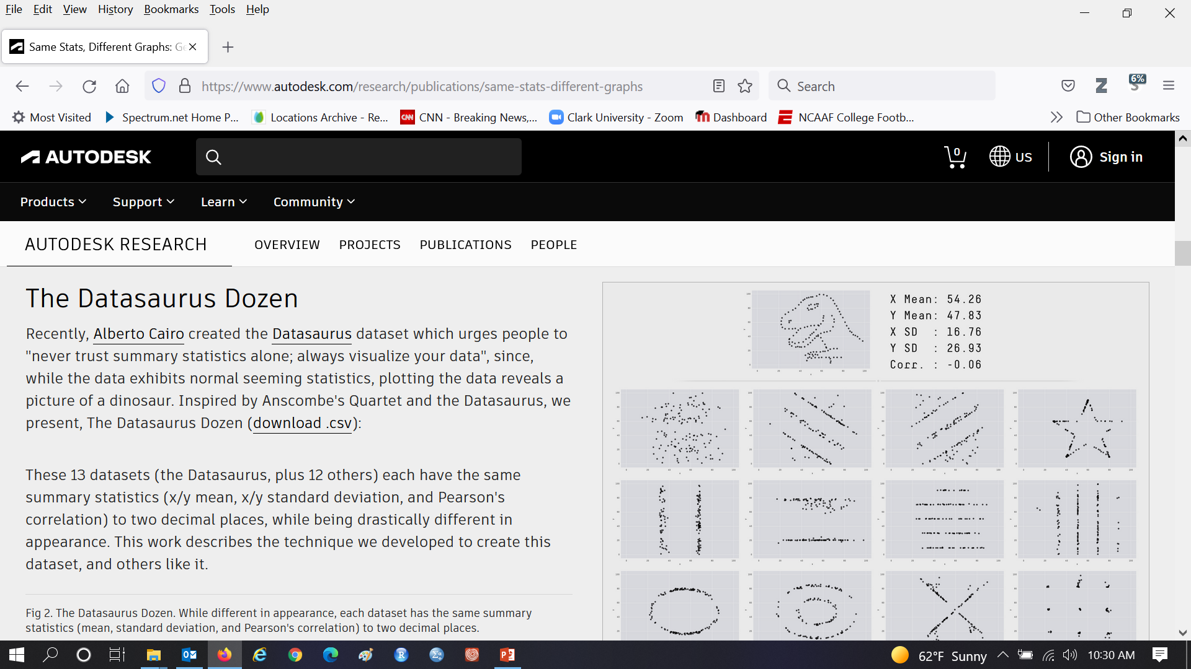
To compare an interval versus interval Variable
The first step is to make at plot with identical axes and the Y=X diagonal line, then look at the plot!

Slide 16
The plots have identical values for popular metrics such as R-squared.

Slide 17
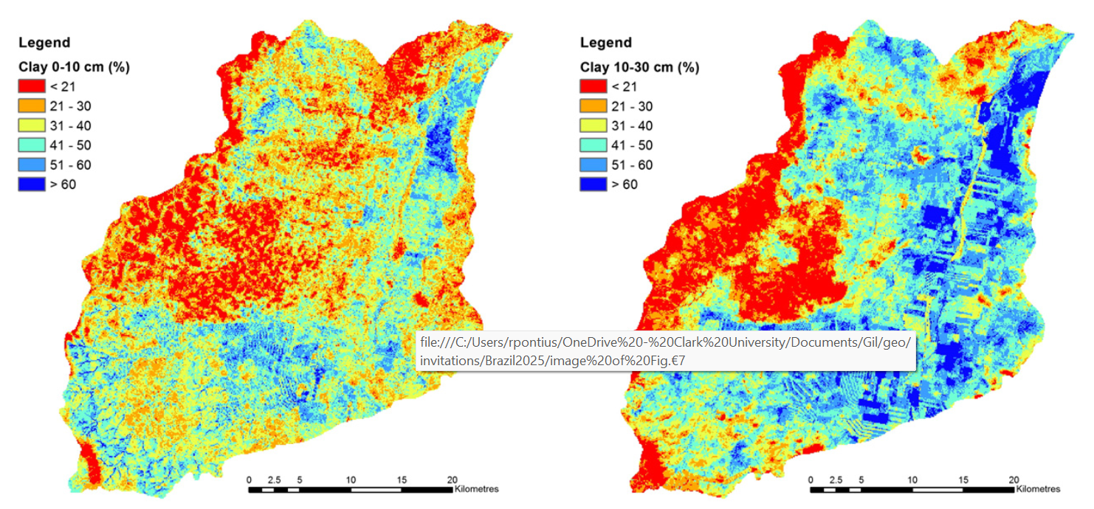
Figure 7 from Bishop et al. (2015)
Bishop et al. shows these excellent maps that have the same legend with colors showing has equal intervals of clay %.

Slide 18
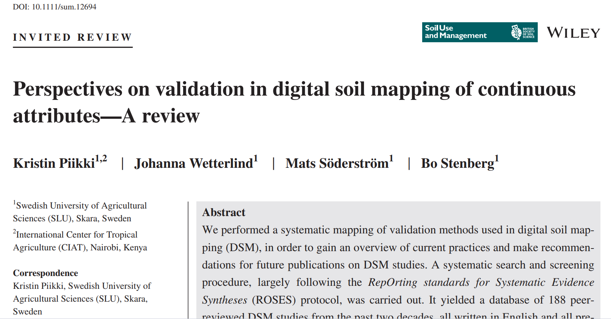
Pikki et al. (2021) recommend choosing a faceted set of validation metrics to characterize multiple aspects of the validation performance, rather than using several metrics that show similar information.

Slide 19
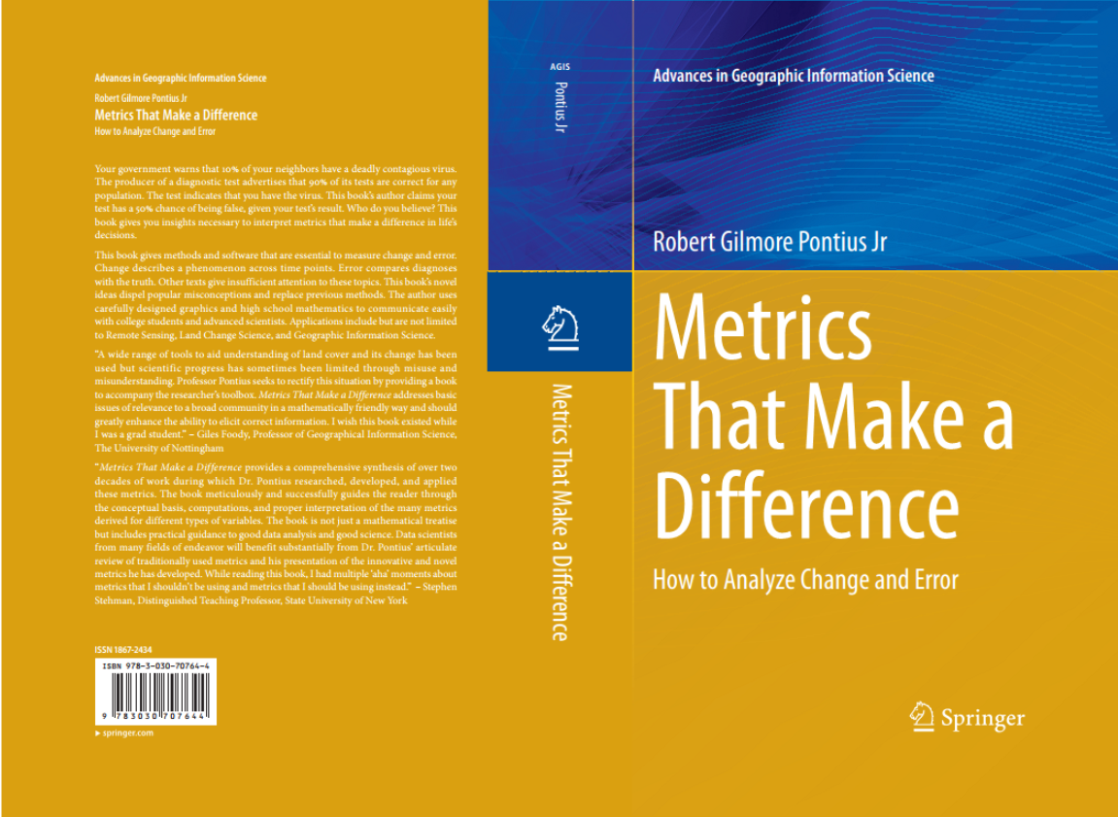
Come to tomorrow’s workshop with your questions concerning these metrics.
The foundational concepts are in Pontius’ book which you can get at https://wordpress.clarku.edu/rpontius/

Slide 20
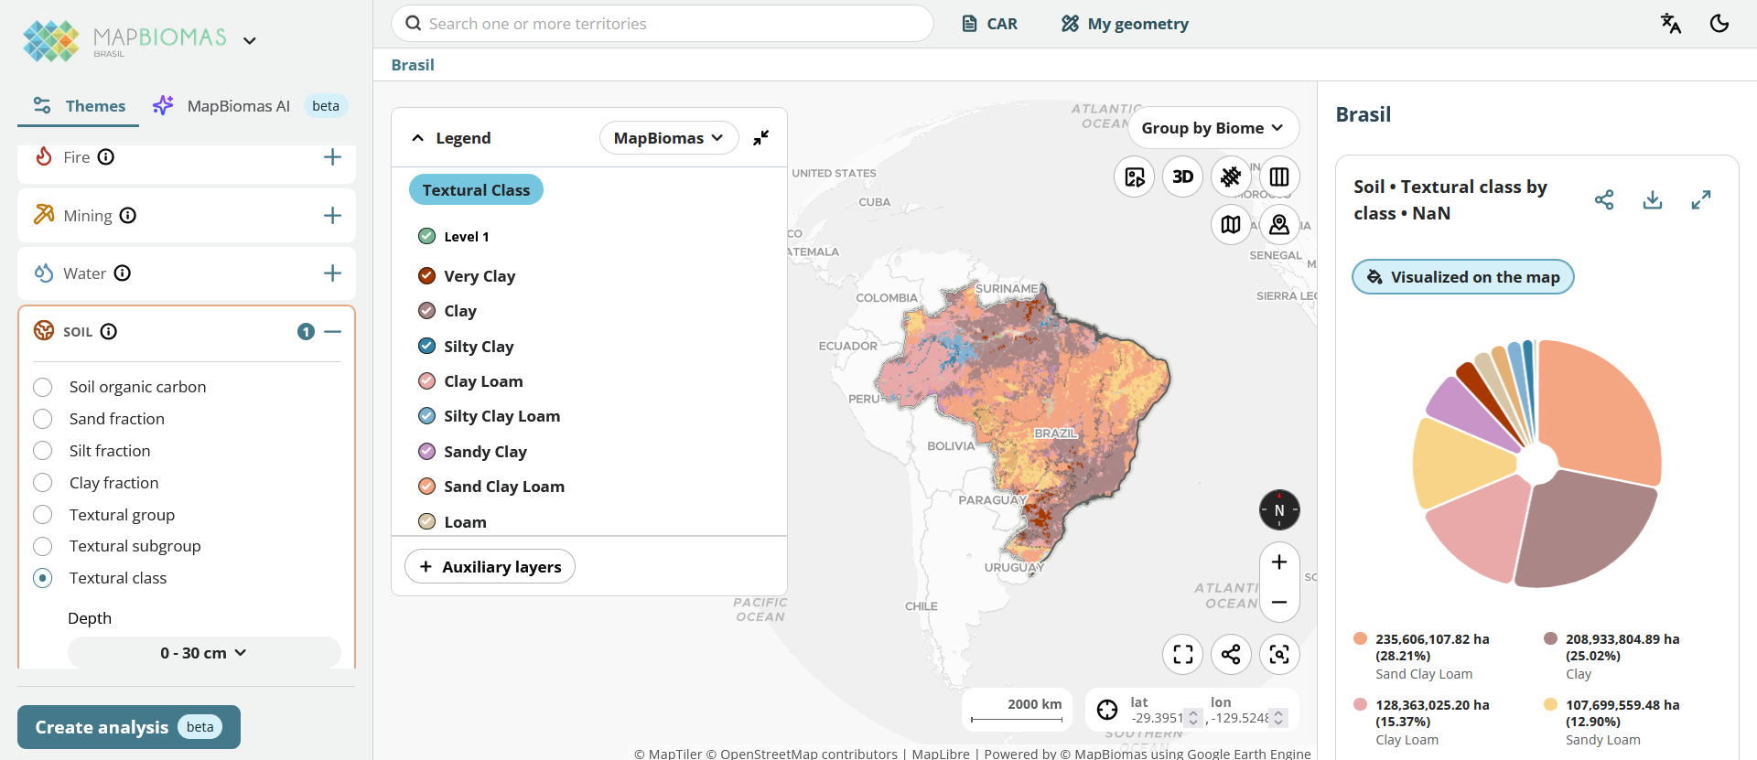
How many of you have used the MapBiomas soil data?

Slide 21
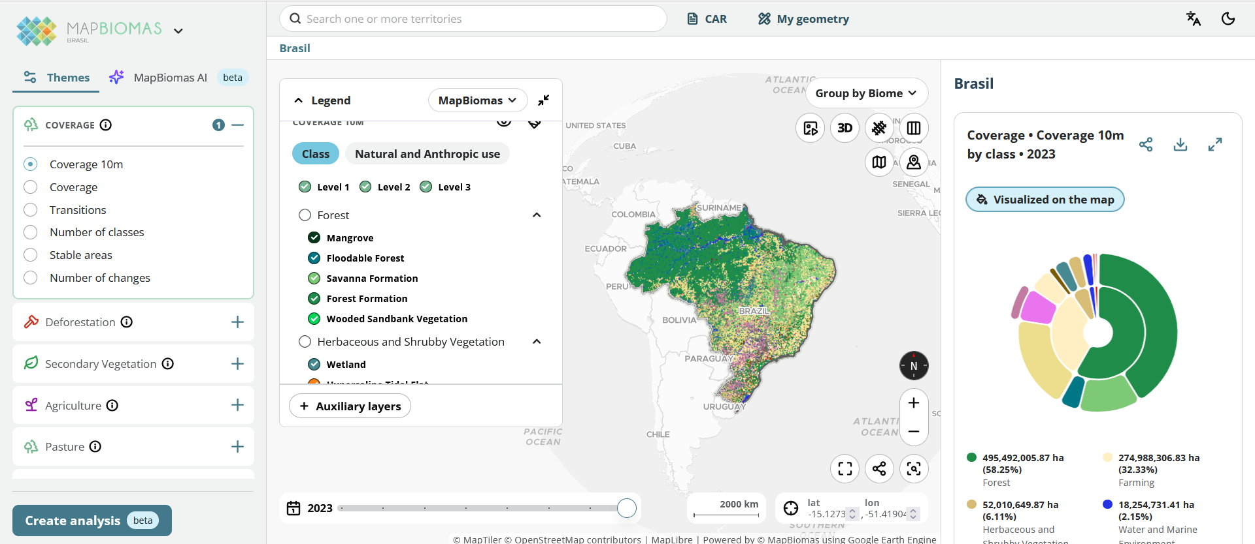
MapBiomas has data concerning land cover

Slide 22
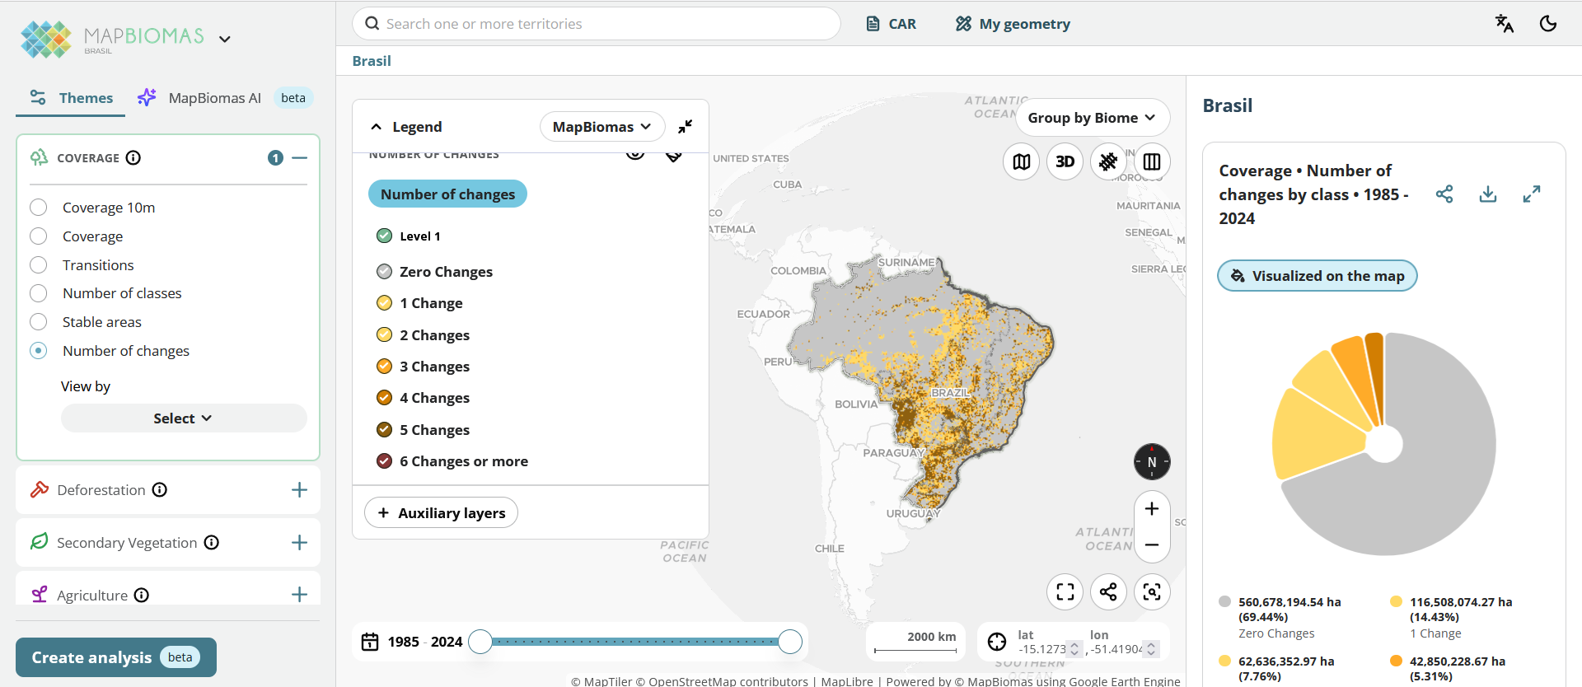
MapBiomas has data concerning land change

Slide 23
There are too many maps, so Pontius and his students have developed summary methods to identify the active places, times and classes for your particular application
Bilintoh, Pontius, Zhang. 2024. Methods to compare sites concerning a category’s change during various time intervals. GIScience and Remote Sensing 61(1), 2409484
Pontius and Fonseca. in press. A GIS method to summarize changes among classes during a time series with an application to land cover in western Bahia, Brazil. Transactions in GIS.
Zhang, Pontius, Bilintoh, Sangermano, Rogan. 2025. DynamicPATCH: Method and Software for Spatially Explicit Dynamic Patch Transition Characterization. Landscape Ecology 40(132). https://doi.org/10.1007/s10980-025-02120-1
Honnef, Pontius. 2025. Best practices for applying and interpreting the Total Operating Characteristic. ISPRS International Journal of Geo-Information 14(4), 134

Slide 24
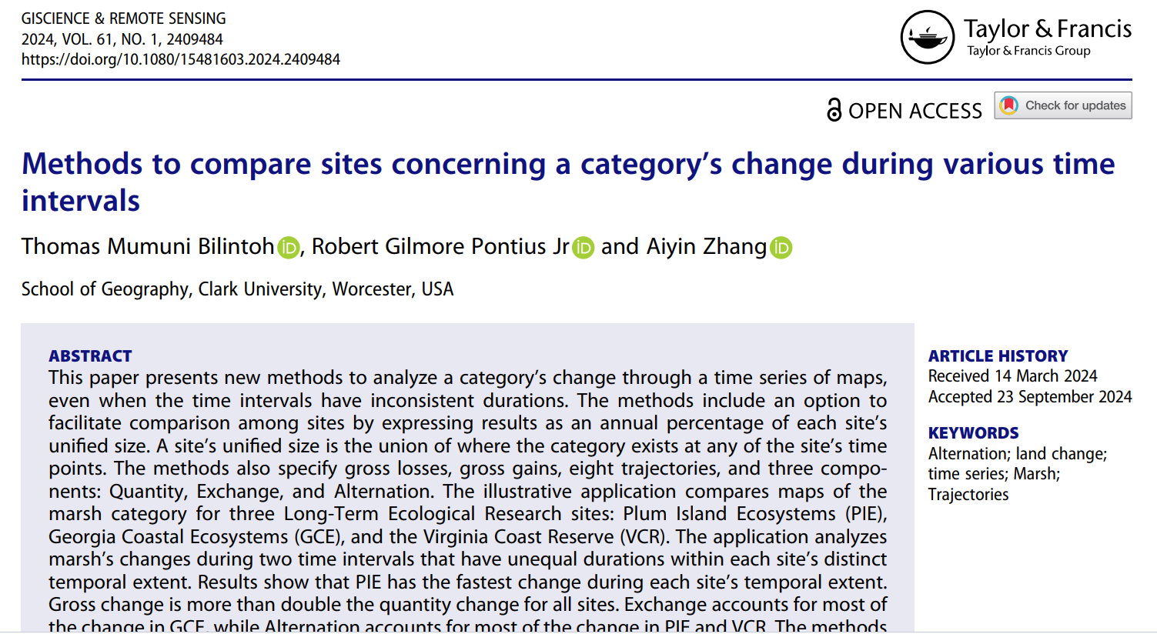
Bilintoh, Pontius, Zhang. 2024. Methods to compare sites concerning a category’s change during various time intervals. GIScience and Remote Sensing 61(1), 2409484

Slide 25
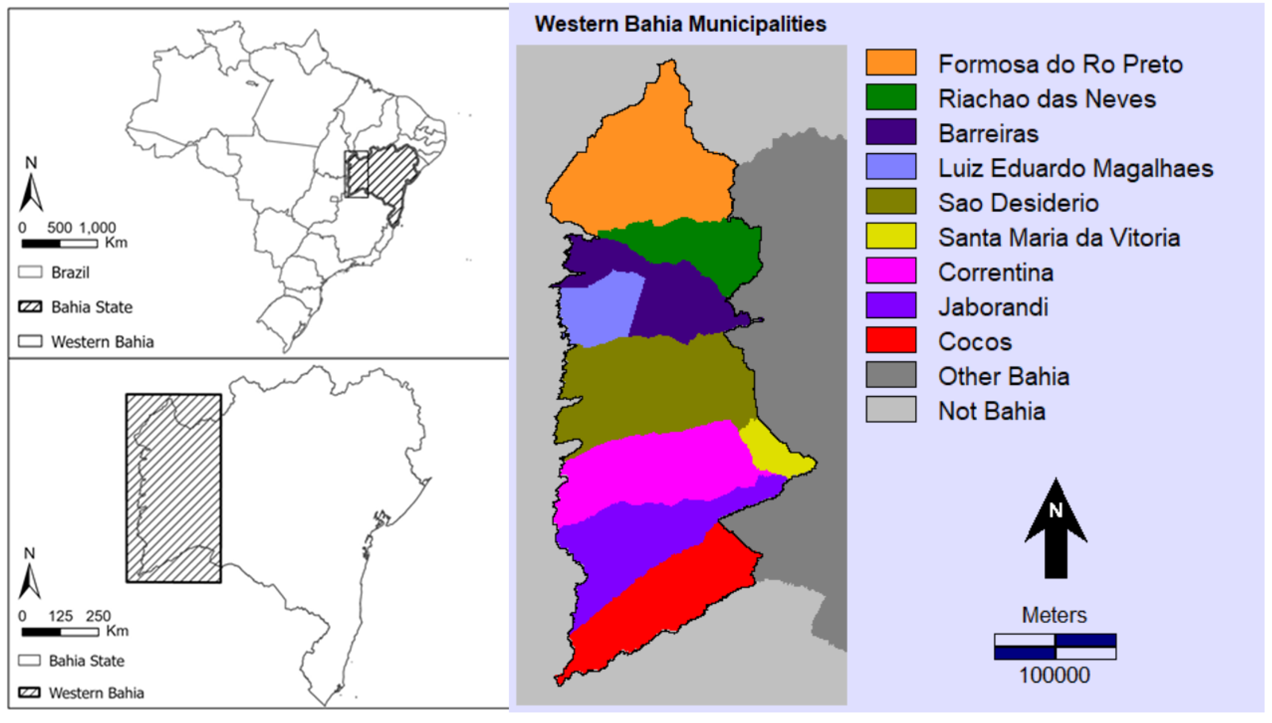

Western Bahia Brazil is a hotspot for soybean cultivation.
What patterns are in the MapBiomas time series?
Pontius Jr, Robert Gilmore, Thomas Bilintoh, Gustavo de L. T. Oliveira, Julia Z. Shimbo. 2023. Trajectories of losses and gains of soybean cultivation during multiple time intervals in western bahia, BRAZIL. Space Week Nordeste. Fortaleza, Brazil.

Slide 26
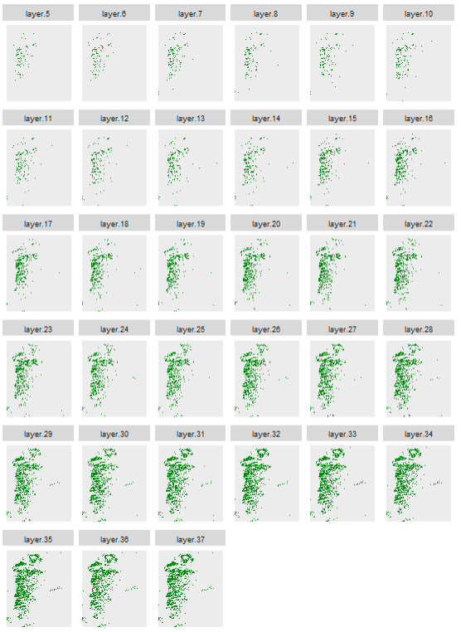
Maps show soybean at 33 years.
The extent has more than 200 million pixels.
Each pixel has more than 8 billion possible combinations of presence or absence of soybean.
We must have a method that focuses on the few broad patterns while directing attention to the places and times that have more interesting patterns.
We must design a method to see whether the data make intuitive sense.
Reference data are costly to collect.
If the data make sense, then what patterns have practical importance?
1989
1990
1991
1992
1993
1994
1995
1996
1997
1998
1999
2000
2001
2002
2003
2004
2005
2006
2007
2008
2009
2010
2011
2012
2013
2014
2015
2016
2017
2018
Presence of soybean
Absence of soybean
2019
2020
2021

Slide 27
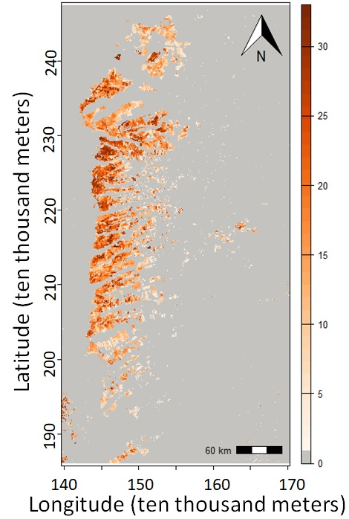
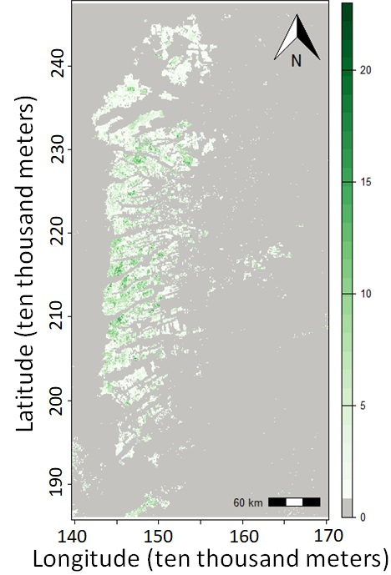
Number of years of presence is on the left and number of changes is on the right.
The unified region is the union of pixels that have at least one year of presence.

Slide 28

One map shows eight trajectories during 32 time intervals.
Get the code and documentation at the GitHub site of Thomas Bilintoh.

Slide 29
Gain is above and Loss below the time axis.

Slide 30
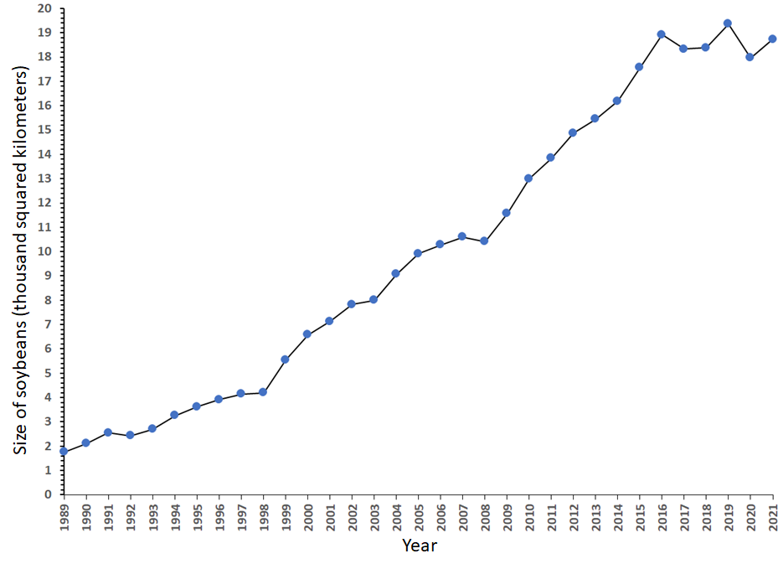
Gross Gain and Gross Loss explain the line graph.
Net change is steep during 1998-1999 because gross gain spikes.
Net change is steep during 1999-2000 because gross loss shrinks.
Area of soybeans versus time

Slide 31
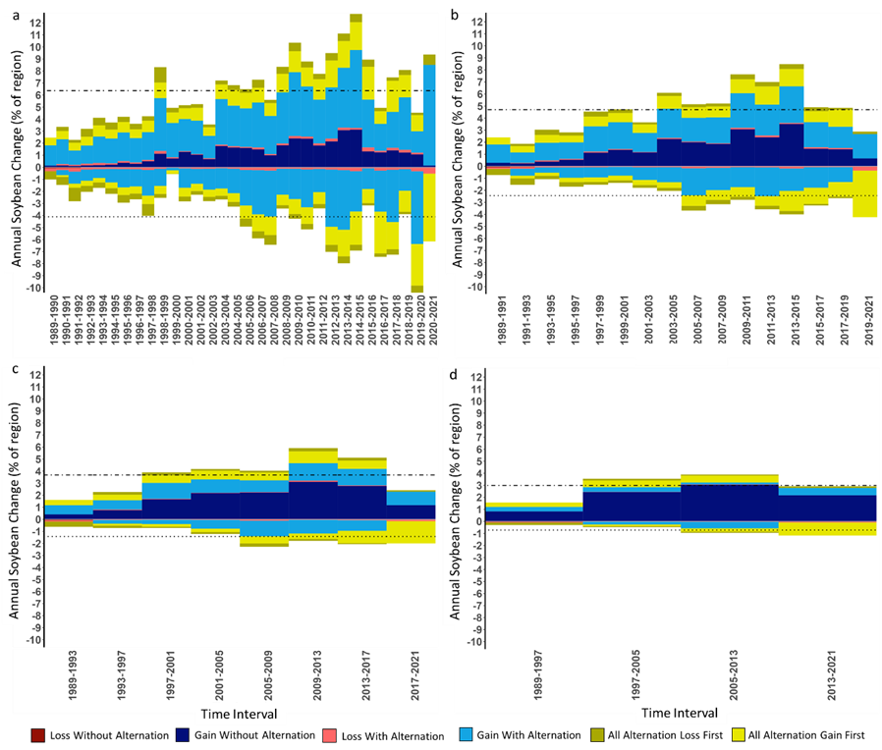
Alternation shrinks as temporal resolution coarsens.
Loss and Gain of soybean cultivation during time intervals of a) one year and b) two years, c) four years, and d) eight years.

Slide 32
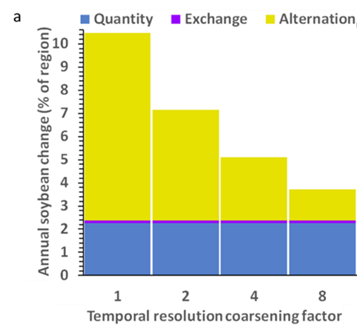
Change shrinks as temporal resolution coarsens.
Half of change is alternation within 4 years.
Bars show soybean change during time intervals of one year, two years, four years, and eight years.

Slide 33
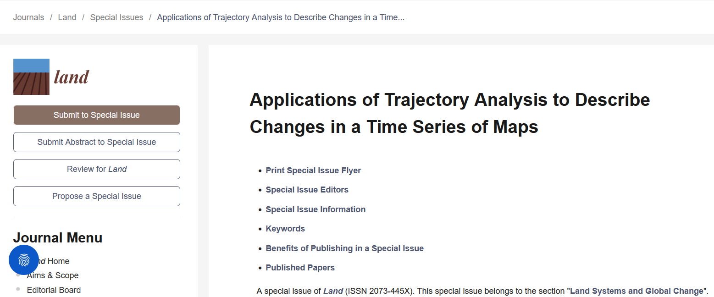
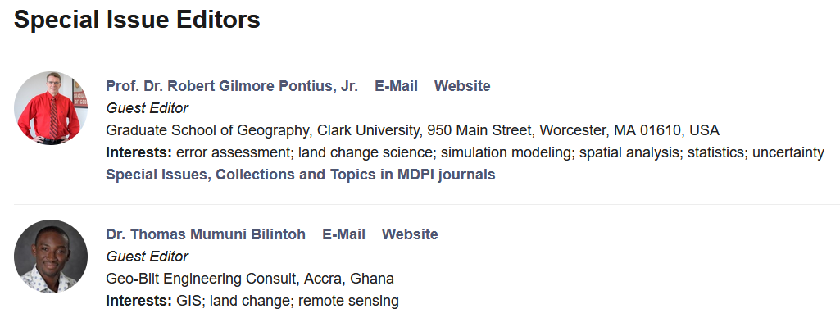
https://www.mdpi.com/journal/land/special_issues/IND622A7L0

Slide 34
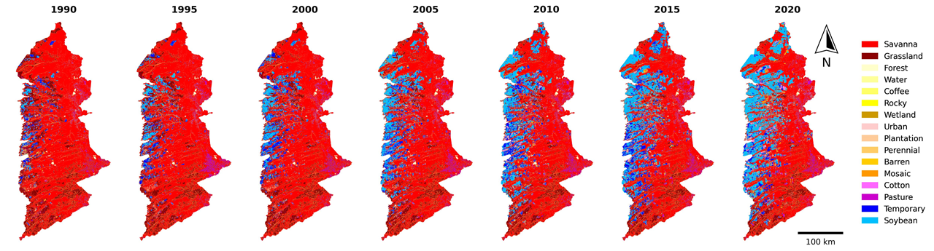
What do you do when you have many classes and time intervals?
Pontius and Fonseca. in press. A GIS method to summarize changes among classes during a time series with an application to land cover in western Bahia, Brazil. Transactions in GIS.
https://github.com/antoniovfonseca/summarize-change-components

Slide 35
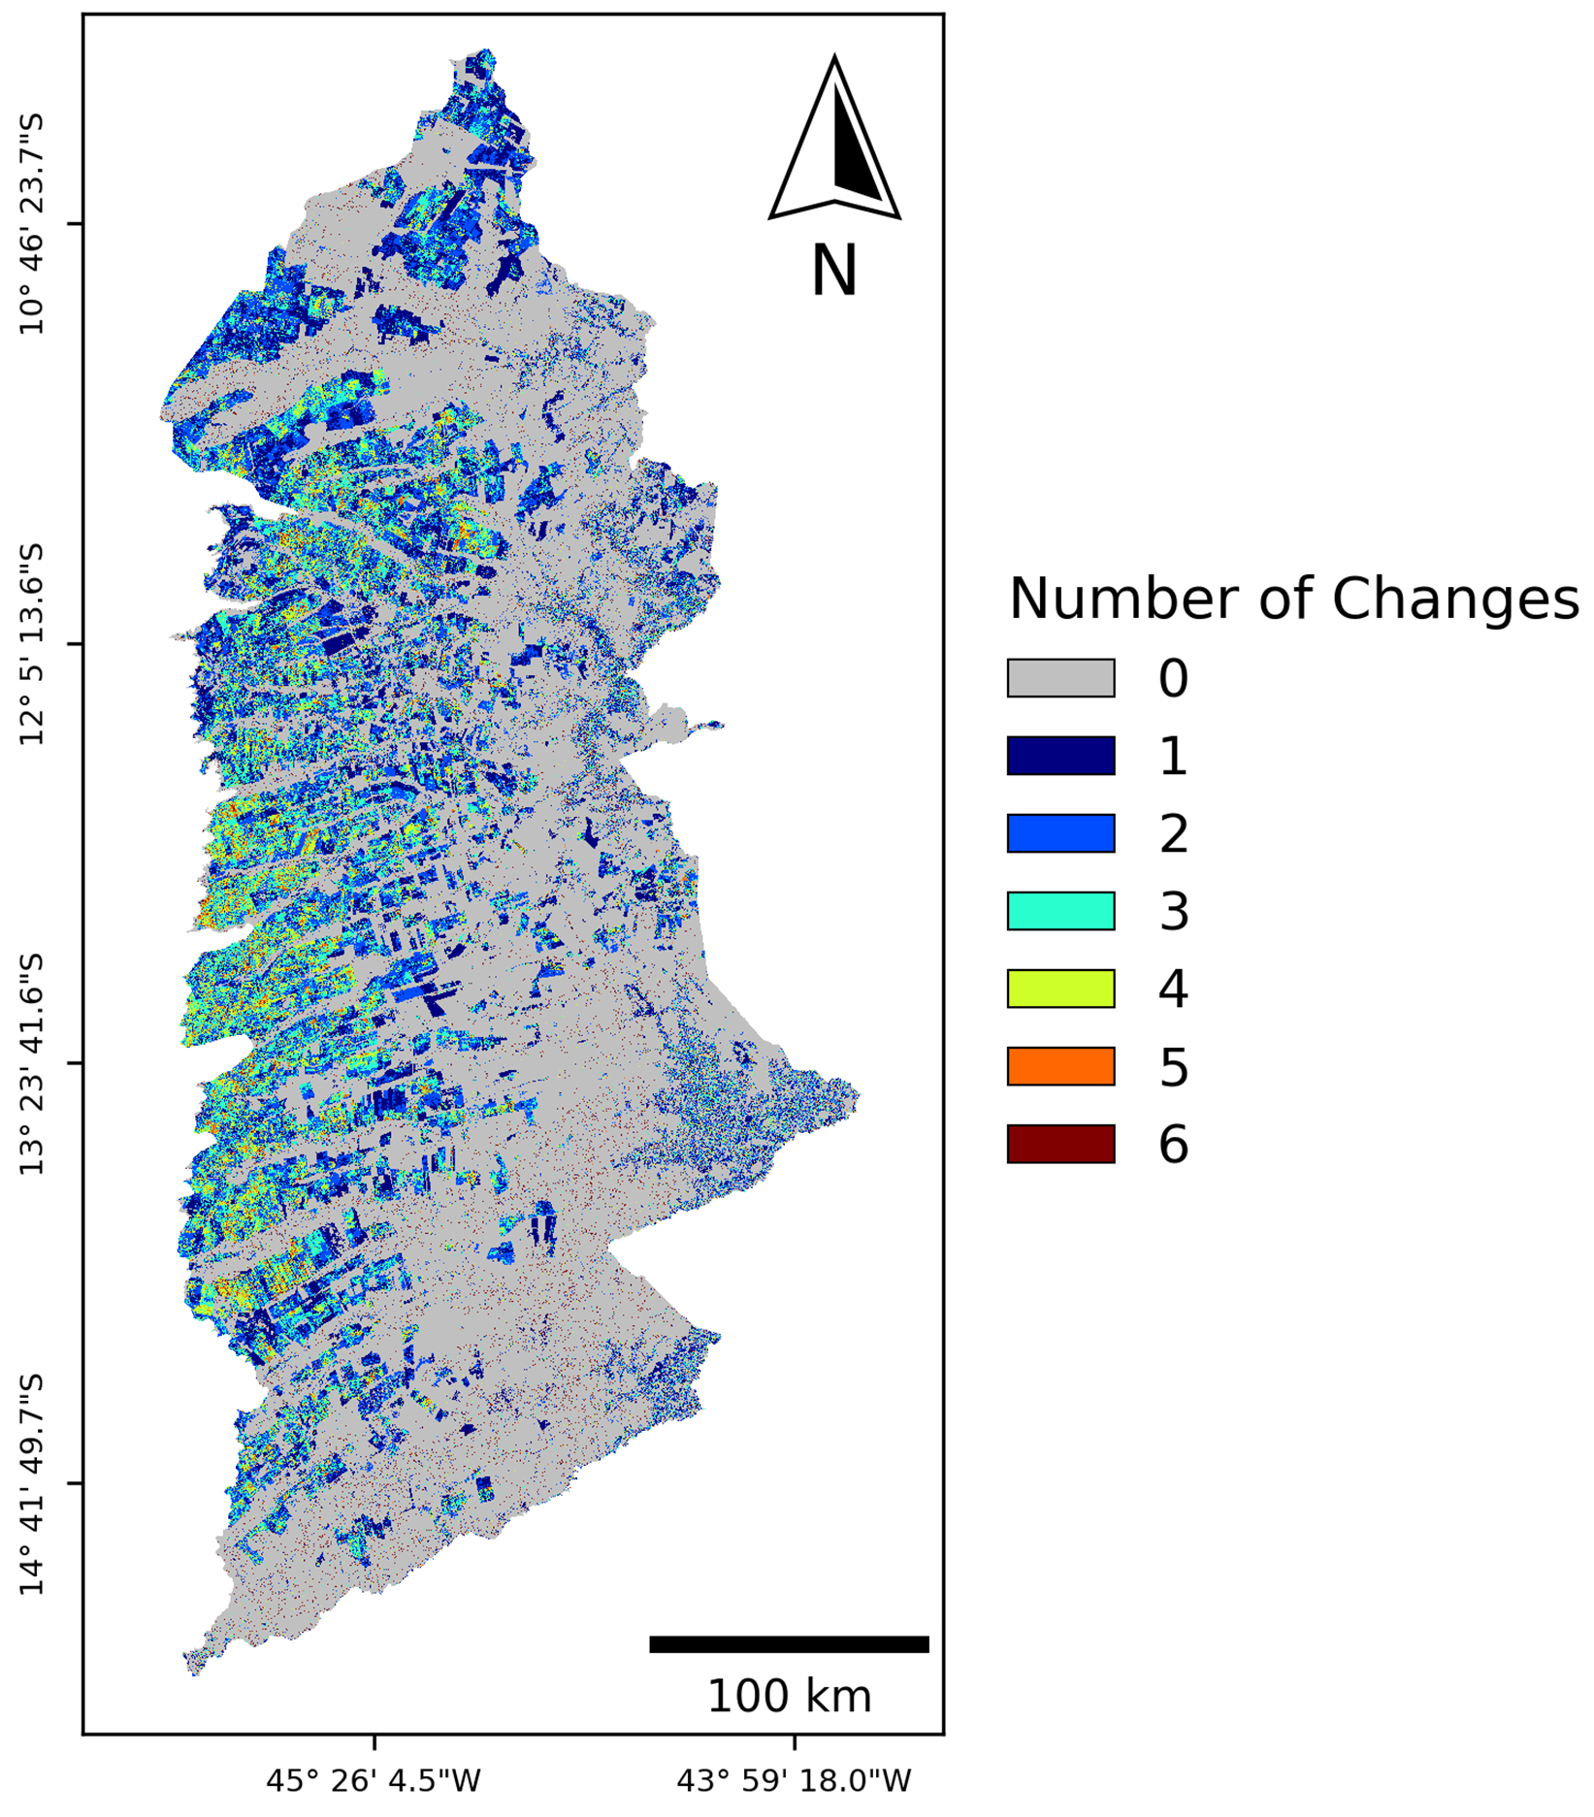
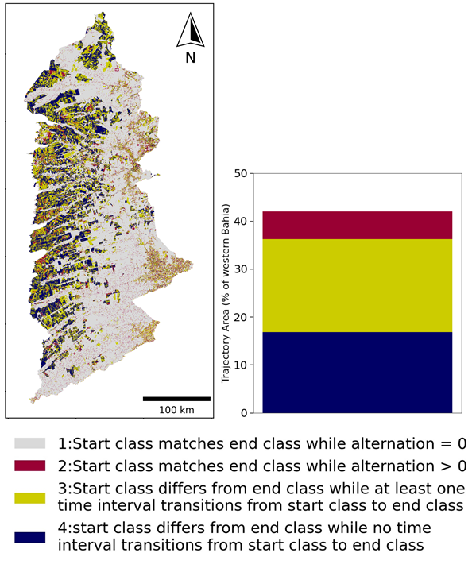
What do you do when you have many classes and time intervals?
Pontius and Fonseca. in press. A GIS method to summarize changes among classes during a time series with an application to land cover in western Bahia, Brazil. Transactions in GIS.
https://github.com/antoniovfonseca/summarize-change-components

Slide 36
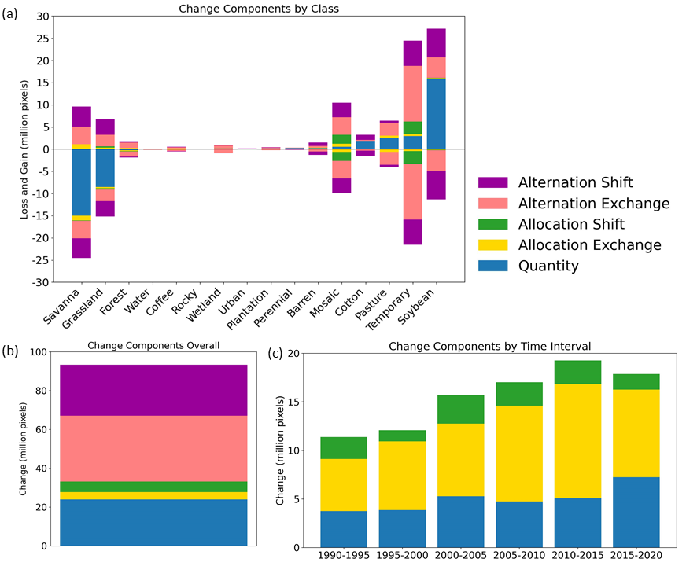
Quantity occurs when classes change size.
Allocation Exchange occurs when class i loses to j at some places while class j loses to class i at other places.
Allocation Shift occurs when class i loses to j at some places while class j loses to class k at other places.
Pontius and Fonseca. in press. A GIS method to summarize changes among classes during a time series with an application to land cover in western Bahia, Brazil. Transactions in GIS.
https://github.com/antoniovfonseca/summarize-change-components

Slide 37
Alternation Exchange occurs when class i loses to j then class j loses to class i at the same place.
Allocation Shift occurs when class i loses to j then class j loses to class k at the same place.
Pontius and Fonseca. in press. A GIS method to summarize changes among classes during a time series with an application to land cover in western Bahia, Brazil. Transactions in GIS.
https://github.com/antoniovfonseca/summarize-change-components

Slide 38
A typical transition is from Savanna to Temporary to Soybean
Pontius and Fonseca. in press. A GIS method to summarize changes among classes during a time series with an application to land cover in western Bahia, Brazil. Transactions in GIS.
https://github.com/antoniovfonseca/summarize-change-components

Slide 39
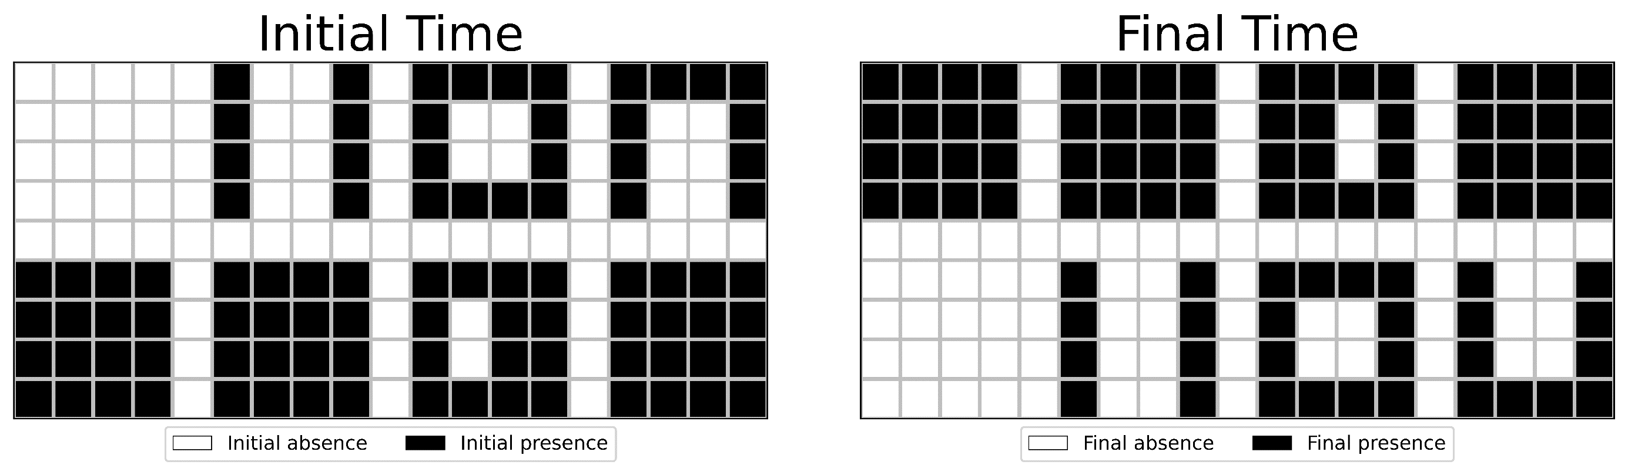
What are the changes in patches?
How many patches exist at the initial time?
How many patches exist at the initial time?
A Zhang, R G Pontius Jr, T M Bilintoh, F Sangermano, J Rogan. 2025. DynamicPATCH: Method and Software for Spatially Explicit Dynamic Patch Transition Characterization. Landscape Ecology 40(132)

Slide 40
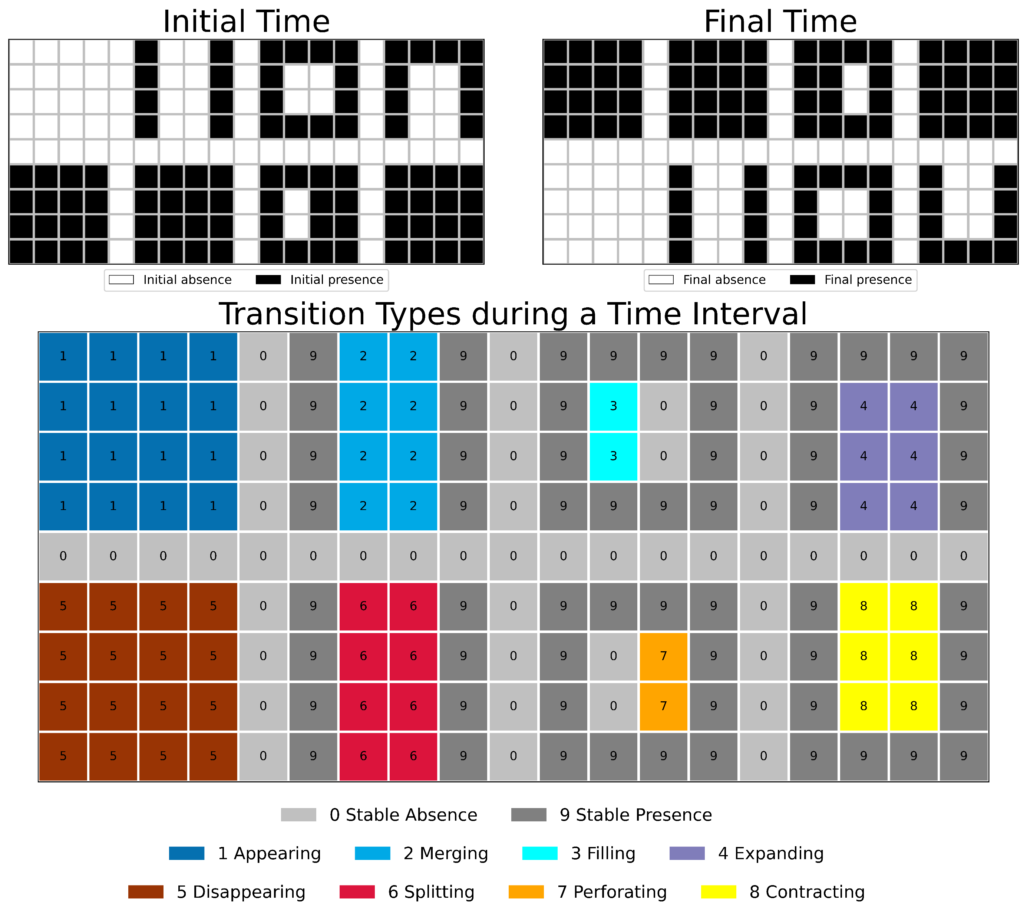
DynamicPATCH is new software for
Spatially Explicit Dynamic PAtch Transition Characterization.

Slide 41
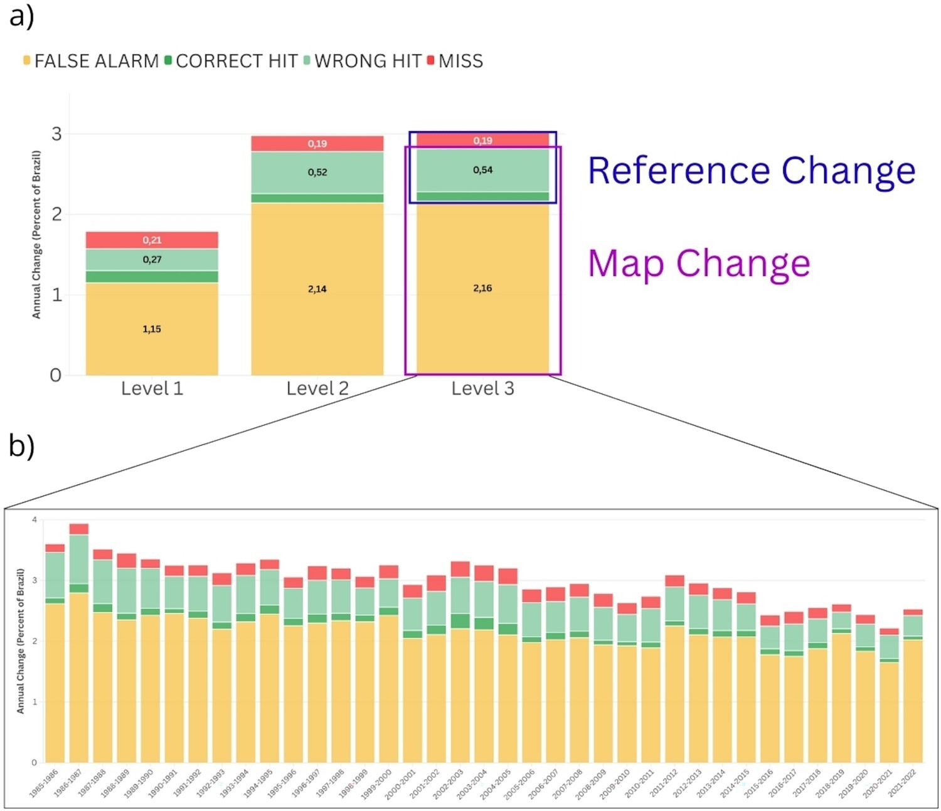
The MapBiomas data show more alternation than the ground reference data concerning change during time intervals
A P Matos, M Hunter, Robert G Pontius Jr, L R Baumann, L L Parente, L G Ferreira. 2025. Accounting for alternation in temporal quality analysis in MapBiomas Brazil. International Journal of Digital Earth 18(1).

Slide 42
Main Points
You must align your evaluation metric with your particular research question, which is obvious but challenging.
Take Pontius’ workshop Thursday 25 September 17:00-19:00.
Use new methods of land change and contribute to a special issue of the journal Land using Trajectory Analysis at https://www.mdpi.com/journal/land/special_issues/IND622A7L0
Get the R package and documentation at this QR code

