Slide 1






Metrics That Make a Difference
Robert Gilmore Pontius Jr
Dr. Pontius is a Geography Professor at Clark University where he conducts research as an applied statistician and environmental scientist with expertise in GIS, ecological modeling, and land change science.
https://wordpress.clarku.edu/rpontius/
rpontius@clarku.edu
28 May 2025

Slide 2



Main Points
Straight forward metrics can help to remedy some of the conceptual blunders in the profession.
Free software packages compute three new methods to describe change during a time series of maps.
Please contribute to the special issue of Land at https://www.mdpi.com/journal/land/special_issues/IND622A7L0
Get the software and documentation at these QR codes
Trajectory Analysis R DynamicPATCH Change Components

Slide 3
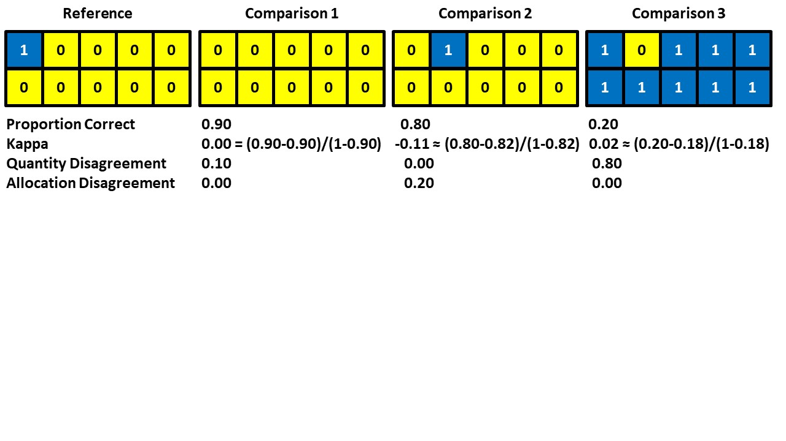
Which Comparison map is the best agreement with the Reference map?
Pontius Jr, Robert Gilmore, Thomas Francis, Marco Millones. 2025. A call to interpret disagreement components during classification assessment. International Journal of Geographical Information Science 1-18. https://www.tandfonline.com/doi/full/10.1080/13658816.2025.2469830

Slide 4
Proportion Correct and Kappa can be misleading and inappropriate.
Quantity and Allocation metrics compute the reasons for disagreement.
Pontius Jr, Robert Gilmore, Thomas Francis, Marco Millones. 2025. A call to interpret disagreement components during classification assessment. International Journal of Geographical Information Science 1-18. https://www.tandfonline.com/doi/full/10.1080/13658816.2025.2469830

Slide 5
Pontius and Millones (2011) published the Death To Kappa paper, which had two recommendations:
1 Don’t use Kappa.
2 Use quantity and allocation disagreement.
The Death to Kappa paper has 2200 citations.
Pontius and Millones (2011) Death to Kappa. International Journal of Remote Sensing.
https://www.tandfonline.com/doi/abs/10.1080/01431161.2011.552923

Slide 6
Here is an example of how some authors cited the Death To Kappa paper by Pontius and Millones (2011)
“kappa coefficient … has proved to be an excellent statistical parameter for measuring consistency (Pontius and Millones 2011).”
cited in Gao et al. (2021) https://doi.org/10.1016/j.ijdrr.2020.101928

Slide 7
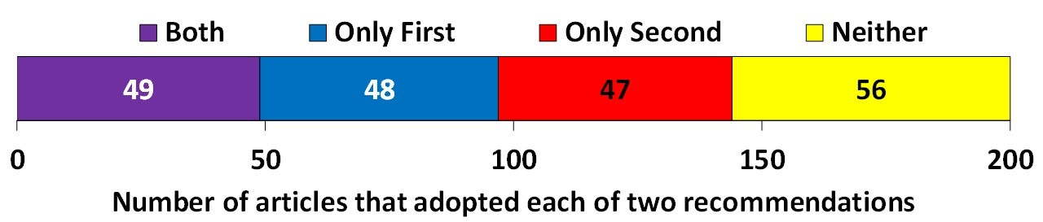
A quarter of the citations fall into each of the four combinations of whether the authors followed each of the two recommendations of Death to Kappa.
Both indicates the authors abandoned Kappa and adopted disagreement components.
Only First means authors abandoned Kappa but did not adopt disagreement components.
Only Second means authors used Kappa and adopted disagreement components.
Neither means authors used Kappa and did not adopt disagreement components.

Slide 8
If each map is a time point, then the disagreement is still more relevant than agreement.
Time 0 Time 1 Time 2 Time 3

Slide 9
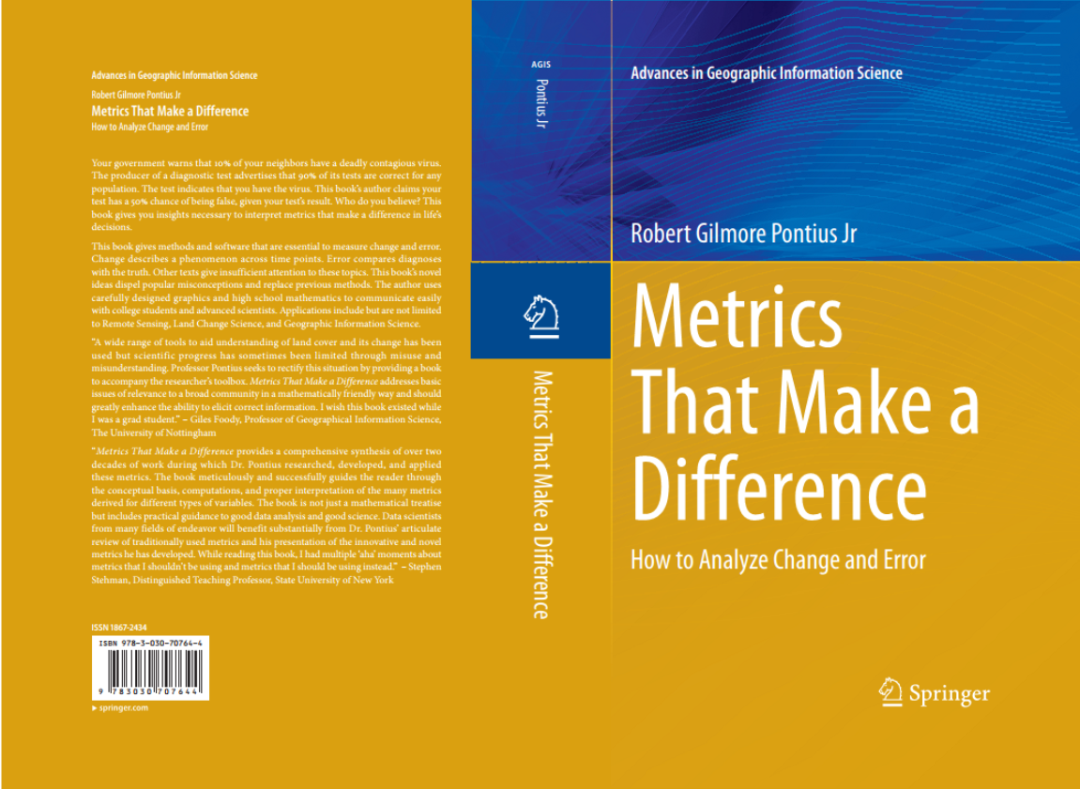
The foundational mathematical concepts are in Pontius’ book. https://wordpress.clarku.edu/rpontius/
9

Slide 10
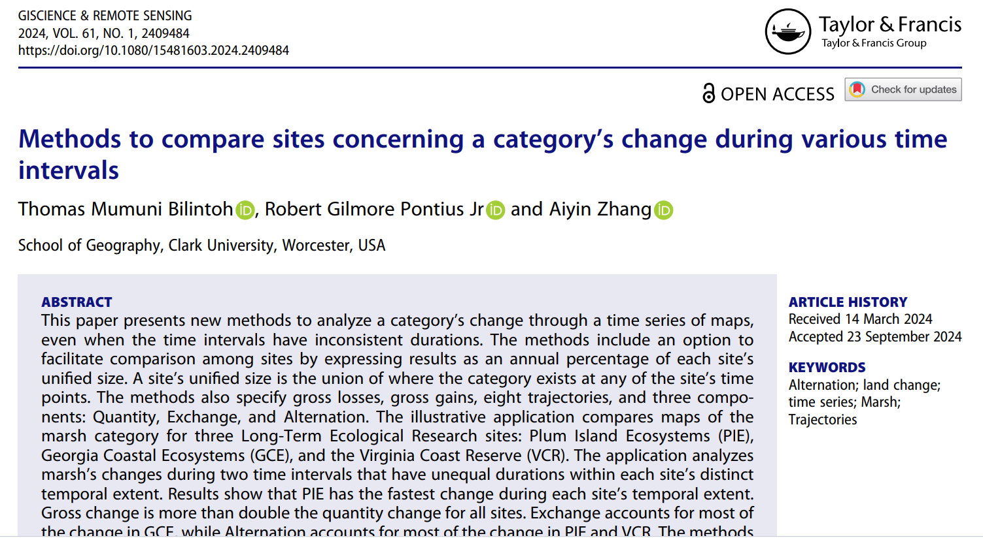
This article presents the method of Trajectory Analysis. https://www.tandfonline.com/doi/full/10.1080/15481603.2024.2409484

Slide 11
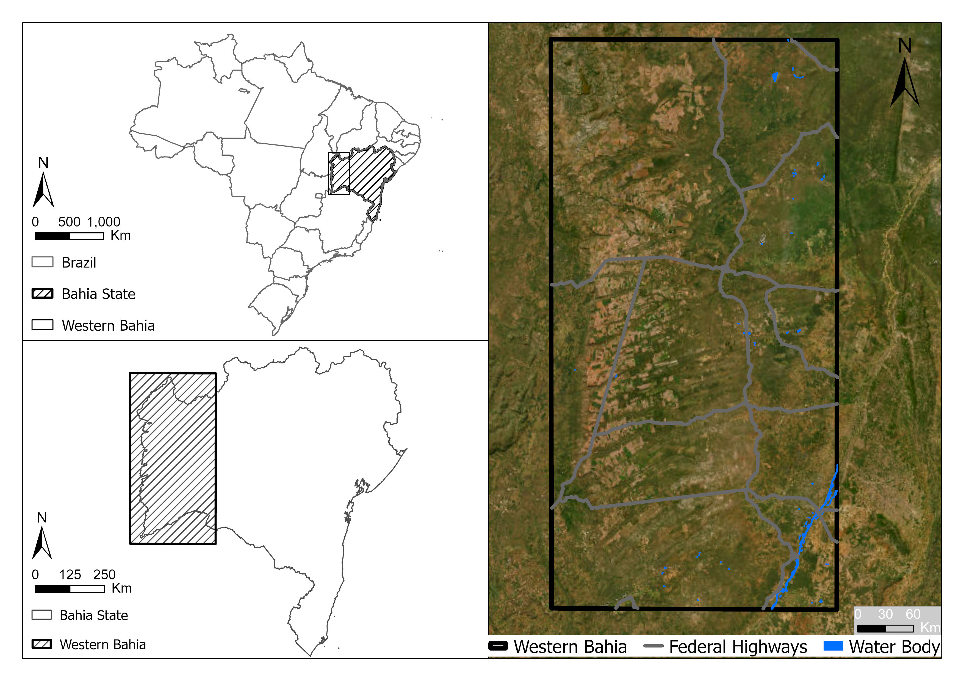

Western Bahia Brazil is a hotspot for soybean cultivation.
What patterns are in the MapBiomas time series?
Pontius Jr, Robert Gilmore, Thomas Bilintoh, Gustavo de L. T. Oliveira, Julia Z. Shimbo. 2023. Trajectories of losses and gains of soybean cultivation during multiple time intervals in western bahia, BRAZIL. Space Week Nordeste. Fortaleza, Brazil.

Slide 12
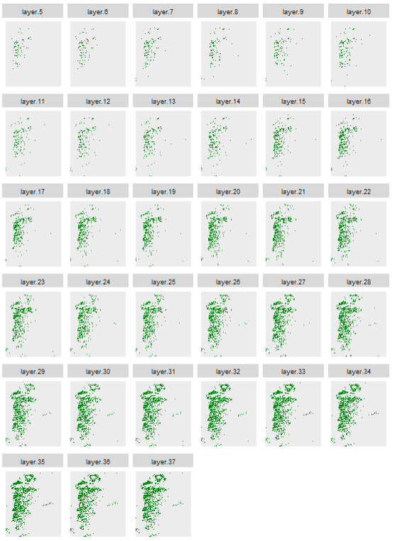
Maps show soybean at 33 years.
The extent has more than 200 million pixels.
Each pixel has more than 8 billion possible combinations of presence or absence of soybean.
We must have a method that focuses on a few important broad patterns while directing attention to the places and times that deserve a closer look.
We must design a method to see whether the data make intuitive sense because reference data are costly to collect.
1989
1990
1991
1992
1993
1994
1995
1996
1997
1998
1999
2000
2001
2002
2003
2004
2005
2006
2007
2008
2009
2010
2011
2012
2013
2014
2015
2016
2017
2018
Presence of soybean
Absence of soybean
2019
2020
2021

Slide 13
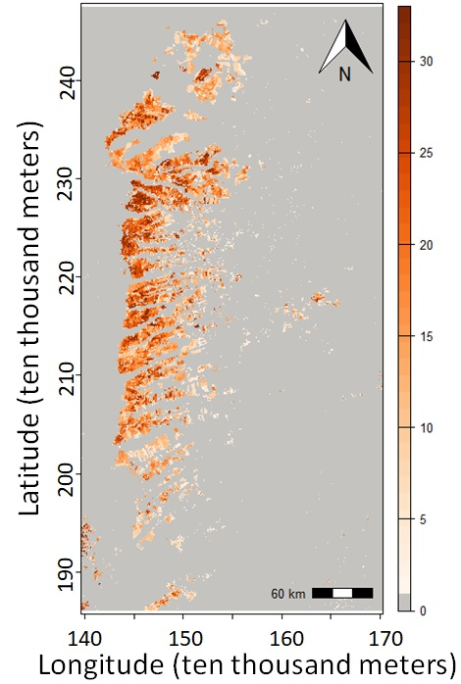
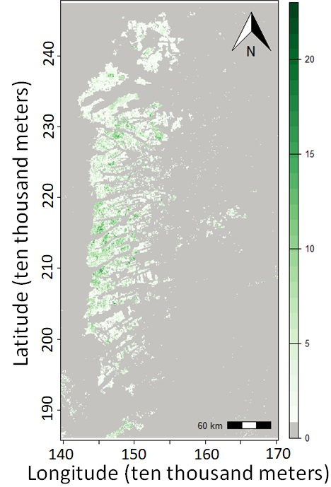
Number of years of presence is on the left and number of changes is on the right.
The unified region is the union of pixels that have at least one year of presence.

Slide 14

One map shows eight trajectories during 32 time intervals.
Get the code and documentation at the GitHub site of Thomas Bilintoh.
The maps show where the changes occur.

Slide 15
This graphic shows when the changes occur.
Gain is above and Loss below the time axis.

Slide 16
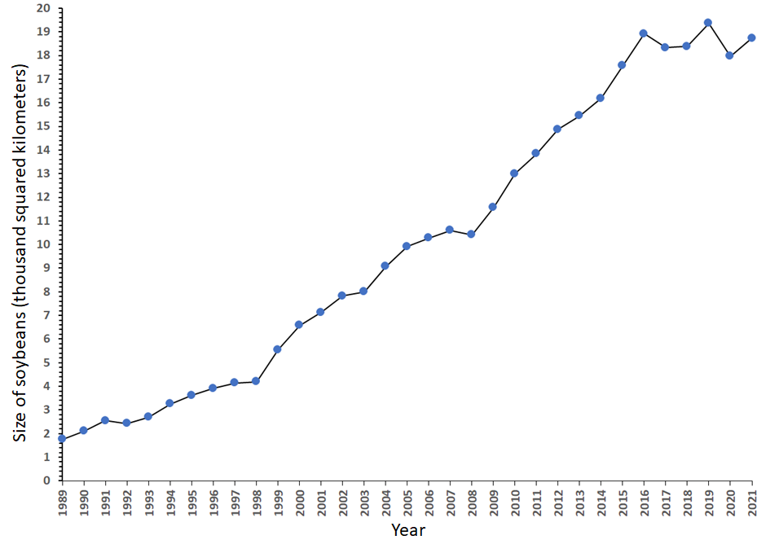
Gross Gain and Gross Loss explain the line graph.
Net change is steep during 1998-1999 because gross gain spikes.
Net change is steep during 1999-2000 because gross loss shrinks.
Area of soybeans versus time

Slide 17
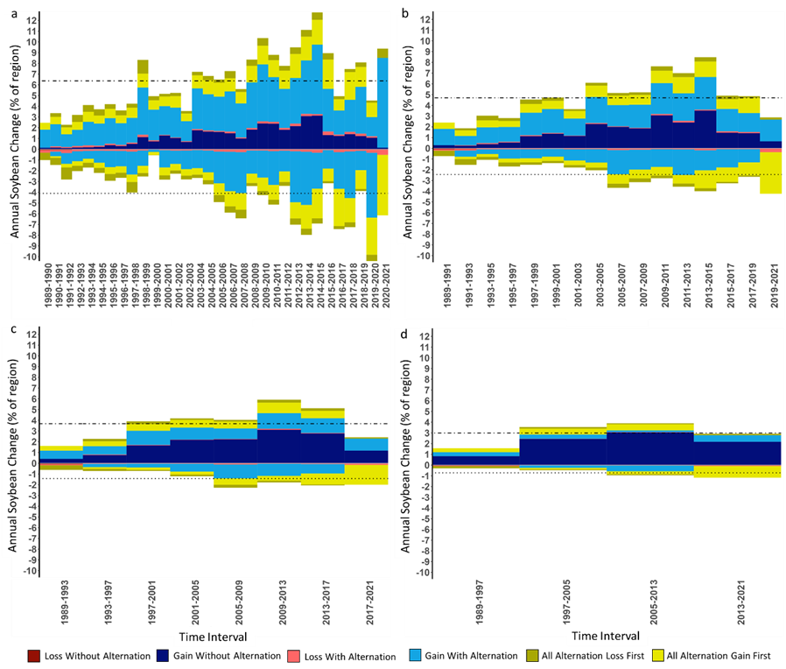
Alternation shrinks as temporal resolution coarsens.
Loss and Gain of soybean cultivation during time intervals of a) one year and b) two years, c) four years, and d) eight years.

Slide 18
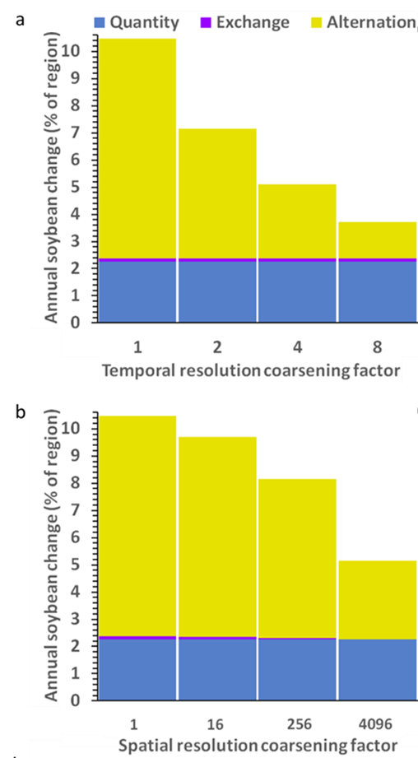
Temporal coarsening shows that half of the change is when gain occurs within 4 years of loss.
Bars show soybean change during time intervals of one year, two years, four years, and eight years.

Slide 19
Spatial resolution coarsening shows that half of the change is where gain occurs within 123 kilometers of loss.
a) Change of soybean cultivation during time intervals of one year, two years, four years, and eight years.
b) Change of soybean cultivation at spatial resolutions of 30 meters, 480 meters, 7,680 meters, and 122,880 meters.

Slide 20
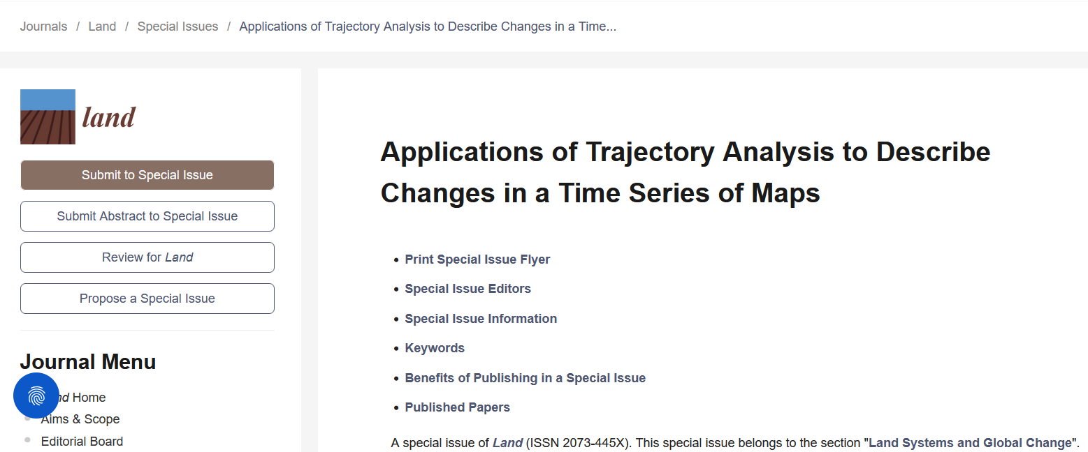
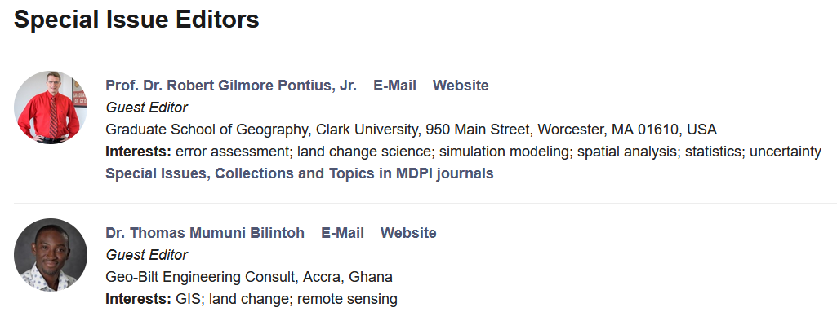
Contact Pontius to participate in this special issue https://www.mdpi.com/journal/land/special_issues/IND622A7L0

Slide 21





DynamicPATCH: Method and Software for
Spatially Explicit Dynamic Patch Transition Characterization
Aiyin Zhang, Robert Gilmore Pontius Jr, Thomas Bilintoh,
Florencia Sangermano, John Rogan. in press. Landscape Ecology
21

Slide 22
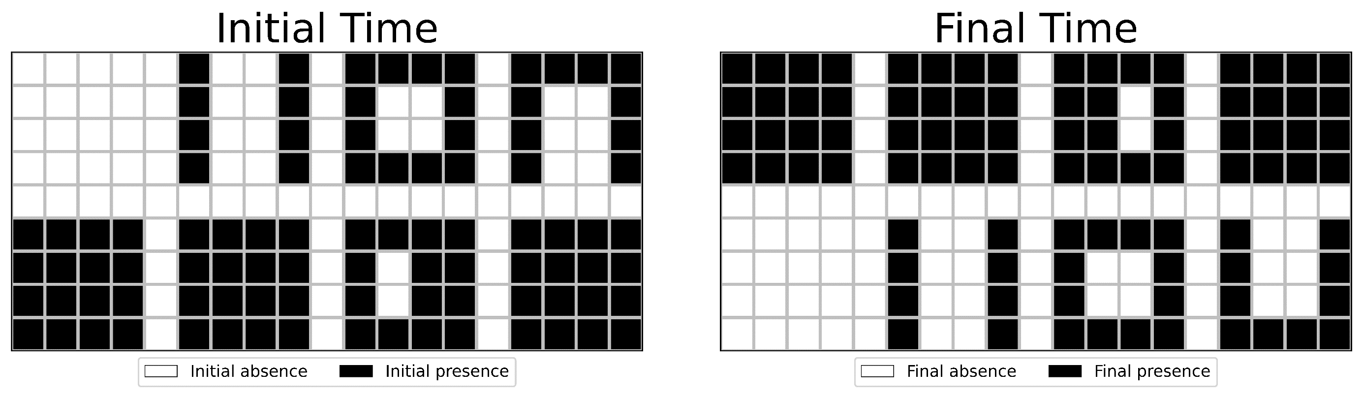
How many presence patches exist at the initial time?
How many presence patches exist at the final time?
What is the change in the number of patches?
What is the change in the number of presence pixels?

Slide 23
How many presence patches exist at the initial time? 8
How many presence patches exist at the final time? 8
What is the change in the number of patches?
What is the change in the number of presence pixels?
  Net change in number of patches is 0.
  Net change in number of presence pixels 0.

Slide 24
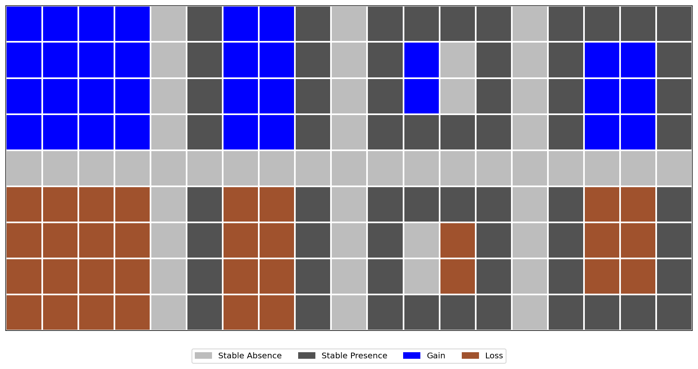
Map overlay reveals the gross changes.
  Gross Change pixels are 64. Gross change patches are 8.

Slide 25
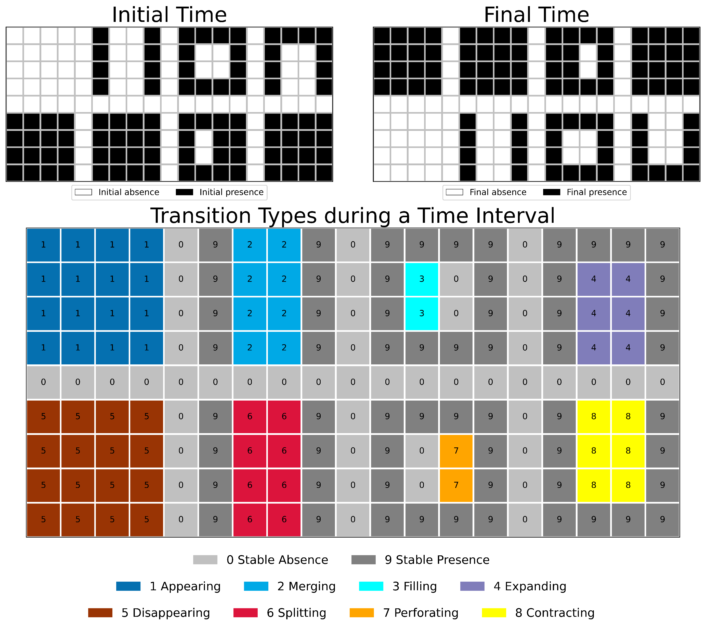
DynamicPATCH identifies eight patch-based transition types.

Slide 26
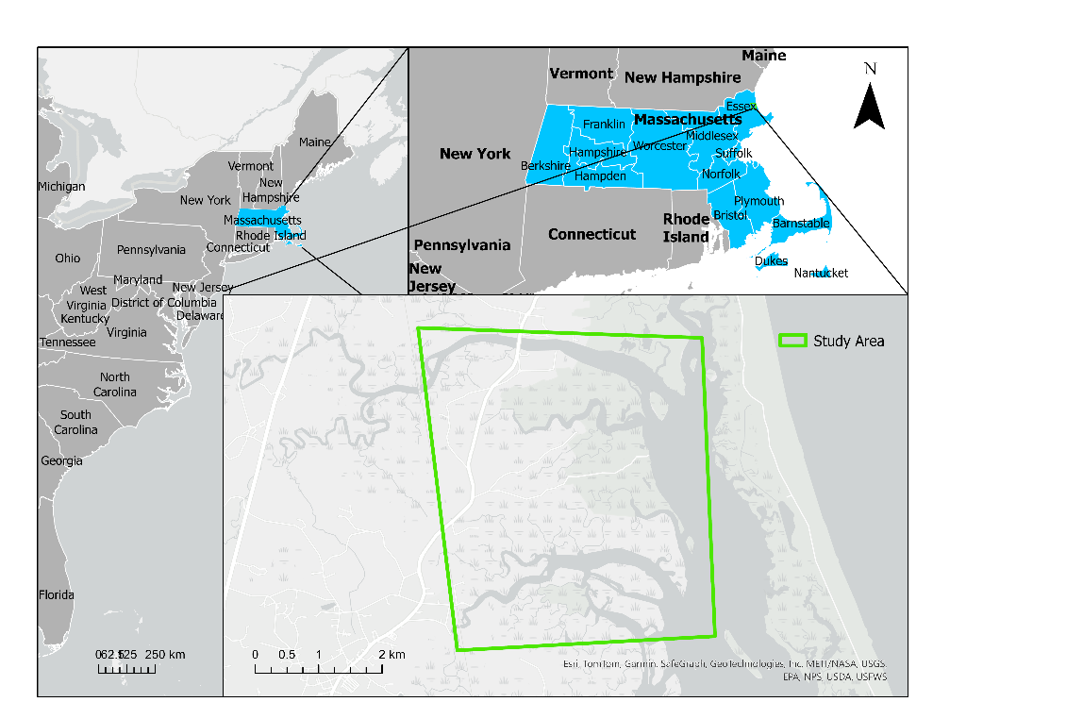
Illustration is the Plum Island Ecosystems in northeastern USA.

Slide 27
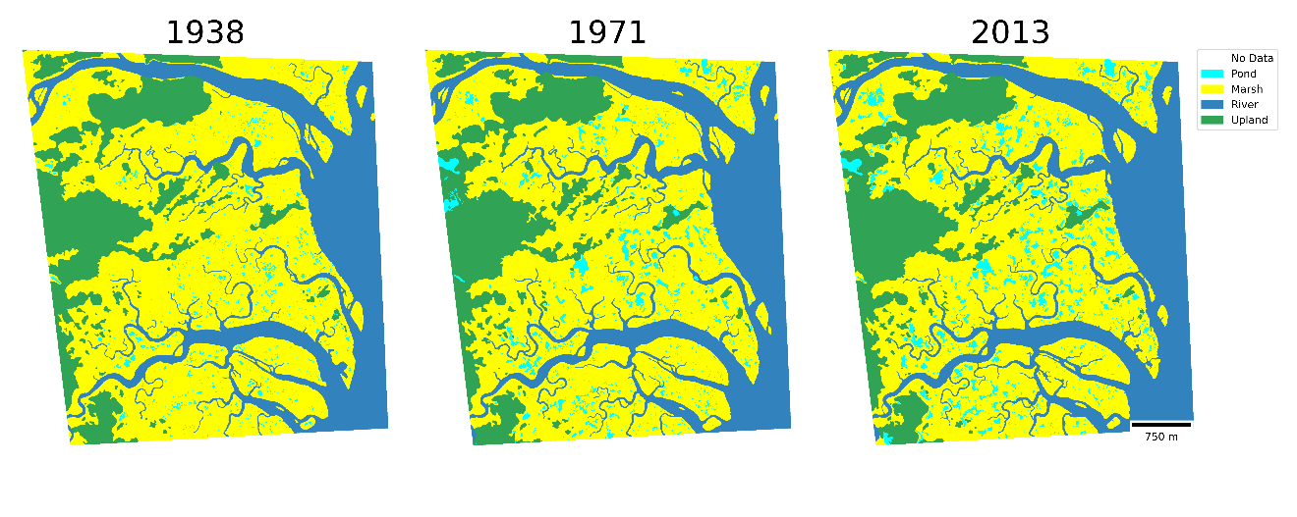
Illustration is the Plum Island Ecosystems in northeastern USA.

Slide 28
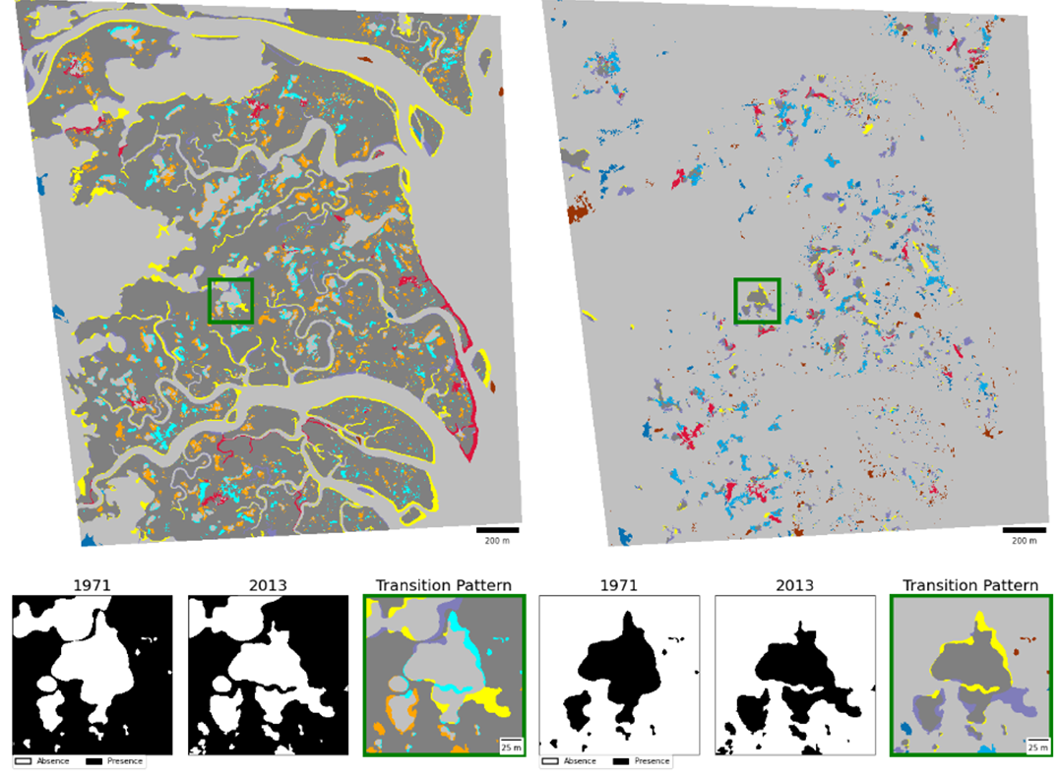
DynamicPATCH creates maps of transition patterns in Marsh and Pond.
Marsh
Pond
Marsh
Pond
1938 - 1971
1971 - 2013

Slide 29
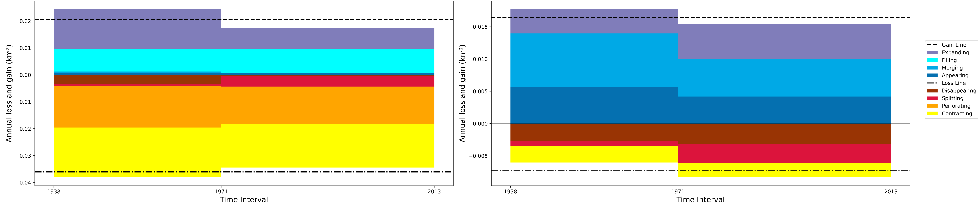
Annual gross gain area extends above the horizontal axis.
Annual gross loss area drops below the horizontal axis.
Marsh
Pond
Loss is larger than gain.
Loss derives mainly from Contracting.
Gain is larger than loss.
Gain derives mainly from Merging.

Slide 30
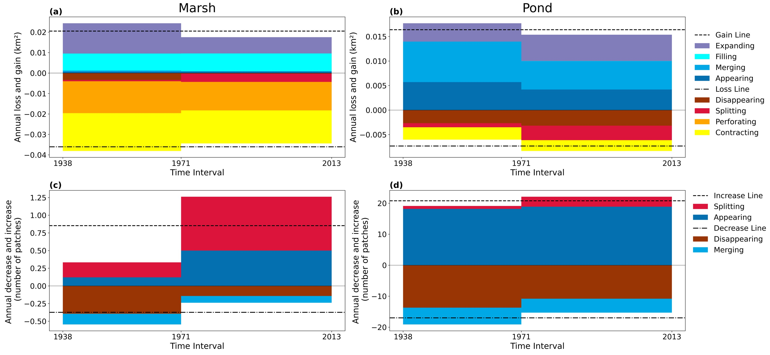
Annual gross increase in patches is above horizontal axis.
Annual gross decrease in patches is below horizontal axis.
Marsh
Pond
Change is non-stationary.
Most of patch increase derives from Splitting.
Gross change is larger than net change.
Most change is Appearing and Disappearing.

Slide 31
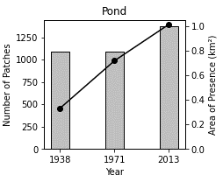
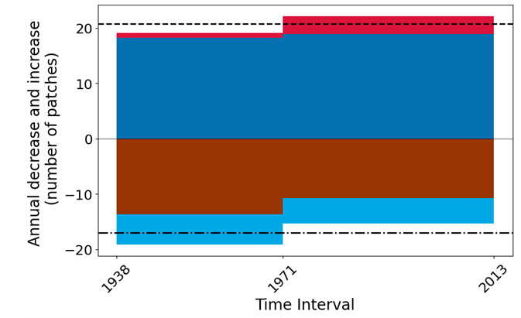
Traditional analysis of time points misses gross changes.
Pond experienced 0 net change in number of patches during 1938 – 1971.
DynamicPATCH shows Pond experienced dramatic gross changes in number of patches.

Slide 32
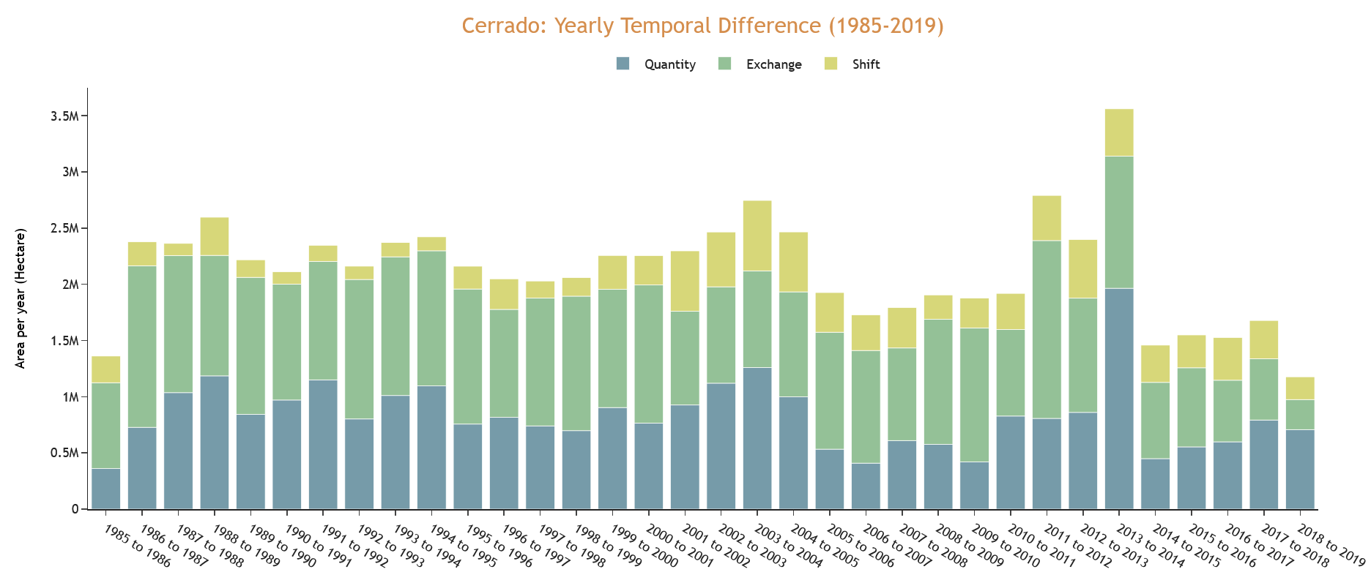
Previous work expressed change during each time interval as the sum of three components: Quantity, Exchange, and Shift.
Quantity is the change in area size during a time interval. Exchange and Shift do not affect area size.
Exchange occurs when class i changes to j at some locations and an equal size of class j changes to i at other locations.
Shift occurs for class j when class i changes to j at some locations and an equal size of class j changes to k at other locations.
https://storymaps.arcgis.com/stories/8ac3f8885b3d453f927c9ec5429af0f8

Slide 33
A GIS method to summarize changes among classes during a time series with an application to land cover in western Bahia, Brazil
Robert Gilmore Pontius Jr and Antonio Fonseca
rpontius@clarku.edu antfonseca@clarku.edu
Submitted to Transactions in GIS

Slide 34
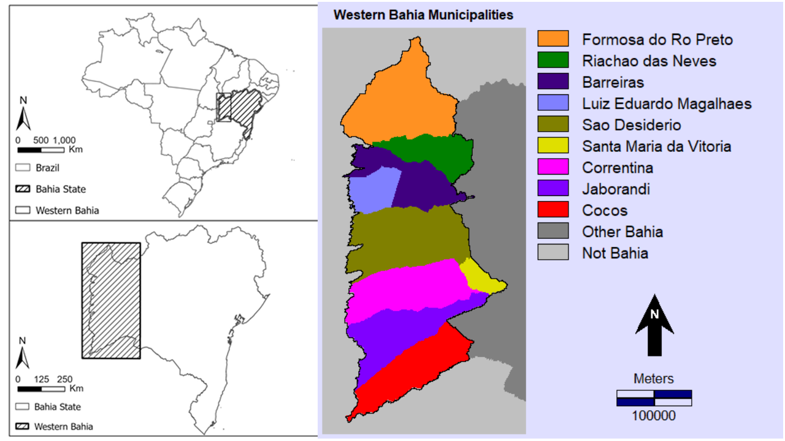
46°26’ W
10°06’ S
15°28’ S
43°28’ W

Slide 35
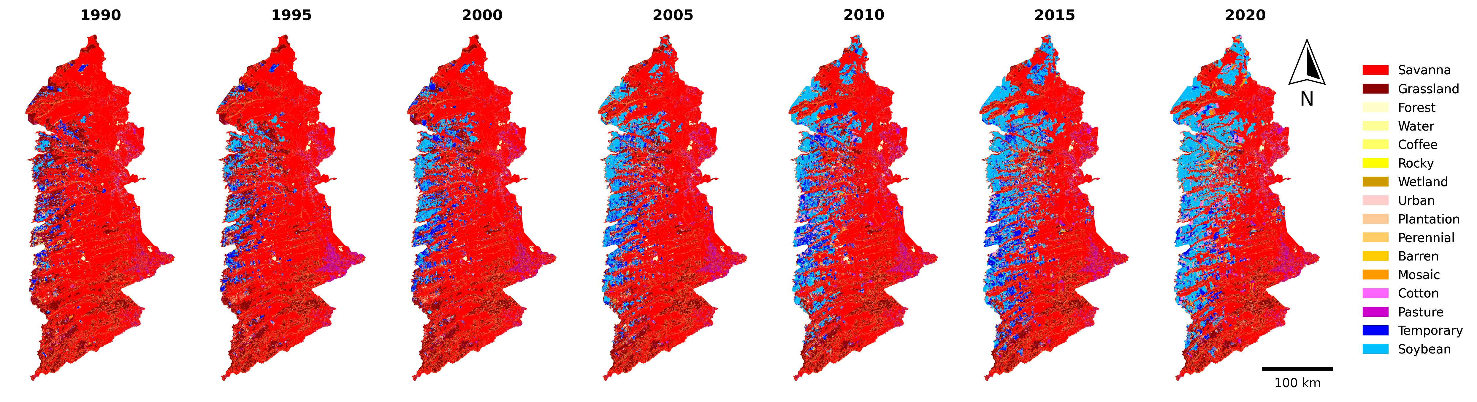
MapBiomas collection 8 has 16 classes at these 7 time points.
Our goal is to create a general method that summarizes change during time intervals for any site, especially when the number of classes and time intervals are large.

Slide 36
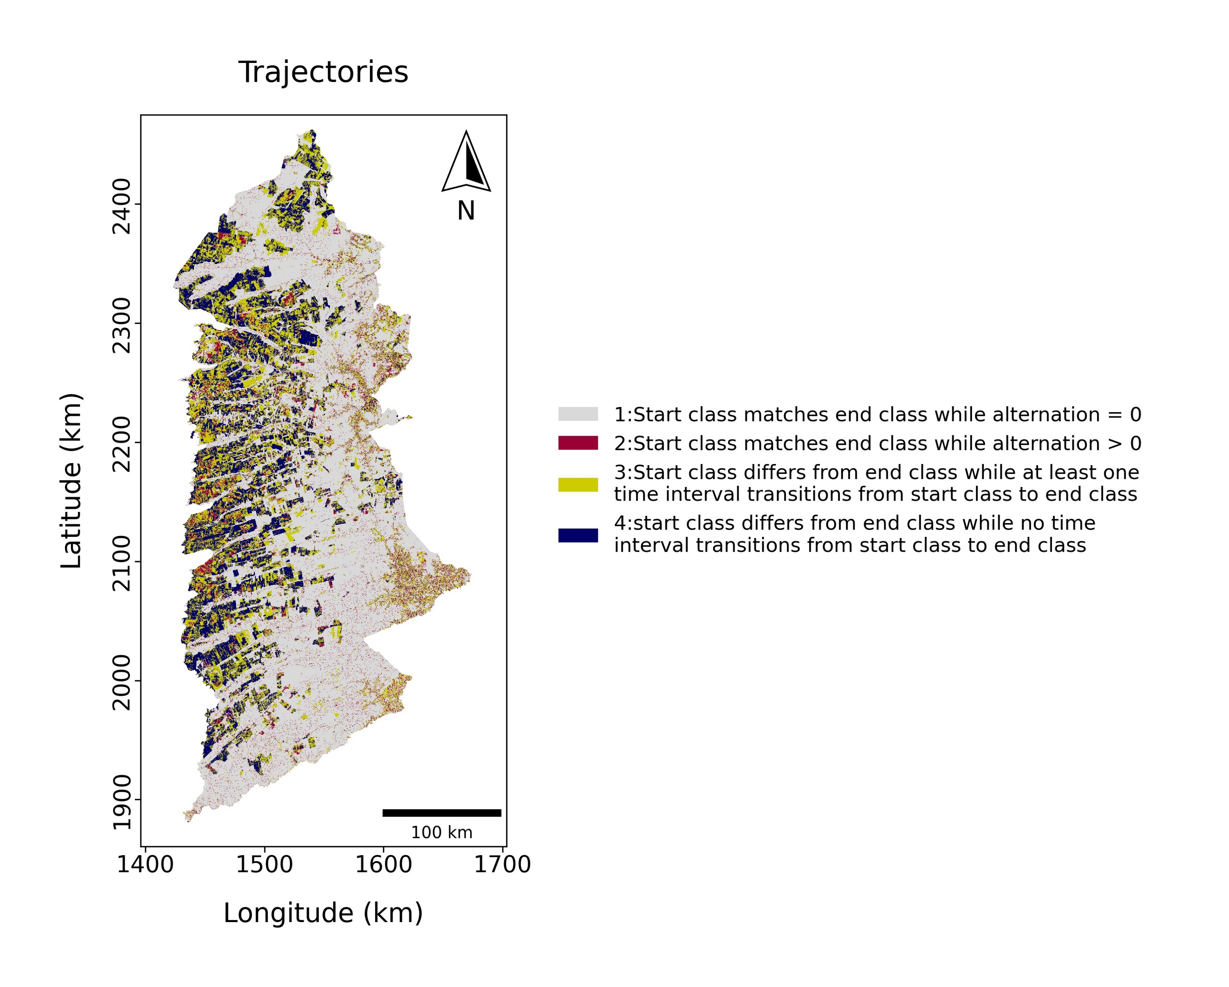
We define four trajectories
(a)
Pixel | t=0 | t=1 | t=2 | Trajectory
1 | A | A | B | 3
2 | A | B | A | 2
3 | A | B | C | 4
4 | A | B | B | 3
5 | B | A | A | 3
6 | B | C | C | 3
Alternation occurs when a pixel changes more than once.
Pixel 2 shows alternation exchange between classes A and B.
Pixel 3 shows alternation shift of class B.

Slide 37
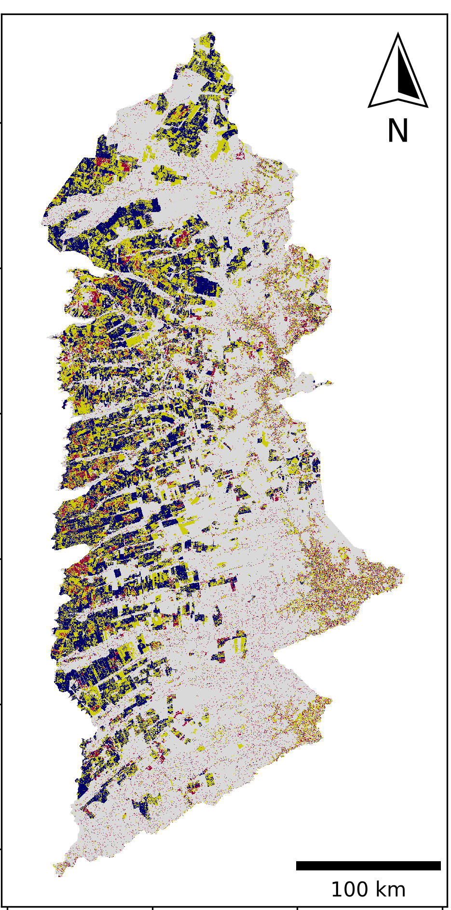
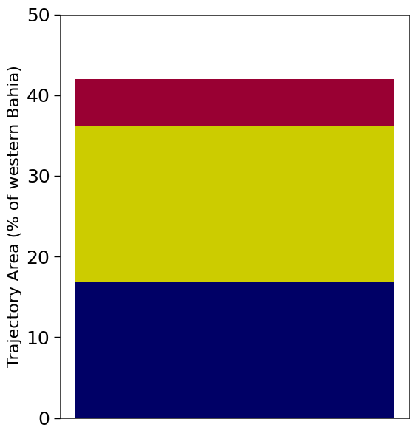

Slide 38
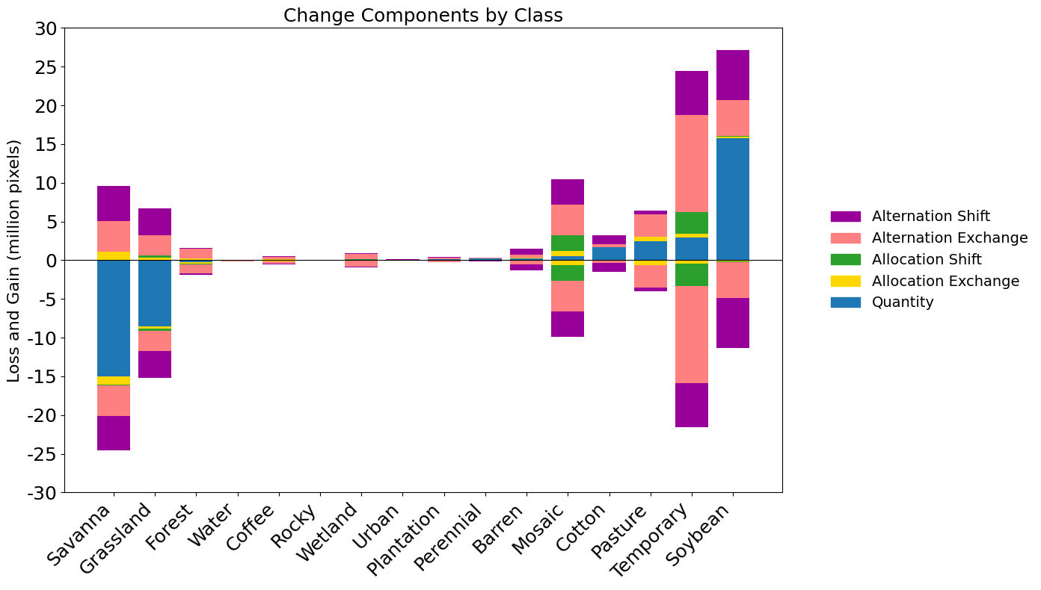
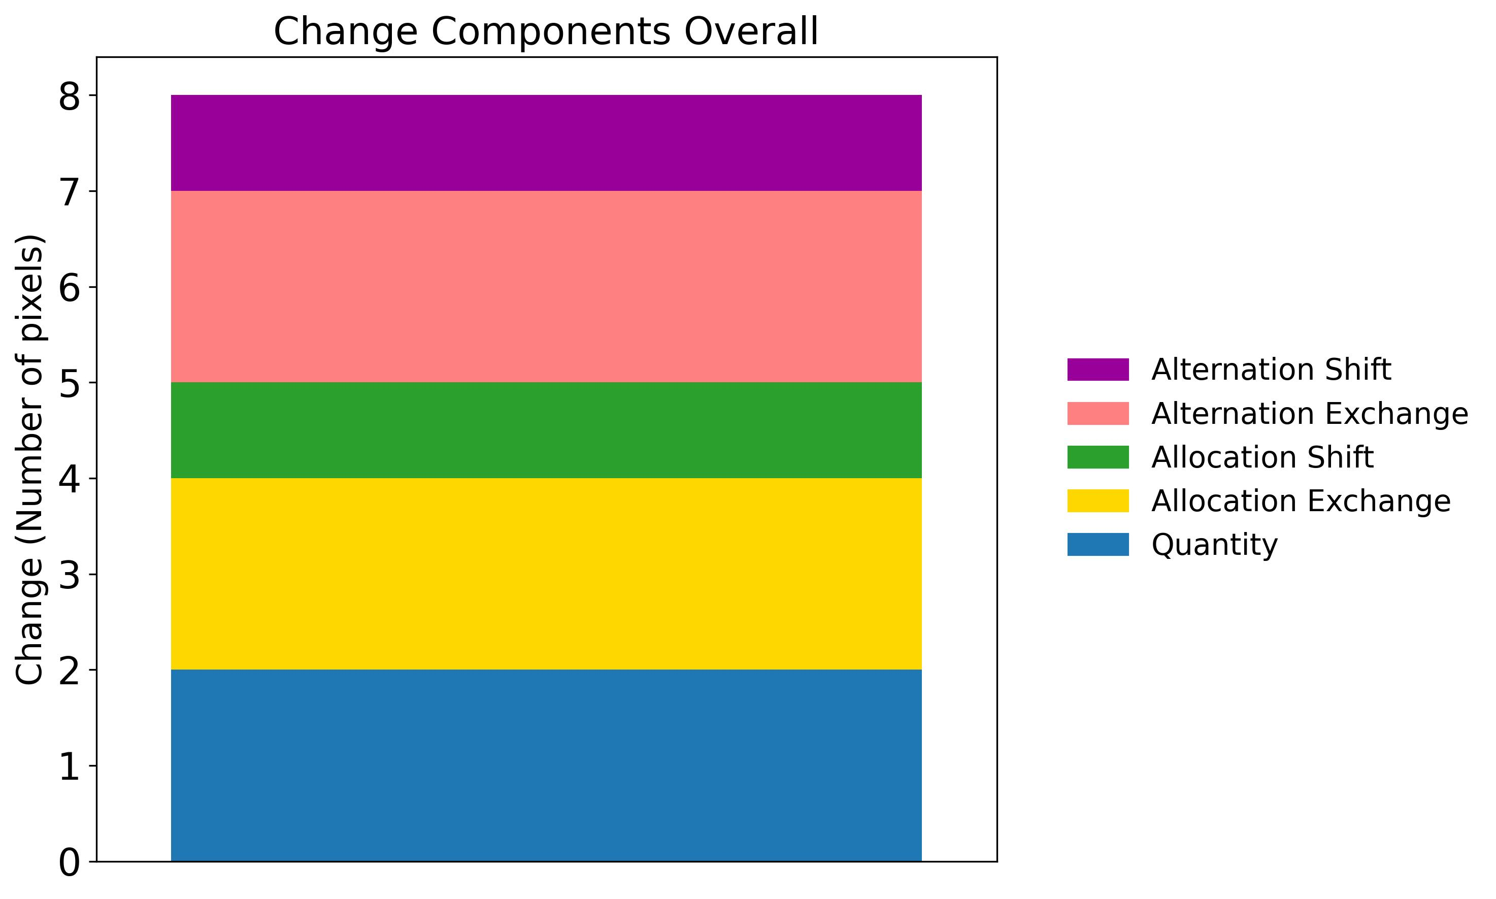
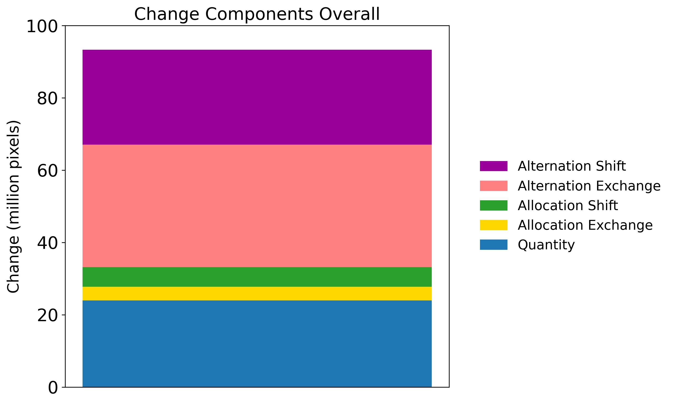
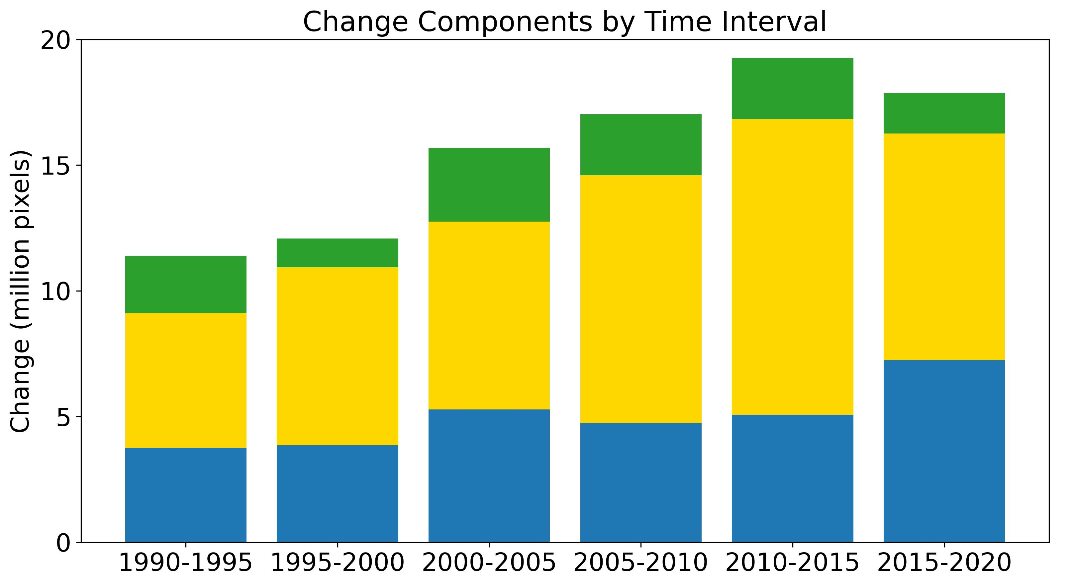
(a)
Results show dynamics by (a) class, (b) overall, and (c) time interval.
Transitions from savannah to temporary to soybean cause Alternation Shift.
(b)
(c)

Slide 39
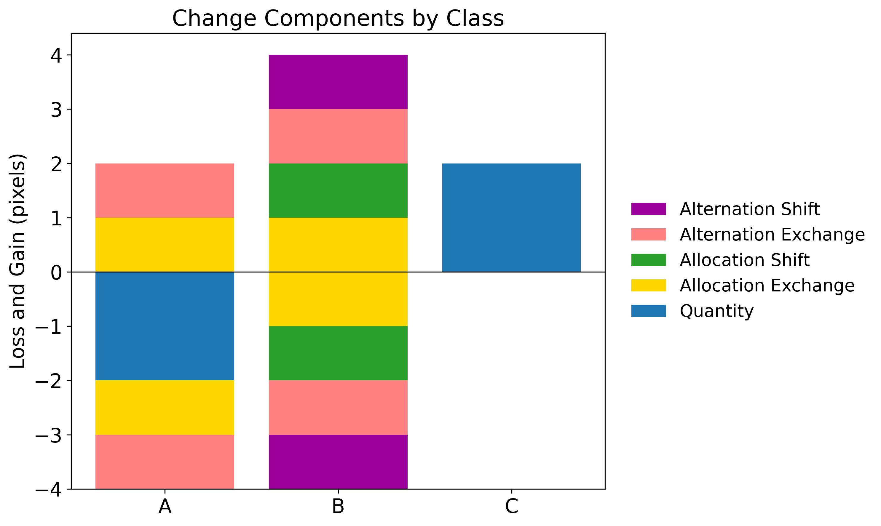
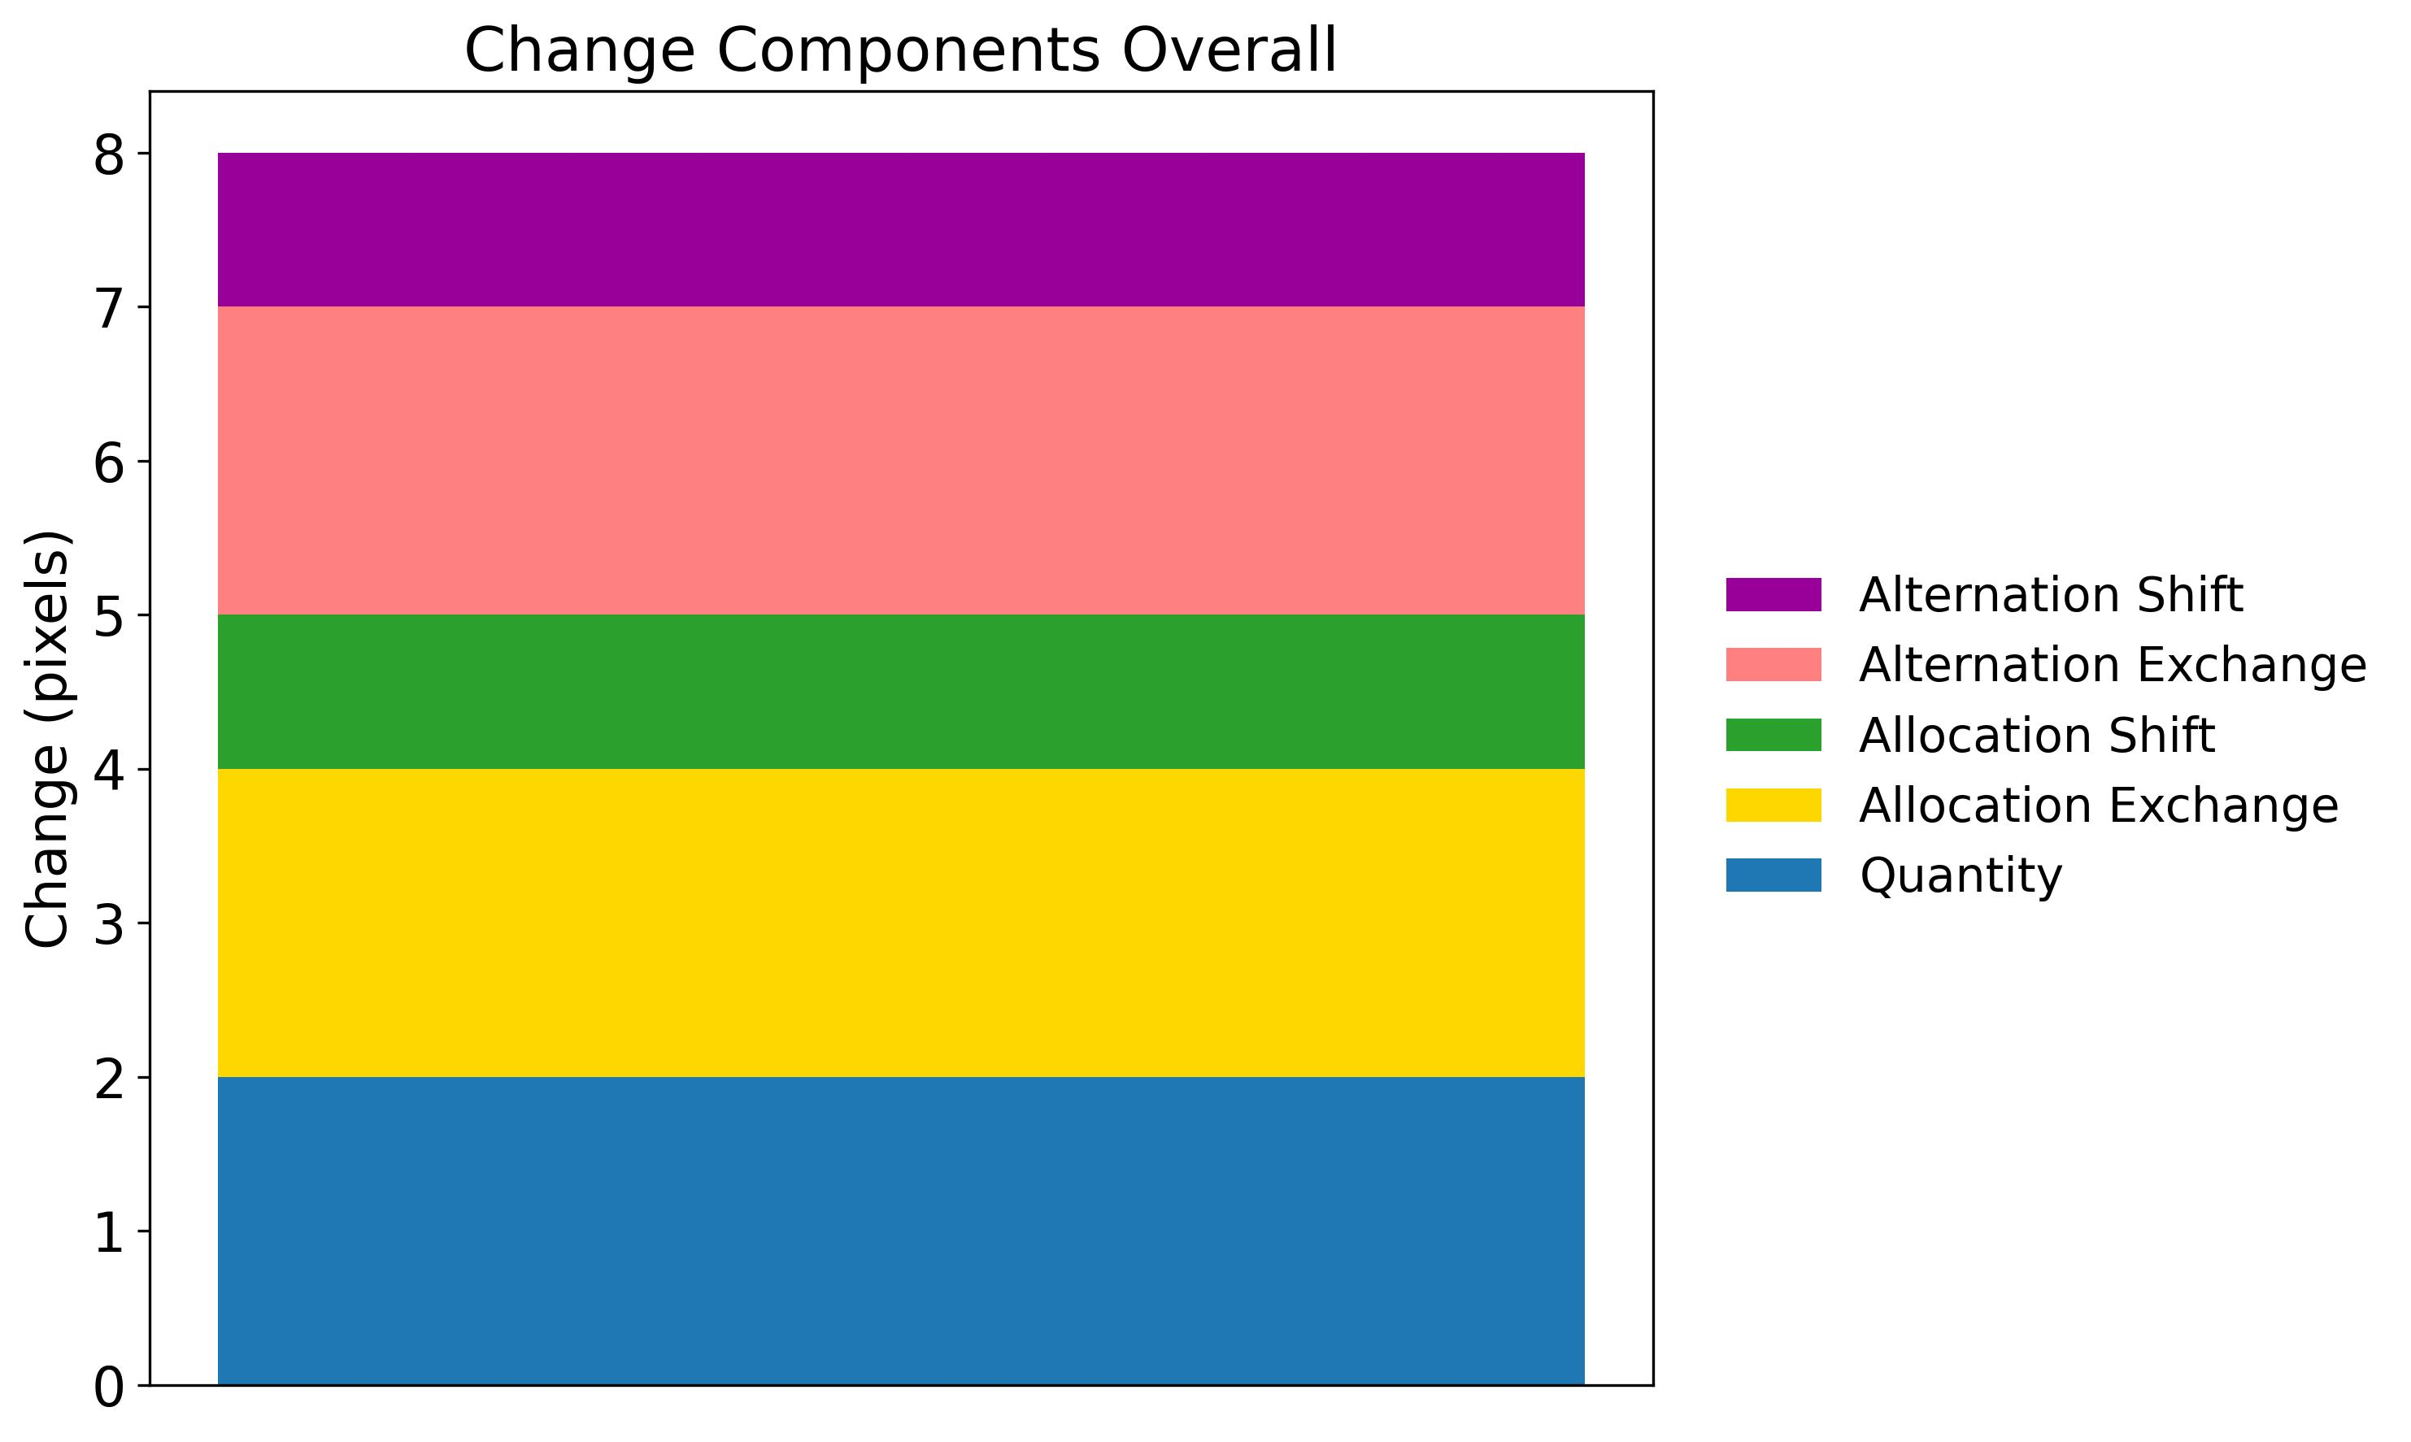
The start and end time points determine Quantity and Allocation
(a)
Pixel | t=0 | t=1 | t=2
1 | A |  | B
2 | A |  | A
3 | A |  | C
4 | A |  | B
5 | B |  | A
6 | B |  | C
(b)
 |  | To
 |  | A | B | C | Loss
From | A | 1 | 2 | 1 | 3
 | B | 1 | 0 | 1 | 2
 | C | 0 | 0 | 0 | 0
 | Gain | 1 | 2 | 2 | 5
Class A has 2 quantity loss. A exchanges with B, thus A has 1 exchange loss and 1 exchange gain.
Exchange gets the first opportunity to account for allocation difference,
then shift accounts for the remaining allocation difference.
Thus A does not shift, despite A losing to C and A gaining from B.
(c)
(d)
Change components Overall =
Sum of Gain components =
Sum of Loss components

Slide 40
Pixel 2 makes Alternation Exchange for classes A and B. Pixel 3 makes Alternation Shift for class B.
(a)
Pixel | t=0 | t=1 | t=2
2 | A | B | A
3 | A | B | C
(Pixel 2)
(Pixel 3)
 |  | To
 |  | A | B | C | Loss
From | A |  | 1 |  | 1
 | B | 1 |  |  | 1
 | C
 | Gain | 1 | 1 |  | 2
 |  | To
 |  | A | B | C | Loss
From | A |  | 1 |  | 1
 | B |  |  | 1 | 1
 | C
 | Gain |  | 1 | 1 | 2
(c)
(d)
Change components Overall =
Sum of Gain components =
Sum of Loss components

Slide 41
Main Points
Straight forward metrics can help to remedy some of the conceptual blunders in the profession.
Free software packages compute three new methods to describe change during a time series of maps.
Please contribute to the special issue of Land at https://www.mdpi.com/journal/land/special_issues/IND622A7L0
Get the software and documentation at these QR codes
Trajectory Analysis R DynamicPATCH Change Components

Slide 42
New Open Access Literature
R G Pontius Jr, T Francis, M Millones. 2025. A call to interpret disagreement components during classification assessment. International Journal of Geographical Information Science
T M Bilintoh, R G Pontius Jr, A Zhang. 2024. Methods to compare sites concerning a category’s change during various time intervals. GIScience and Remote Sensing 61(1), 2409484
T Honnef, R G Pontius Jr. 2025. Best practices for applying and interpreting the Total Operating Characteristic. ISPRS International Journal of Geo-Information 14(4), 134
T M Bilintoh, R G Pontius Jr, Z Liu. 2024. Analyzing the Losses and Gains of a Land Category: Insights from the Total Operating Characteristic. Land 13(8), 1177
C M Viana, R G Pontius Jr, J Rocha 2023. Four Fundamental Questions to Evaluate Land Change Models with an Illustration of a Cellular Automata–Markov Model. American Association of Geographers
J Strzempko, R G Pontius Jr. 2023. The Flow matrix offers a straightforward alternative to the problematic Markov matrix. Land 12(7), 1471

Slide 43
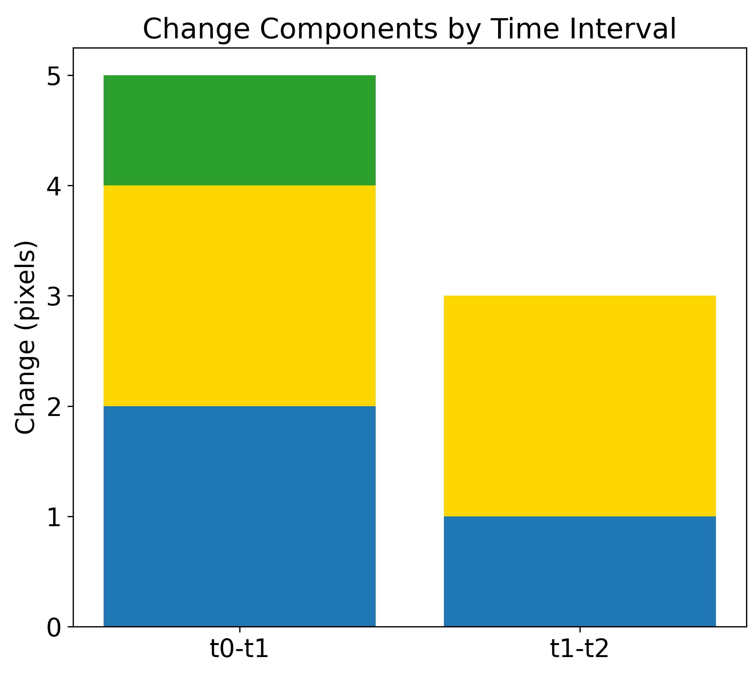
Neither time interval has transition from A to C, but the extent matrix has a transition from A to C, which makes a negative number in the alternation matrix.
(a)
Pixel | t=0 | t=1 | t=2 | Trajectory
1 | A | A | B | 3
2 | A | B | A | 2
3 | A | B | C | 4
4 | A | B | B | 3
5 | B | A | A | 3
6 | B | C | C | 3
(b)
 |  | To
 |  | A | B | C | Loss
From | A | 1+1-1=1 | 3+1-2=2 | 0+0-1=-1 | 3+1-3=1
 | B | 1+1-1=1 | 0+1-0=1 | 1+1-1=1 | 2+2-2=2
 | C | 0+0-0=0 | 0+0-0=0 | 0+1-0=1 | 0+0-0=0
 | Gain | 1+1-1=1 | 3+1-2=2 | 1+1-2=0 | 5+3-5=3
The number before the + is the first time interval.
The number after the + is the second time interval.
The number before the = is the extent time interval.
The number after the = is the alternation.
(c)
(d)
(e)

Slide 44
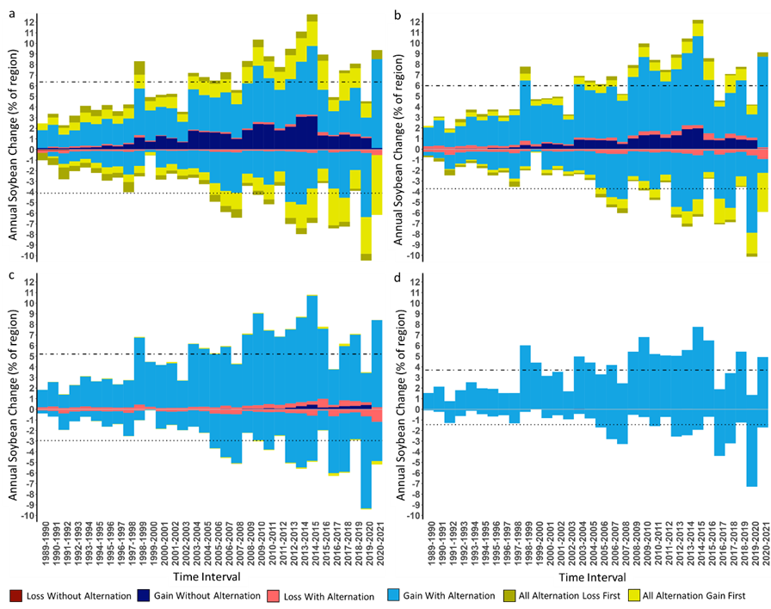
Change shrinks as spatial resolution coarsens.
Loss and Gain of soybean cultivation at spatial resolutions of a) 30 meters, b) 480 meters, c) 7,680 meters, and d) 122,880 meters.

Slide 45
DynamicPATCH:
Spatially Explicit Dynamic PAtch Transition CHaracterization
Identification of transition types
Transition Type | Change type | Number of connected patch(es)* |  |  |  | Gross change in the number of patches
 |  | Initial Presence | Final Presence | Initial Exterior Absence | Final Exterior Absence
Appearing | Gain |  | 0 |  |  | Increase
Merging | Gain | >1 |  |  |  | Decrease
Filling | Gain | 1 |  |  | 0 | No gross change
Expanding | Gain | 1 |  |  | >0 | No gross change
Disappearing | Loss | 0 |  |  |  | Decrease
Splitting | Loss |  | >1 |  |  | Increase
Perforating | Loss |  | 1 | 0 |  | No gross change
Contracting | Loss |  | 1 | >0 |  | No gross change
DynamicPATCH identifies eight patch-based transition types that are mutually exclusive and collectively exhaustive
Characterizing patch-transition types: a designed example

Slide 46
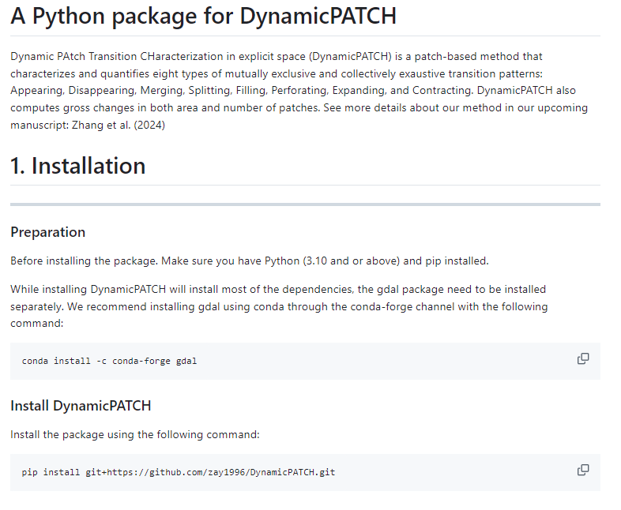
Use our free open-source Python package at
https://github.com/zay1996/DynamicPATCH.git

