Slide 1

Analysis of change and data quality in a time series of maps
This symposium explores frontiers concerning methods to analyze change and data quality in a time series of maps. Popular methods to describe change and data quality often remain an obstacle to the effective use or creation of time series datasets. Some conventions apply misleading metrics, such as reporting spatial patterns or accuracy at time points when the research question concerns change during the time intervals. Other conventions have yet to address features such as objects or patches in a time series of maps. This session focuses on methods to address existing challenges and establish future practices.
10:00-10:20 Tanner Honnef Best practices for applying and interpreting the Total Operating Characteristic
10:20-10:40 Vincenzo Cribari Discussing Changes in Historical Human–Environmental Dynamics in a Rural- Mining Region of Central Appalachians
10:40-11:00 Michaella A Ivey Woody Cover Increases Linked to Forest Infilling and Land Conversion in the Eastern United States
11:00-11:20 Aiyin Zhang Introducing DynamicPATCH: Method and Software for Spatially Explicit Dynamic Patch Transition Characterization
11:20-11:40 R Gil Pontius Jr The new method of Trajectory Analysis characterizes change in a time series of maps
11:40-Noon Discussion

Slide 2






The new method of Trajectory Analysis characterizes change in a time series of maps
Robert Gilmore Pontius Jr,
Thomas Bilintoh, Antonio Fonseca, Gustavo Oliveira, Aiyin Zhang
Dr. R Gil Pontius Jr is a Geography Professor at Clark University where he conducts research as an applied statistician and environmental scientist with expertise in GIS, ecological modeling, and land change science. He offers a workshop entitled Metrics That Make a Difference on Tuesday April 15 1:30-5:30pm
https://wordpress.clarku.edu/rpontius/
rpontius@clarku.edu
April 2025

Slide 3

Main Points
Trajectory Analysis is a method to analyze a time series of maps for a category or any non-negative continuous variable.
A free R package performs Trajectory Analysis.
R Gil Pontius Jr rpontius@clarku.edu and Thomas Bilintoh thomasbilintoh@yahoo.com invite you to contribute to a special issue of Land at https://www.mdpi.com/journal/land/special_issues/IND622A7L0
Get the R package and documentation at this QR code

Slide 4
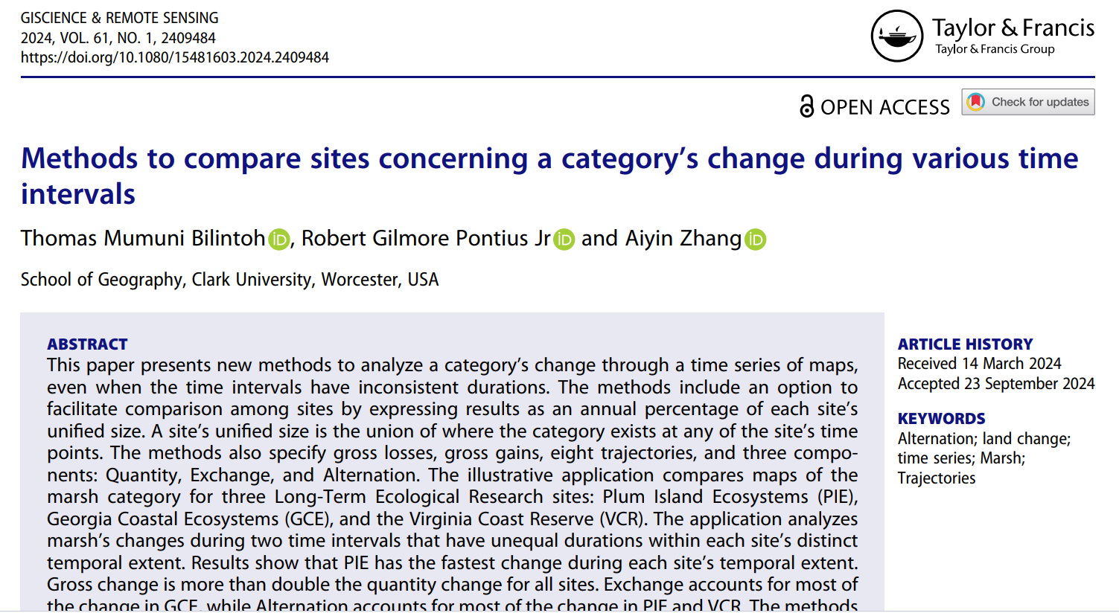
This publication is avaible for free now

Slide 5
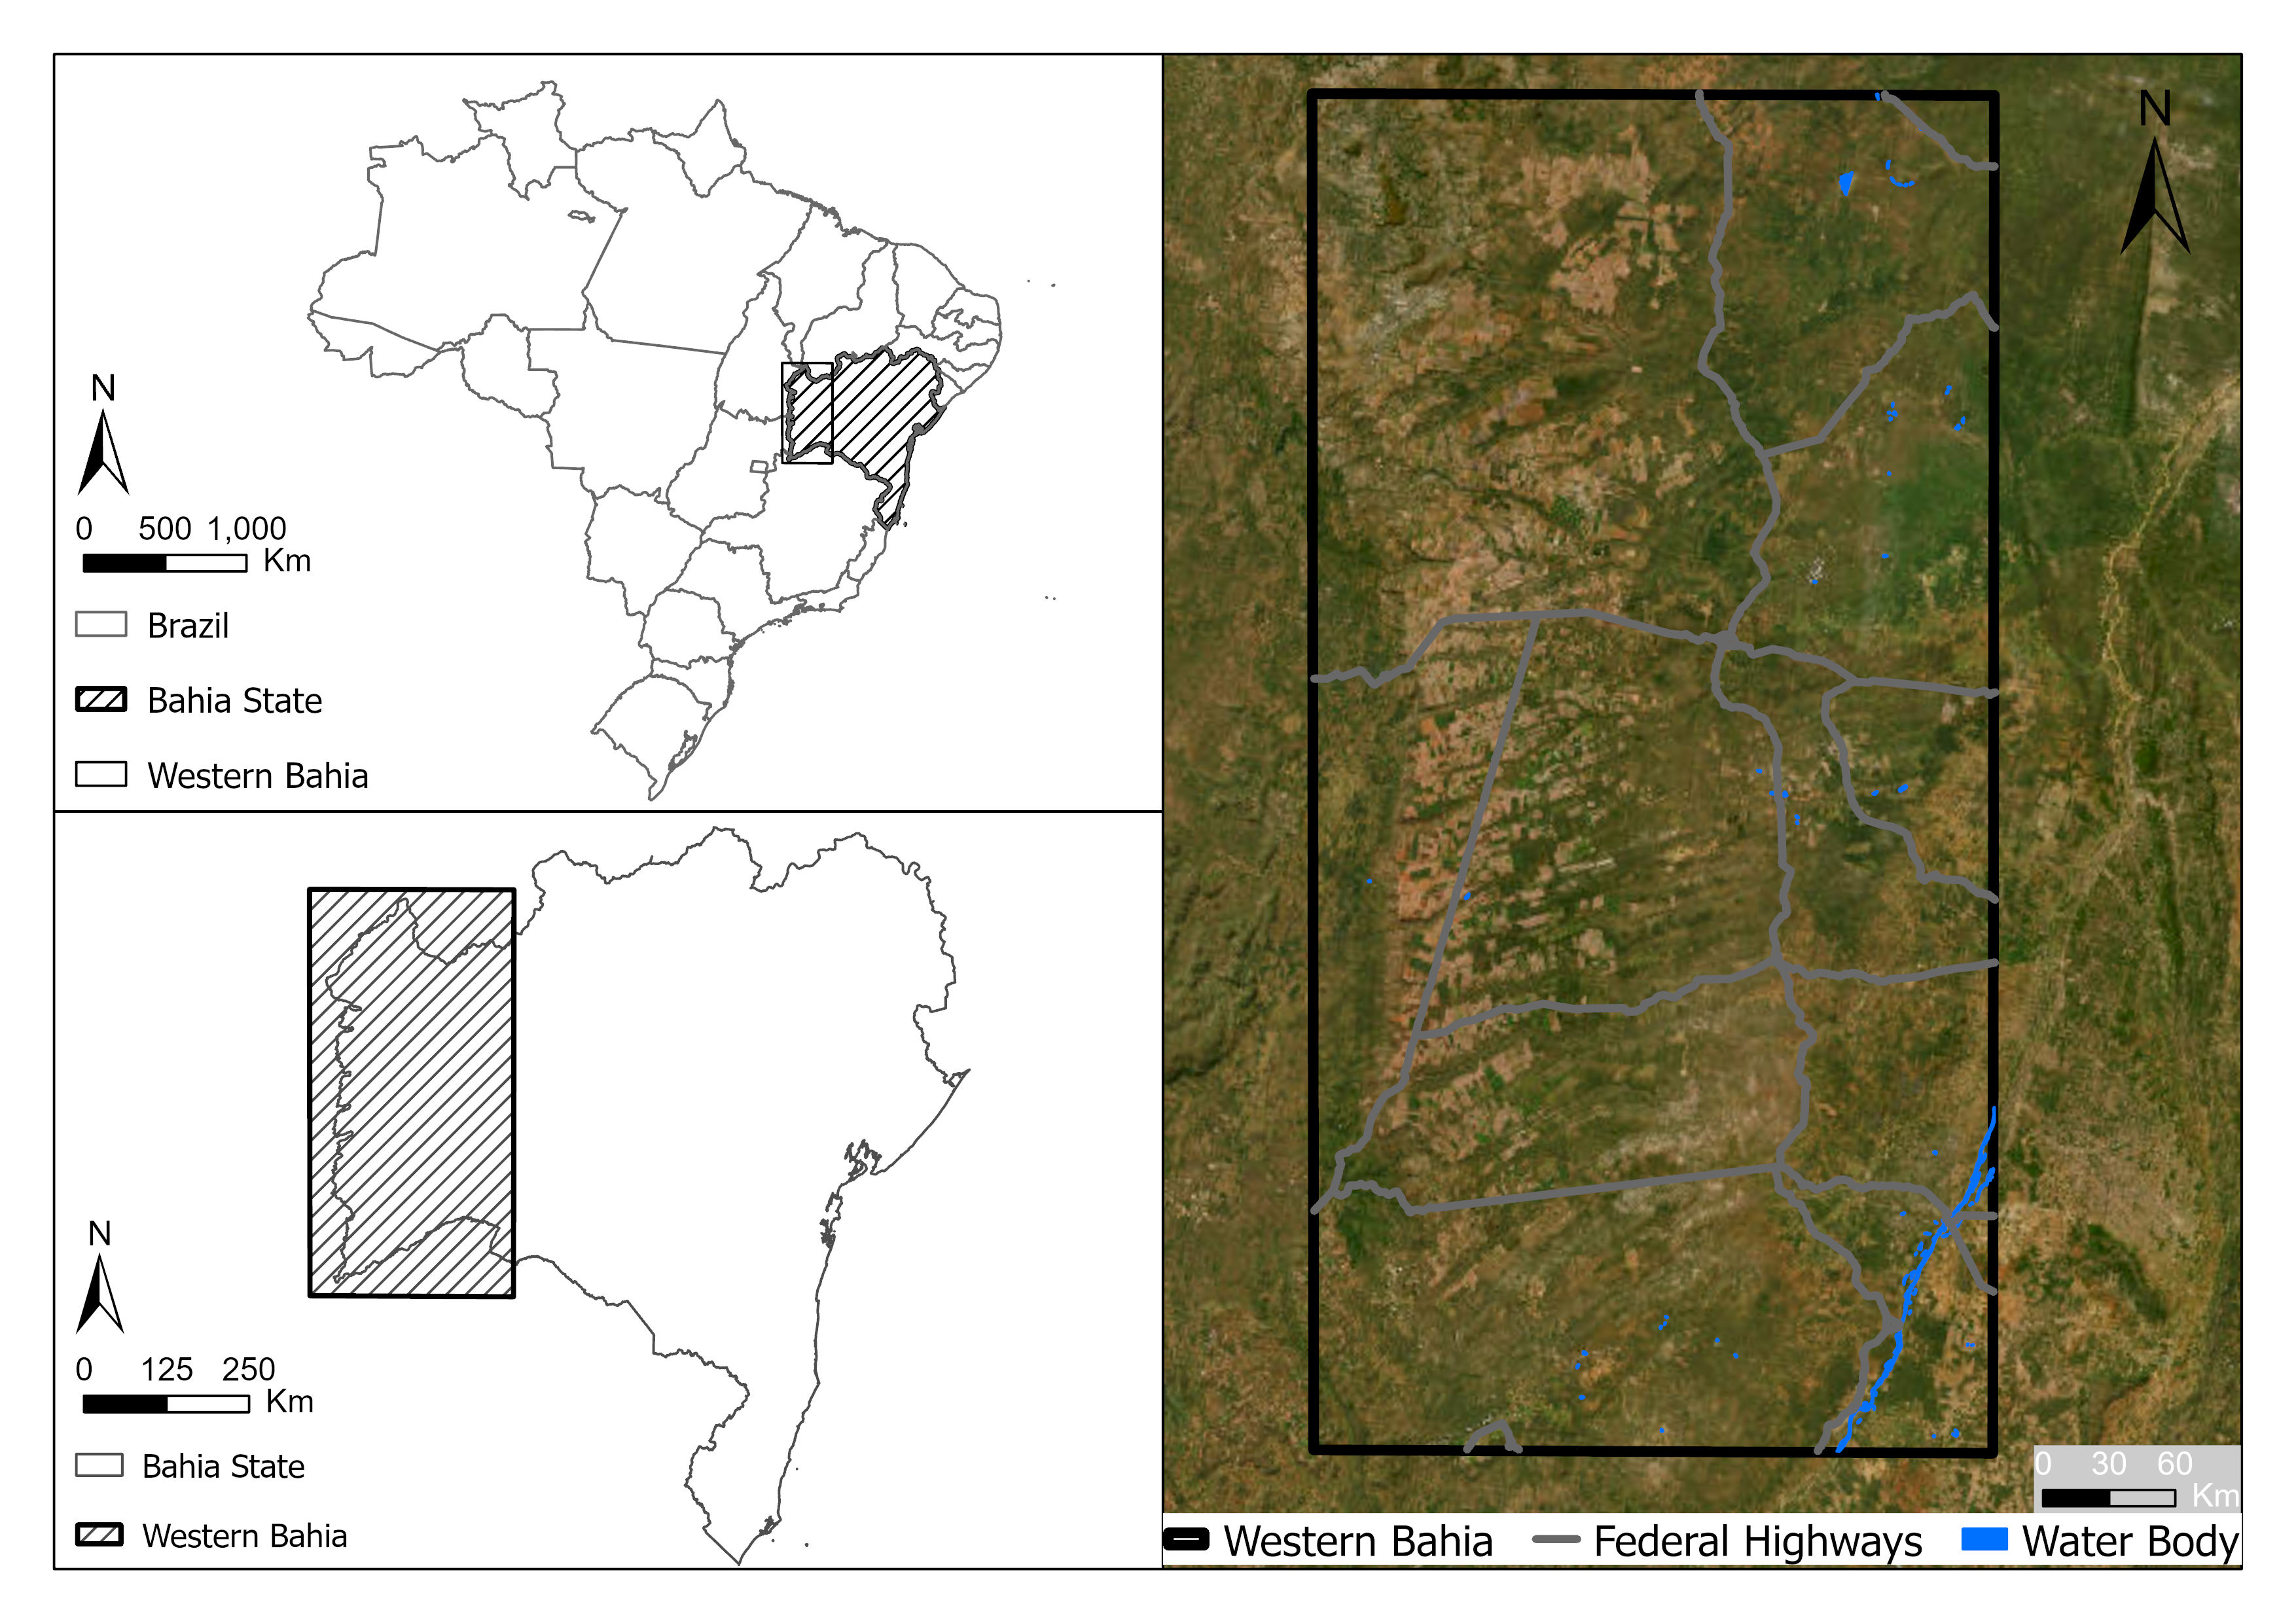

Western Bahia Brazil is a hotspot for soybean cultivation.
What patterns are in the MapBiomas time series?
Pontius Jr, Robert Gilmore, Thomas Bilintoh, Gustavo de L. T. Oliveira, Julia Z. Shimbo. 2023. Trajectories of losses and gains of soybean cultivation during multiple time intervals in western bahia, BRAZIL. Space Week Nordeste. Fortaleza, Brazil.

Slide 6
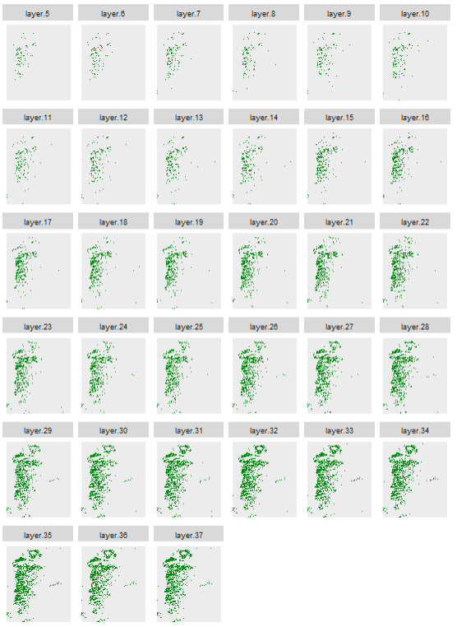
Maps show soybean at 33 years.
The extent has more than 200 million pixels.
Each pixel has more than 8 billion possible combinations of presence or absence of soybean.
We must have a method that focuses on the few broad patterns while directing attention to the places and times that have more interesting patterns.
We must design a method to see whether the data make intuitive sense.
Reference data are costly to collect.
If the data make sense, then what patterns have practical importance?
1989
1990
1991
1992
1993
1994
1995
1996
1997
1998
1999
2000
2001
2002
2003
2004
2005
2006
2007
2008
2009
2010
2011
2012
2013
2014
2015
2016
2017
2018
Presence of soybean
Absence of soybean
2019
2020
2021

Slide 7
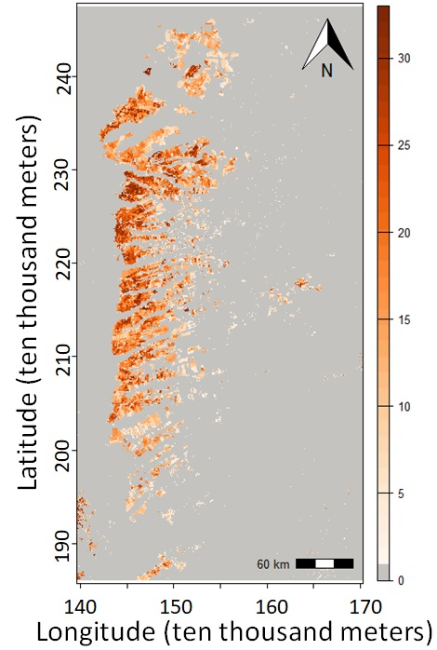
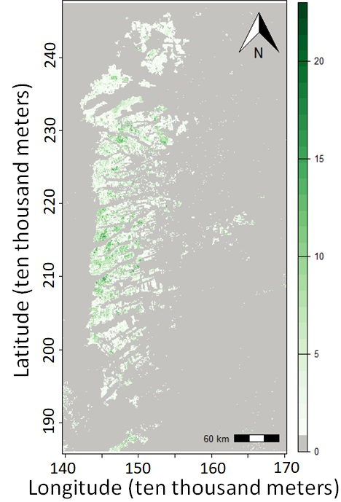
Number of years of presence is on the left and number of changes is on the right.
The unified region is the union of pixels that have at least one year of presence.

Slide 8

One map shows eight trajectories during 32 time intervals.
Get the code and documentation at the GitHub site of Thomas Bilintoh.

Slide 9
Gain is above and Loss below the time axis.

Slide 10
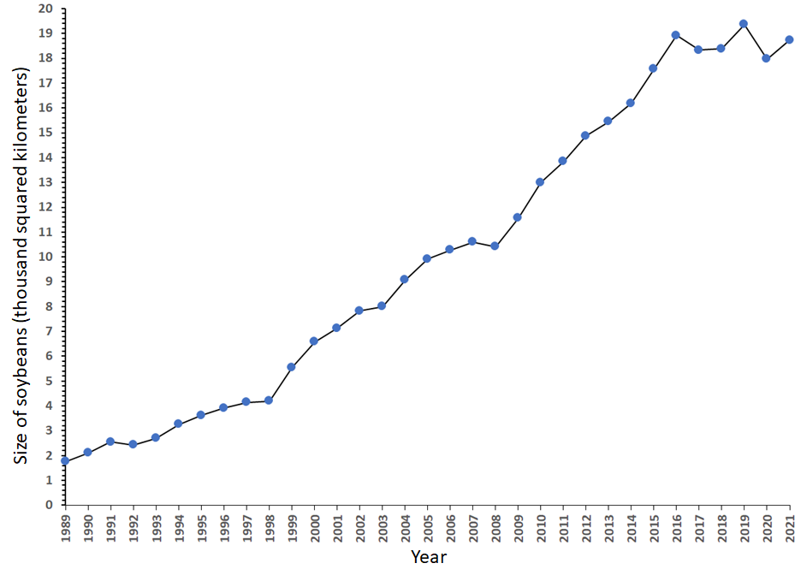
Gross Gain and Gross Loss explain the line graph.
Net change is steep during 1998-1999 because gross gain spikes.
Net change is steep during 1999-2000 because gross loss shrinks.
Area of soybeans versus time

Slide 11
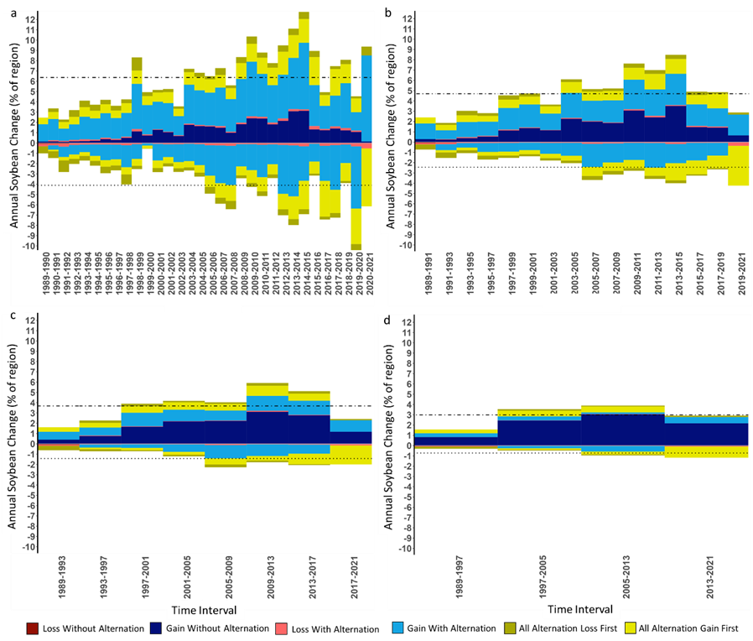
Alternation shrinks as temporal resolution coarsens.
Loss and Gain of soybean cultivation during time intervals of a) one year and b) two years, c) four years, and d) eight years.

Slide 12
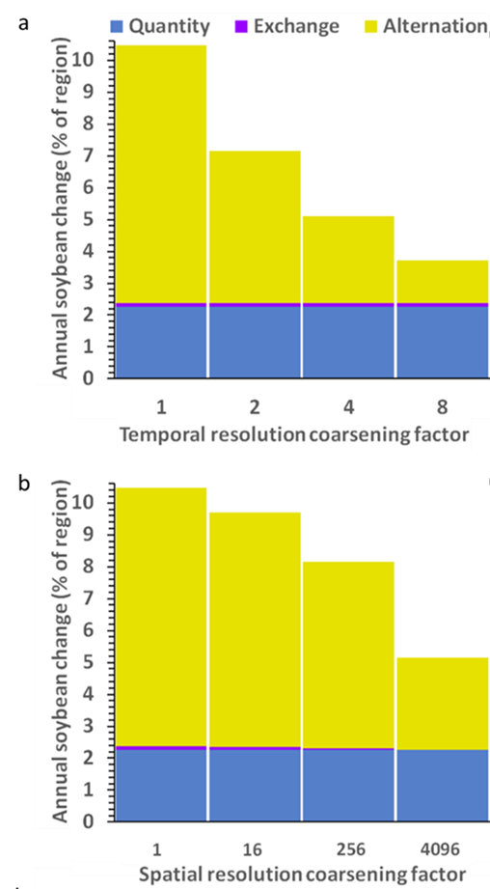
Change shrinks as temporal resolution coarsens.
Half of change is alternation within 4 years.
Bars show soybean change during time intervals of one year, two years, four years, and eight years.

Slide 13
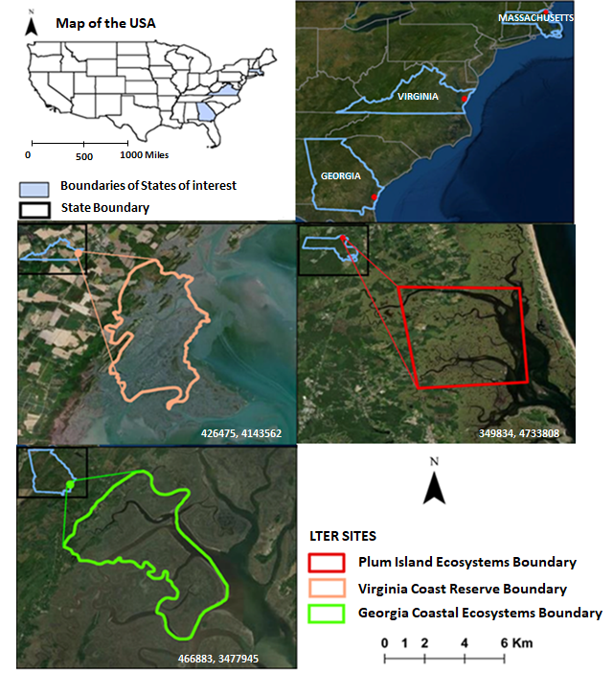
Bilintoh et al. (2024)

Slide 14
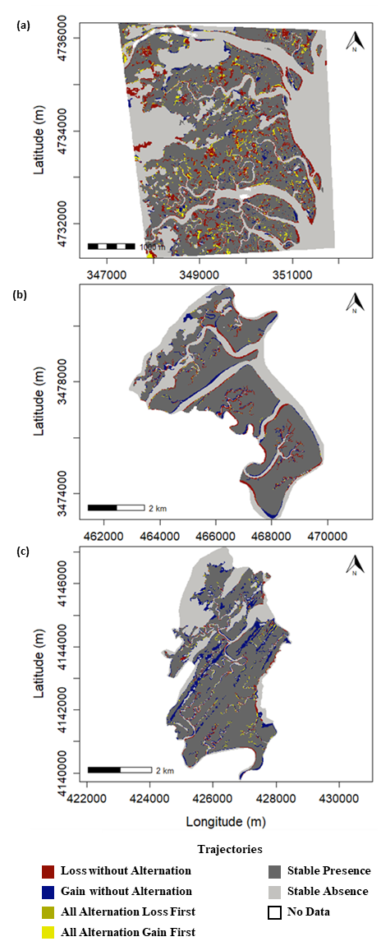
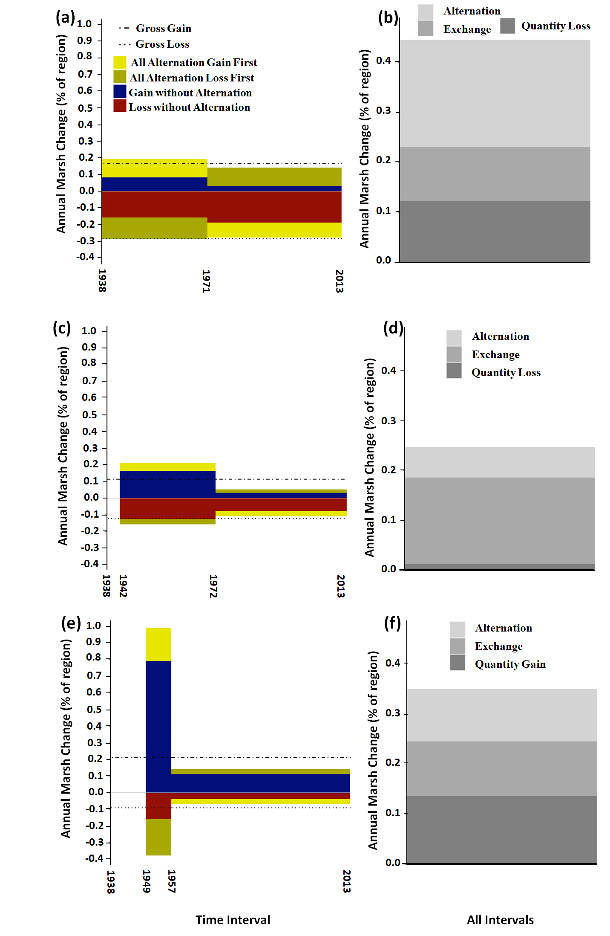
Bilintoh et al. (2024)
Plum Island Ecosystems
Georgia Coastal Ecosystems
Virginia Coast Reserve

Slide 15
Vertical axis is annual % of unified region to facilitate comparison.
Plum Island Ecosystems (PIE) Georgia Coastal Ecosystems (GCE) Virginia Coast Reserve (VCR)

Slide 16
Change is fastest in PIE where most change is alternation.
Change slowest in GCE where most change is exchange.
Plum Island Ecosystems (PIE) Georgia Coastal Ecosystems (GCE) Virginia Coast Reserve (VCR)

Slide 17
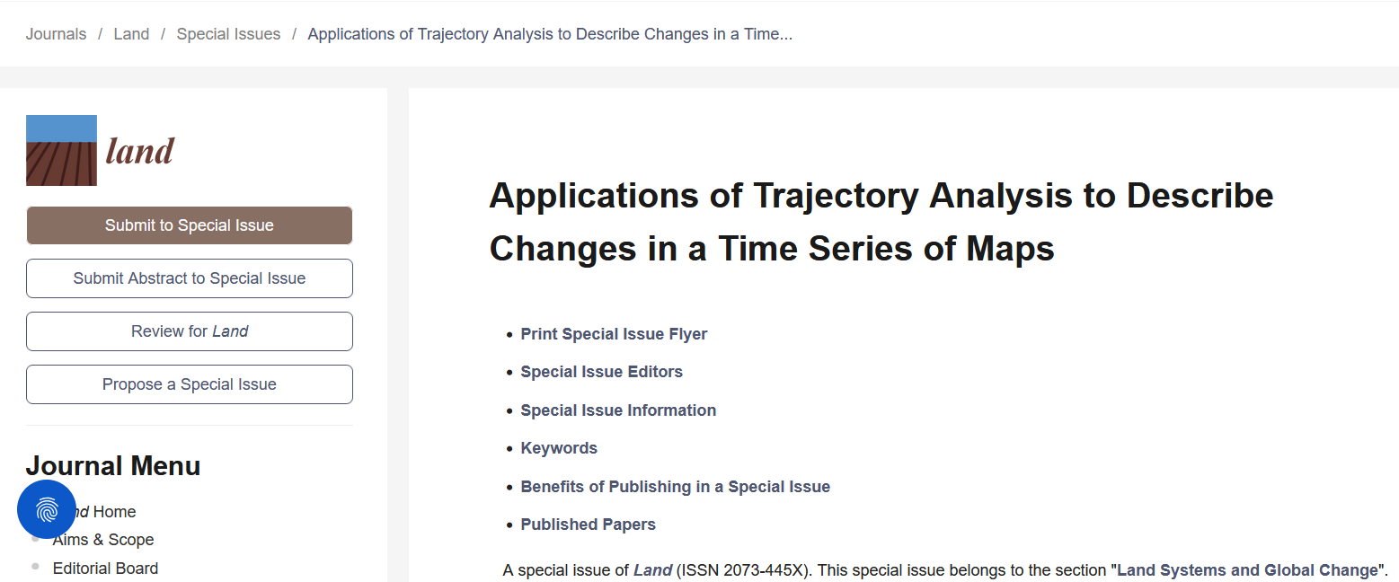
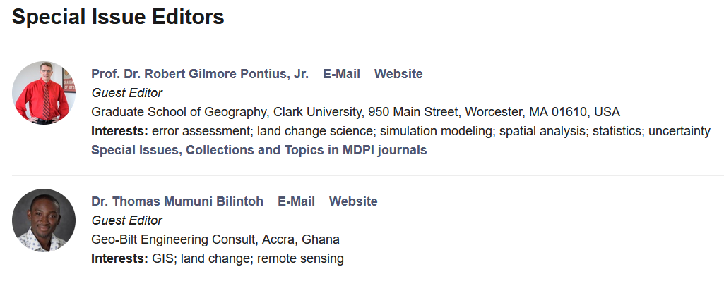
https://www.mdpi.com/journal/land/special_issues/IND622A7L0

Slide 18
New Open Access Literature
T M Bilintoh, R G Pontius Jr, A Zhang. 2024. Methods to compare sites concerning a category’s change during various time intervals. GIScience and Remote Sensing 61(1), 2409484
T Honnef, R G Pontius Jr. 2025. Best practices for applying and interpreting the Total Operating Characteristic. ISPRS International Journal of Geo-Information 14(4), 134
R G Pontius Jr, T Francis, M Millones. 2025. A call to interpret disagreement components during classification assessment. International Journal of Geographical Information Science
T M Bilintoh, R G Pontius Jr, Z Liu. 2024. Analyzing the Losses and Gains of a Land Category: Insights from the Total Operating Characteristic. Land 13(8), 1177
C M Viana, R G Pontius Jr, J Rocha 2023. Four Fundamental Questions to Evaluate Land Change Models with an Illustration of a Cellular Automata–Markov Model. American Association of Geographers
J Strzempko, R G Pontius Jr. 2023. The Flow matrix offers a straightforward alternative to the problematic Markov matrix. Land 12(7), 1471

Slide 19
To Do list at this conference
Speak with Tanner Honnef about the Total Operating Characteristic and Aiyin Zhang about DynamicPATCH.
Take Pontius’ workshop on Tuesday afternoon.
See Antonio Fonseca’s presentation this evening at the poster session.

Slide 20
Main Points
Trajectory Analysis is a method to analyze a time series of maps for a category or any non-negative continuous variable.
A free R package performs Trajectory Analysis.
R Gil Pontius Jr rpontius@clarku.edu and Thomas Bilintoh thomasbilintoh@yahoo.com invite you to contribute to a special issue of Land at https://www.mdpi.com/journal/land/special_issues/IND622A7L0
Get the R package and documentation at this QR code

Slide 21
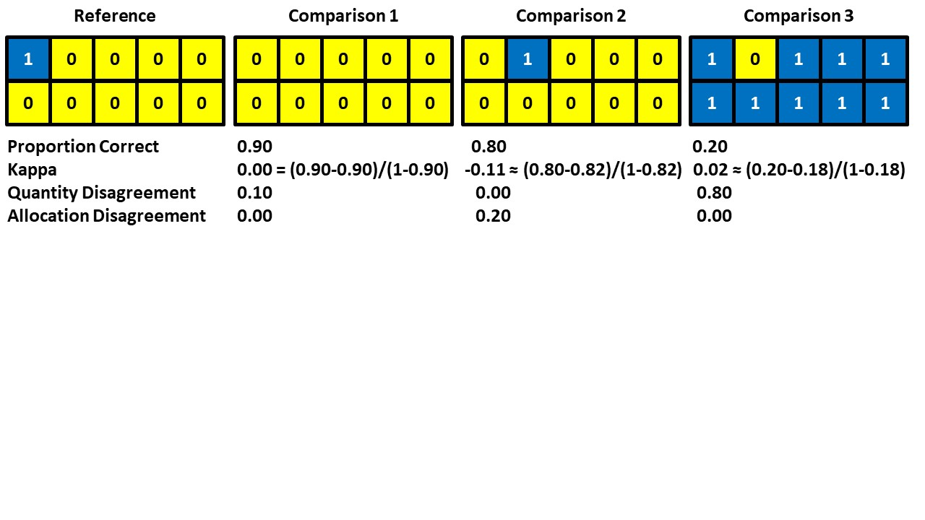
These maps portray the end time point of the validation interval.
Which Comparison map is the best agreement with the Reference map?

Slide 22
Proportion Correct and Kappa can be misleading and inappropriate.
It is more helpful to compute the reasons for the difference.

Slide 23
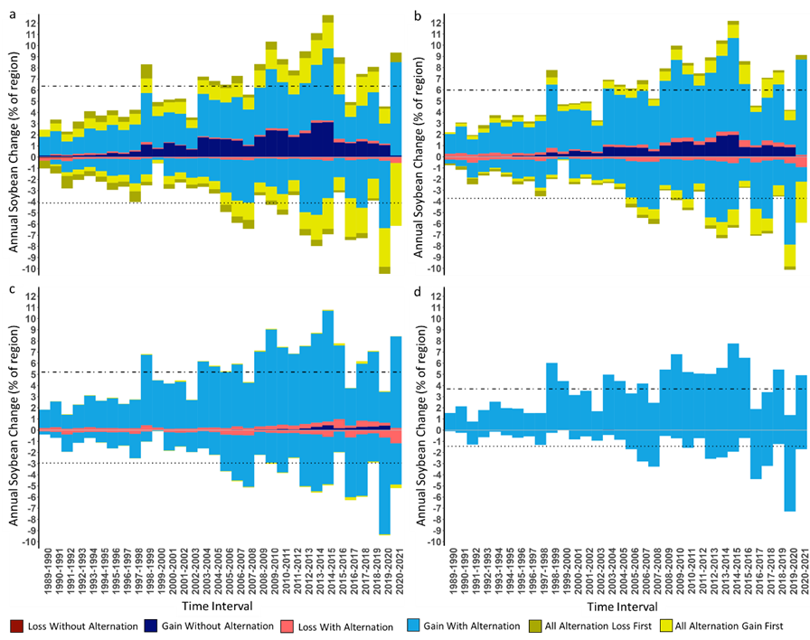
Change shrinks as spatial resolution coarsens.
Loss and Gain of soybean cultivation at spatial resolutions of a) 30 meters, b) 480 meters, c) 7,680 meters, and d) 122,880 meters.

Slide 24
Change shrinks as resolution coarsens.
(a) Half of change is alternation within 4 years.
(b) Half of change is where gross gain is within 174 kilometers of gross loss.
a) Change of soybean cultivation during time intervals of one year, two years, four years, and eight years.
b) Change of soybean cultivation at spatial resolutions of 30 meters, 480 meters, 7,680 meters, and 122,880 meters.

Slide 25
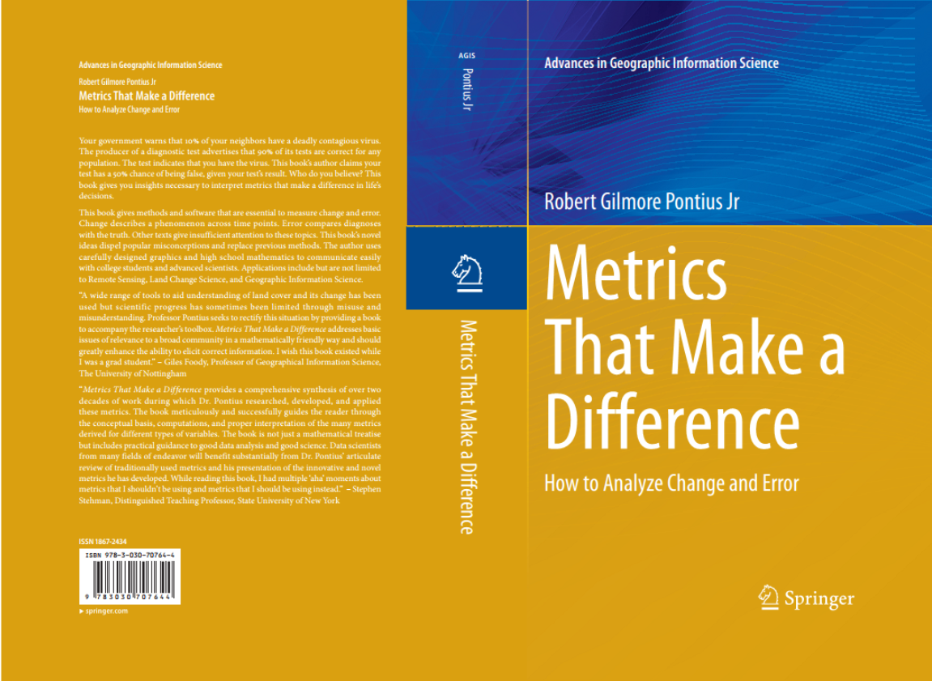
The foundational mathematical concepts are in Pontius’ book. https://link.springer.com/book/10.1007/978-3-030-70765-1
25

Slide 26




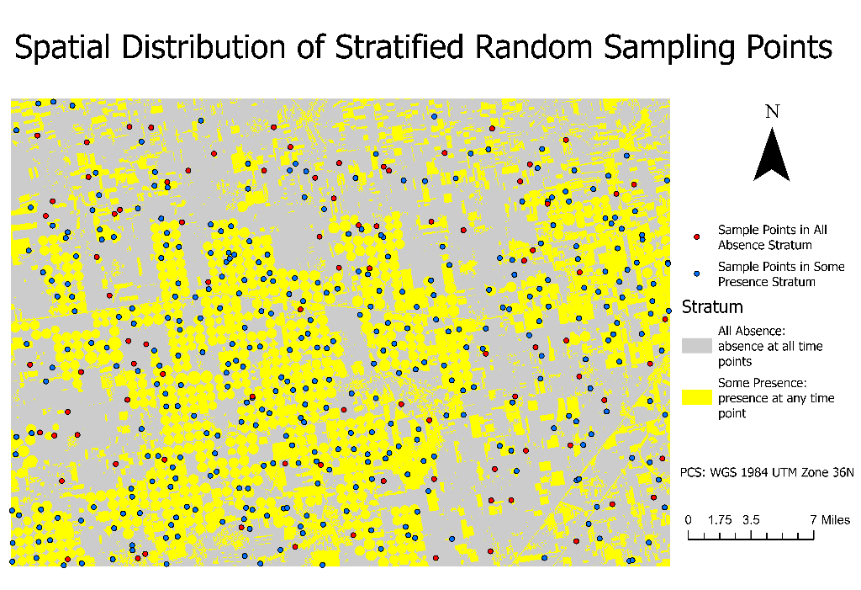
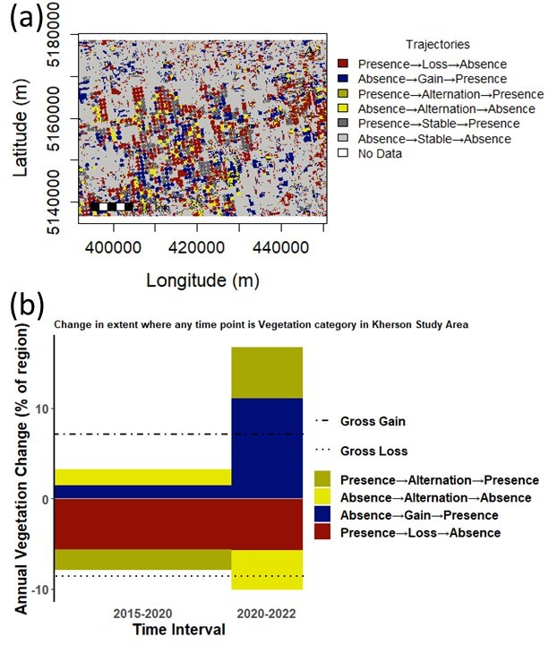
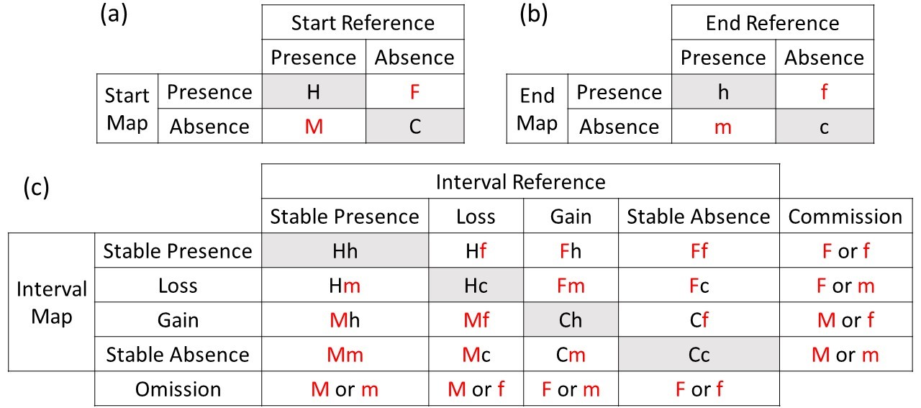


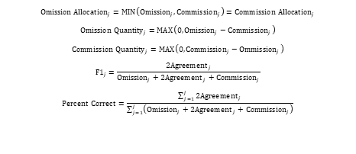
A method to measure how the quality of classifications at each of two time points influences the measurement of change during the resulting time interval
Zeyu Zhang (zeyzhang@clarku.edu)
Masters Student from Clark University’s Graduate School of Geography
Abstract
2. Stratified random sampling has greater sampling intensity in the Some Presence Stratum.
5. Stacked bar graphs show greater accuracy at individual time points in parts (a) and (b) than during time intervals in parts (c-f).
My research gives a method to describe how the quality of a classification at each of two time points influences the measurement of the change of a category during the resulting time interval. The method uses Hit, False Alarm, Miss, and Correct Rejection to describe the relationship between the reference and mapped data for a category at each time point. Hit means that the reference data and the mapped data both show presence. False Alarm means that the reference data shows absence while the mapped data shows presence. Miss means that the reference data shows presence while the mapped data shows absence. Correct Rejection means that the reference data and the mapped data both show absence. Four possibilities exist at the start time, and four possibilities exist at the end time, thus 16 combinations exist during the resulting time interval. My method shows how these 16 combinations influence the time interval’s Commission and Omission of the category’s Stable Presence, Gain, Loss, and Stable Absence. I illustrate my method with an application to vegetation in Kherson, Ukraine at 2015, 2020, and 2022.
(a) Vegetation for both strata at 2015, 2020, and 2022
(b) Vegetation for Some Presence Stratum at 2015, 2020, and 2022
b
(c) 2015-2020 for both strata
(d) 2015-2020 for Some Presence Stratum
1. Trajectories derive from the presence or absence of vegetation at 2015, 2020, and 2022. The stacked bar graph of annual vegetation change shows that change has accelerated across two time intervals where the region is the union of presence at any time point.
Figure 2 All Absence stratum receives 90 sample points. Some Presence Stratum receives 360 sample points.
3. Three conceptual contingency tables show that the pairing of the results at each time point influences the result during the time interval.
a
(e) 2020-2022 for both strata
(f) 2020-2022 for Some Presence Stratum
At the start time point, M denotes a Miss, H denotes a Hit, F denotes a False Alarm, and C denotes a Correct Rejection.
At the end time point, m denotes a Miss, h denotes a Hit, f denotes a False Alarm, and c denotes a Correct Rejection.
Figure 3 Conceptual format of three contingency tables where gray entries are agreement, and red font denotes error at time points. (a) Start time’s table. (b) End time’s table. (c) Time interval’s table where each entry is a combination of the first letter in the start time’s table and the second letter in the end time’s table. Entries in the commission column and omission row give the time point errors that are possible causes of commission and omission error, respectively during the time interval.
6. Conclusions
If the percent correct at the start is X% and at the end is Y%, then the percent correct during the interval ranges from MAXIMUM(0, X+Y-100)% to MINIMUM(X, Y)% depending on the pairing of the results at the two time points.
F1-scores are more enlightening than percent correct, especially when Absence or Stable Absence accounts for most of the percent correct.
Misses at 2020 caused an overestimation of loss during 2015-2020, an overestimation of gain during 2020-2022, and an underestimation of Stable Presence during both time intervals in the stratum that has mapped presence.
4. Equations for category j where the number of categories is J
a
b
$${Omission Allocation}_{j}=MIN\left({Omission}_{j}, {Commission}_{j}\right)={Commission Allocation}_{j}$$
$${Omission Quantity}_{j}=MAX\left(0,{Omission}_{j}−{Commission}_{j}\right)$$
$${Commission Quantity}_{j}=MAX\left(0,{Commission}_{j}−{Ommission}_{j}\right)$$
$${F1}_{j}=\frac{2{Agreement}_{j}}{{Omission}_{j}+2{Agreement}_{j}+{Commission}_{j}}$$
$$Percent Correct=\frac{\sum_{j=1}^{J}{{2Agreement}_{j}}}{\sum_{j=1}^{J}{\left({Omission}_{j}+{2Agreement}_{j}+{Commission}_{j}\right)}}$$
Acknowledgements
The United States National Science Foundation’s Division of Environmental Biology supported this work via grant OCE-1637630 for the Plum Island Ecosystems Long Term Ecological Research site. The Edna Bailey Sussman Trust supplied additional funding. Thomas Bilintoh’s R package binaryTimeSeries computed trajectory analysis. Ryan Shumeyko, Ken Baird, Rob Kearney, Annabel Krugman, Tommy McCarthy, Ben Hollerbach, Ryan Mickelson, Ravi Thapaliya, André de Oliveira Domingues performed visual assessment. Clark Labs facilitated this work by creating the GIS software TerrSet®.
Figure 1 (a) Map of vegetation trajectories (b) Stacked bar graph of annual vegetation change
26

