Slide 1
Newton Building Energy Disclosure and Reporting Ordinance (BERDO)
Zoning and Planning Committee Hearing
September 23, 2024
Philip Eash-Gates, PE CEM

Slide 2
Agenda: Questions from Prior Hearings
Context
Reporting Energy Data
How challenging is it to use Energy Star Portfolio Manager?
Can building owners obtain tenant energy data?
Impacts of BERDO on Newton
Will Newton require quick decarbonization like Boston and Cambridge?
When will owners need to reduce emissions?
Has reporting been challenging in Boston? How will Newton be different?
What will BERDO cost taxpayers?
Technical Assistance and Support
What resources are available to help building owners comply?
What financial resources are available?
How will BERDO affect energy costs? Is decarbonization affordable?
How will BERDO affect property values and Newton’s tax base?
Do case studies show that decarbonization is achievable?
Feasibility and Cost of Complying
Case Studies
Does the City have adequate staffing?

Slide 3
Context

Slide 4
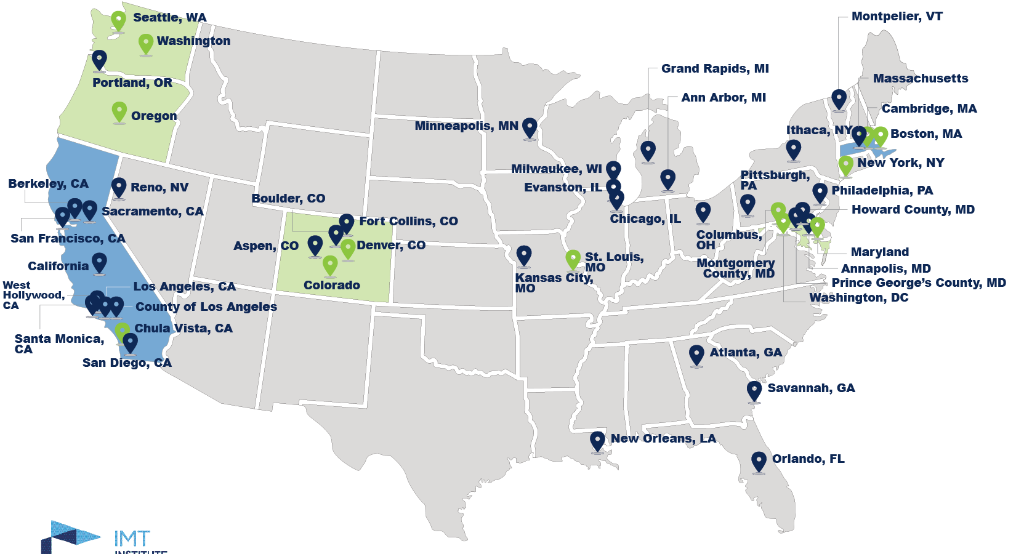
Building Performance Standards
Leading policy tool available to local government for building decarbonization
Large impact, few regulated buildings, resilient to legal challenge
17 jurisdictions have adopted performance standards
35+ more have committed to adoption by 2026
Status of building performance standards in the United States
Sources: IMT, National BPS Coalition

Slide 5
Massachusetts Context
Supportive environment for local decarbonization policies
Tapestry of supply- and demand-side initiatives
Renewable Portfolio Standard and Clean Energy Standard
Proposed Clean Heat Standard
Mass Save program for energy efficiency and electrification
Federally funded programs through Inflation Reduction Act
Net zero emissions in 2050 required under Global Warming Solutions Act (GWSA) and Clean Energy and Climate Plan (CECP)
Newton BERDO efforts toward decarbonizing offers benefits:
Hedges against uncertainty in state planning to meet GWSA requirements
Phased decarbonization avoids early replacement, lowering costs
Reduces exposure to rising gas rates under state policy

Slide 6
Feasibility and Cost of Complying

Slide 7
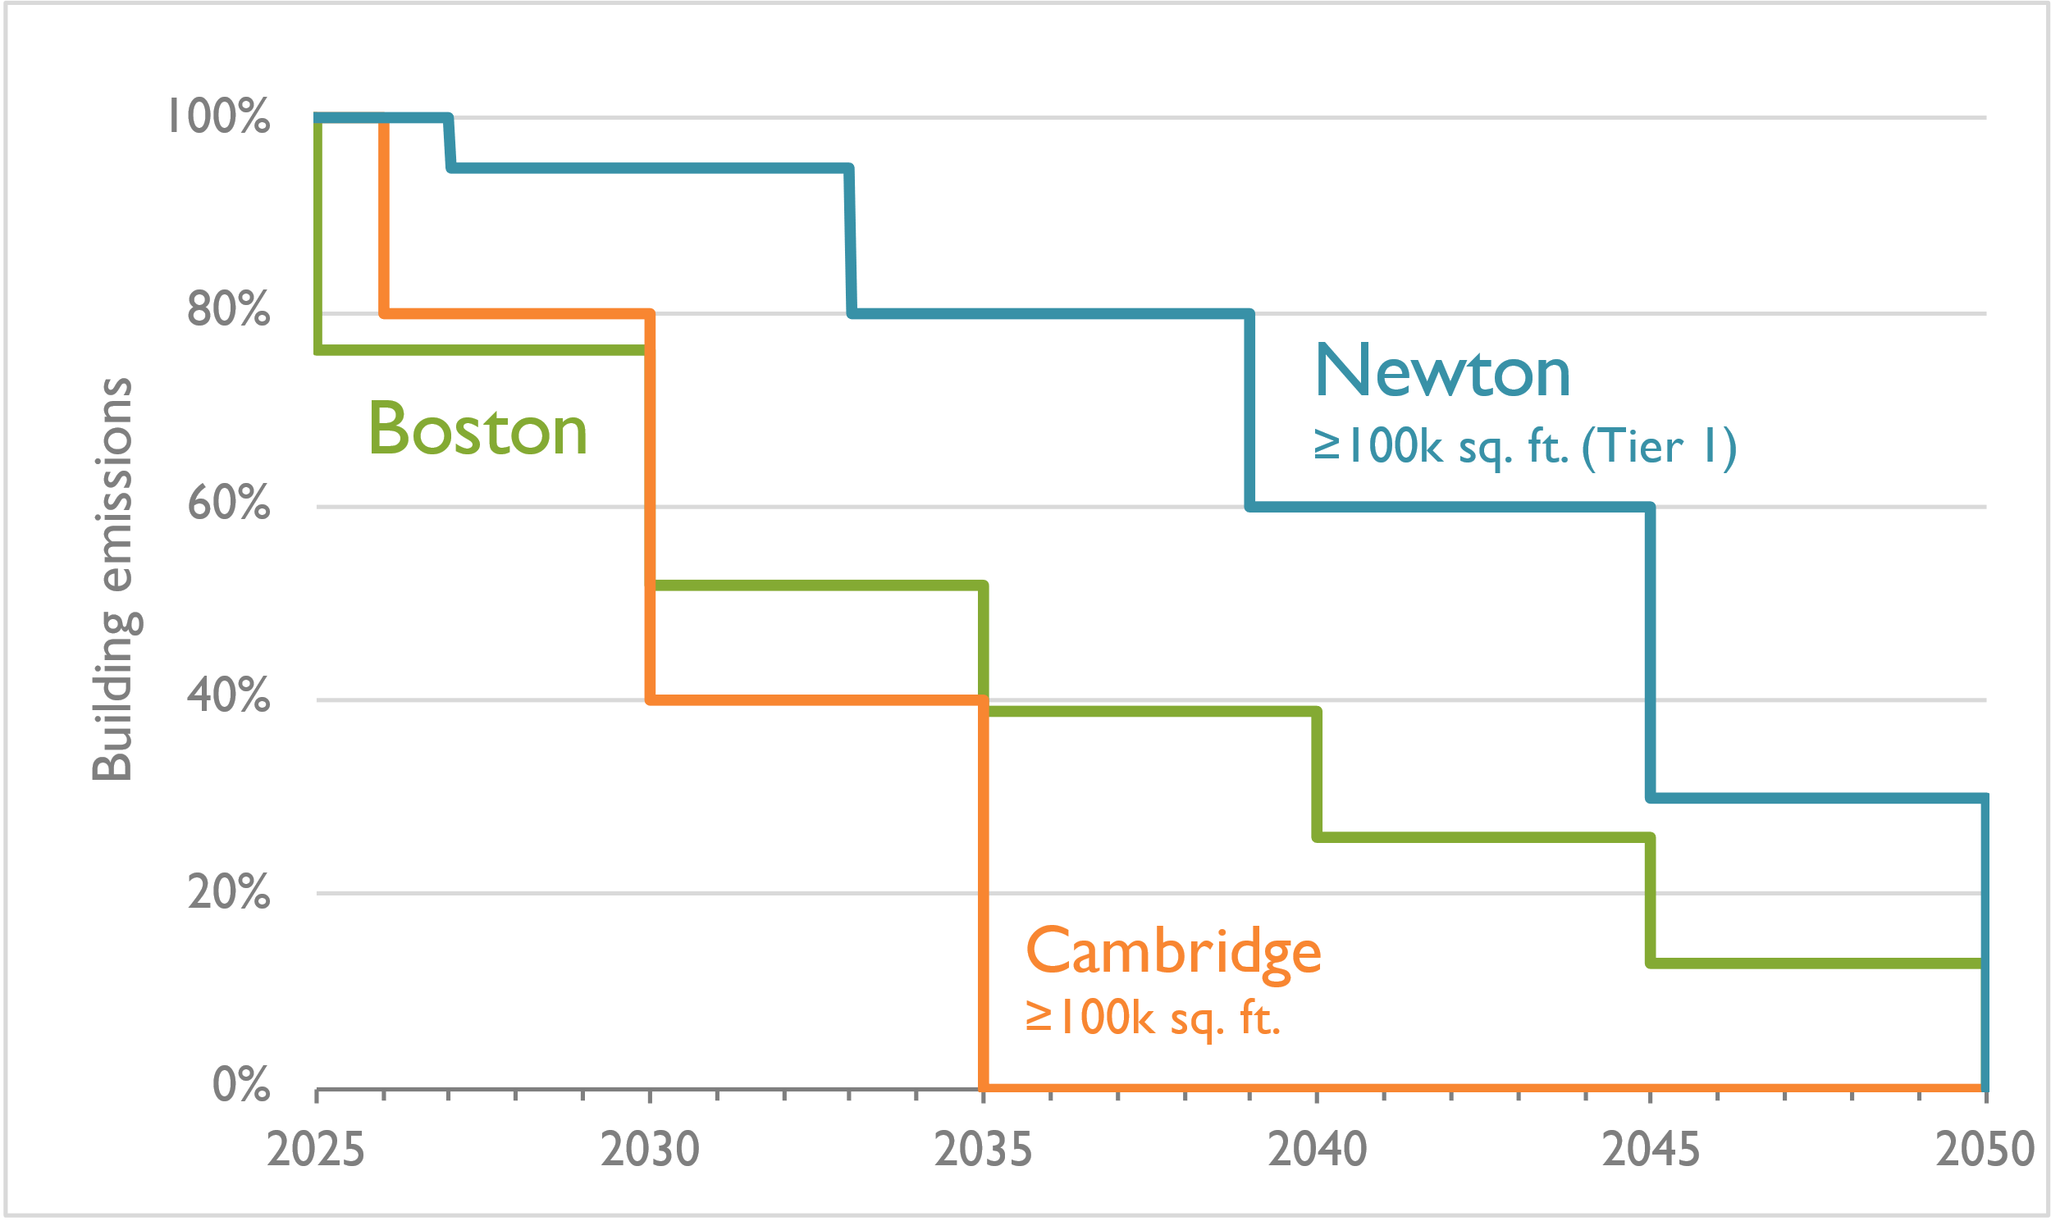
Pace of Decarbonization
Will Newton require quick decarbonization like Boston and Cambridge?
Newton standards are aligned to capital planning cycles
Reductions are comparatively later, less frequent, and more gradual
Building performance standard emission limits in Massachusetts
Notes:
Boston and Cambridge include electricity emissions
Cambridge allows carbon offsets for buildings ≥100,000 sq. ft.
Newton and Cambridge have slower pace for buildings <100,000 sq. ft.

Slide 8
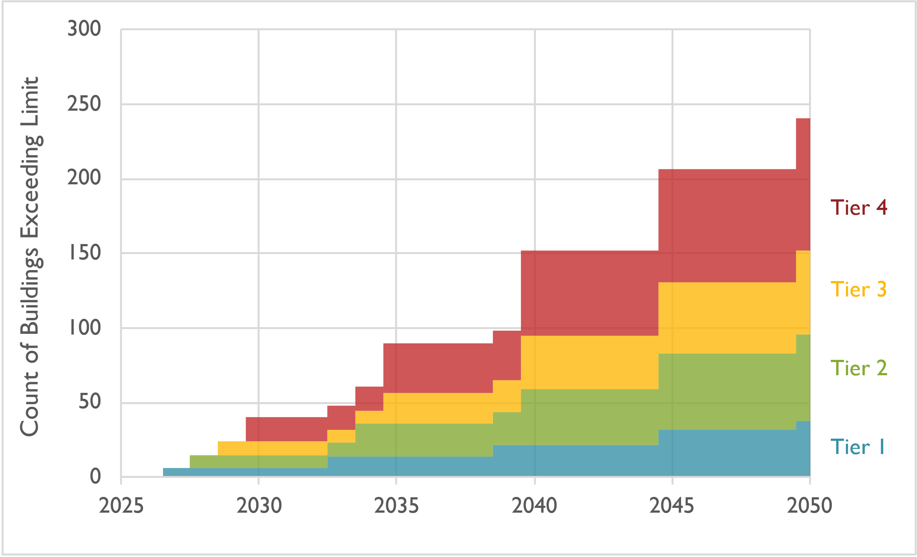
Pace of Decarbonization
When will owners need to reduce emissions?
About 10 buildings impacted each year; 40 buildings by 2030
Most buildings (67%) will comply until 2040
All public and non-profit affordable housing buildings (nine total) comply until 2040
Count of buildings over BERDO limits (in absence of upgrades)
Notes:
Assumes Newton buildings have similar performance as Boston buildings of same type
Does not total to 293 buildings because all-electric buildings will not need to make changes.

Slide 9
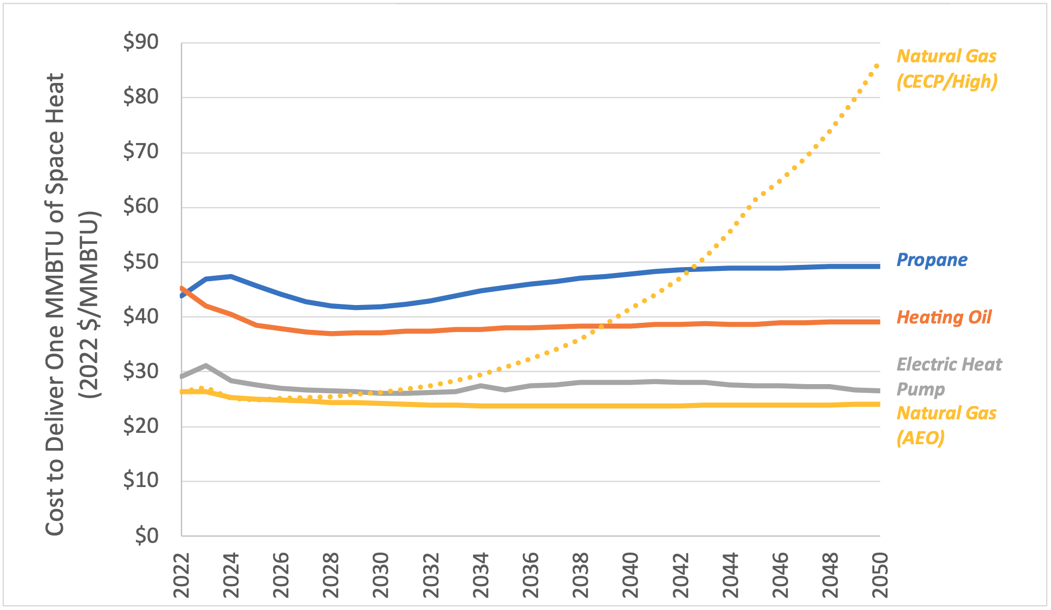
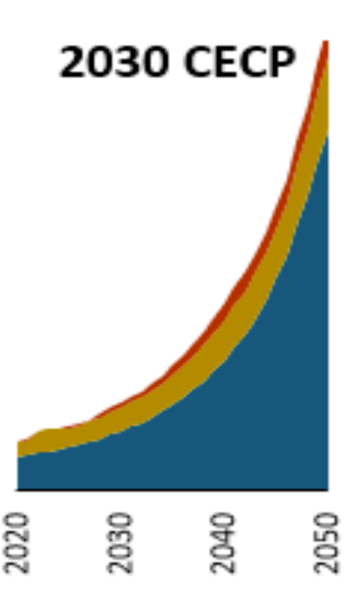
Cost of Complying: Energy
How will BERDO affect energy costs?
Studies for MA DEP and MA DPU forecast heat pumps to be less expensive to operate than gas heating by 2030 under CECP
Gas heating costs are expected to rise to 300%–700% of current costs by 2050
BERDO reduces exposure to rising gas rates
Massachusetts space heating cost forecast
Massachusetts natural gas cost forecast
Sources: Sustainable Energy Advantage and Synapse Energy Economics for MA DEP, 2023 (Link)
Energy+Environmental Economics and Scott Madden Management Consultants for MA DPU, 2022. (Link)

Slide 10
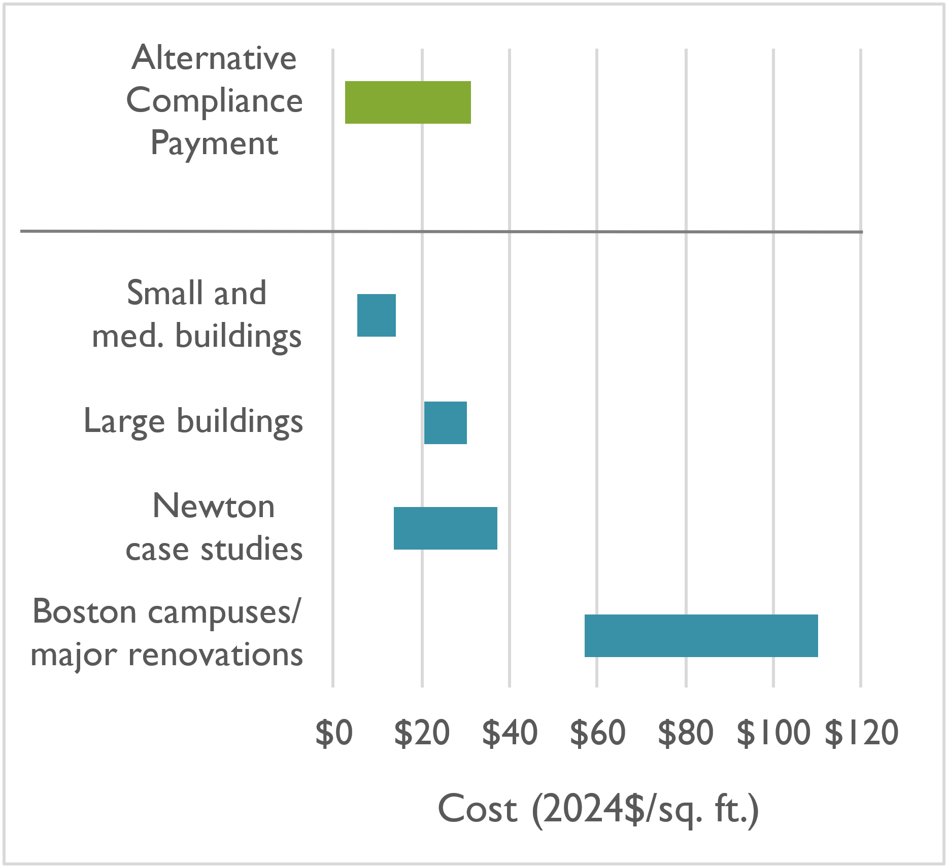
Cost of Complying: Capital Costs
Is decarbonization affordable?
Synapse and BERDO Team evaluated completed projects, published literature, contractor quotes, and interviews with industry professionals
Costs vary by building type and size
Typical costs:
One-time: $5–35 per sq. ft. before incentives
Amortized: $0.40–$3.00 per sq. ft. annual (at 6% over 20-year equipment life)
Building upgrade costs before incentives
Sources: Jones, B. 2021, Synapse 2024, City of Newton 2024, City of Boston 2024, Synapse 2024, various contractors

Slide 11
Cost of Complying: Capital Costs
Is decarbonization affordable?
Amortized: $0.40–$3.00 per sq. ft. annual
Compared to annual operating costs:
Commercial rent for offices in Newton: $42 per sq. ft. (+4% costs)
Multifamily rent in Newton: $2,810 per unit (+4% costs)
Incentives will reduce net costs
Sources: National Association of Realtors 2024

Slide 13
Cost of Complying: Capital Costs
Is decarbonization affordable?
Amortized: $0.40–$3.00 per sq. ft. annual
Compared to annual operating costs:
Commercial rent for offices in Newton: $42 per sq. ft. (+4% costs)
Multifamily rent in Newton: $2,810 per unit (+4% costs)
Incentives will reduce net costs
Sources: National Association of Realtors 2024

Slide 14
Cost of Complying: Financial Support
What financial resources are available?
Mass Save commercial incentives: $9.00–$15.00 per sq. ft.
Heat pumps: $2,500–$4,500 per ton
Heat pump water heaters: $1,000–$2,200 per unit
Deep energy retrofits: $1 per sq. ft.
179D Federal tax deduction for commercial retrofits: $0.50–$6.00 per sq. ft
Sliding scale for achieving 25–50% energy savings: $0.50–$1.00 per sq. ft.
Plus $2.50–$5.00 per sq. ft. for meeting prevailing wage and apprenticeship requirement
Capped at price of retrofit
Combined incentives up to $20+ per sq. ft.
Low- and no-interest loans

Slide 15
Cost of Complying: Financial Support
What financial resources are available?
Low- and no-interest financing for energy upgrades
Property Assessed Clean Energy (PACE):
Low-interest loans to commercial and multifamily owners
Repaid through property taxes with terms up to 20 years
Available through MassDevelopment and DOER
Can reduce tax liability
Massachusetts Community Climate Bank:
Loans for affordable housing
$70 million to date in seed funding
Available through MassHousing
Eversource and National Grid:
0%–2% interest loans up to $500,000
Terms up to 7 years
Incentives used to buy down interest rate
Combined incentives up to $20+ per sq. ft.
Low- and no-interest loans

Slide 16
Case Studies

Slide 17
Local Case Studies
Buildings in Newton
181 Lexington Apartments Planning phase
Newton Early Childhood Program Complete
Auburndale Library Complete
First Unitarian Universalist Society in Newton Multiple phases complete
Chapman Construction and Design office Phase 1 complete
Project costs
Before incentives: $14 to $37 per sq. ft.
After incentives: $10 to $32 per sq. ft.
Incremental cost vs. fossil fuel equipment: –$4 to +$5 per sq. ft.
Energy savings
Energy use: 53% to 76% MMBtu savings
Cost: 41% cost decrease to 18% cost increase (due to rate increases; gas prices will increase)

Slide 18
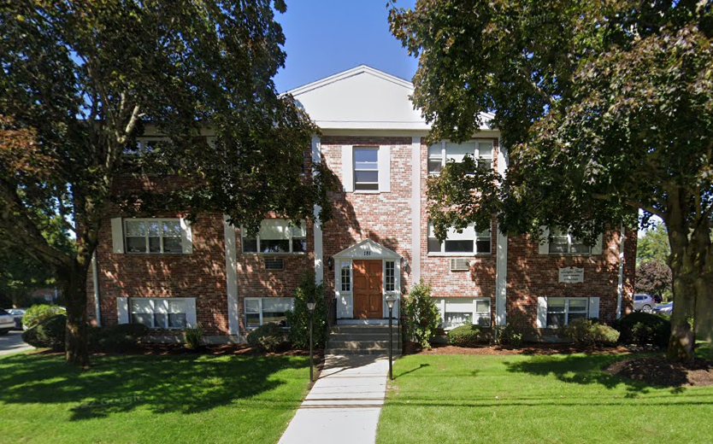
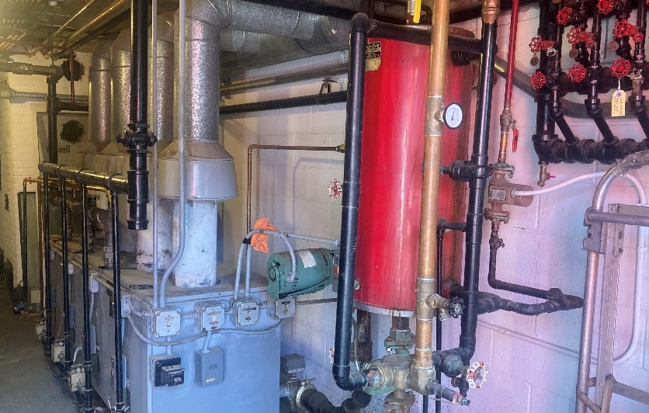
181 Lexington Street
Location: Newton, MA
Sector: Multifamily
Project size: 24,570 sq. ft. (30 units)
Emission intensity: 3.1 kgCO2e per sq. ft.
Complies with BERDO until 2035
Project scope for full decarbonization:
Replace gas boilers with central heat pump for space heat and domestic hot water
Electrical service upgrade
Project cost:
Total: $660,000
Incremental: $330,000 ($11,000 per unit)
Monthly per-unit cost: $80, +3% rent (financed at 6% interest, 20 year)
181 Lexington Street with boiler room

Slide 19
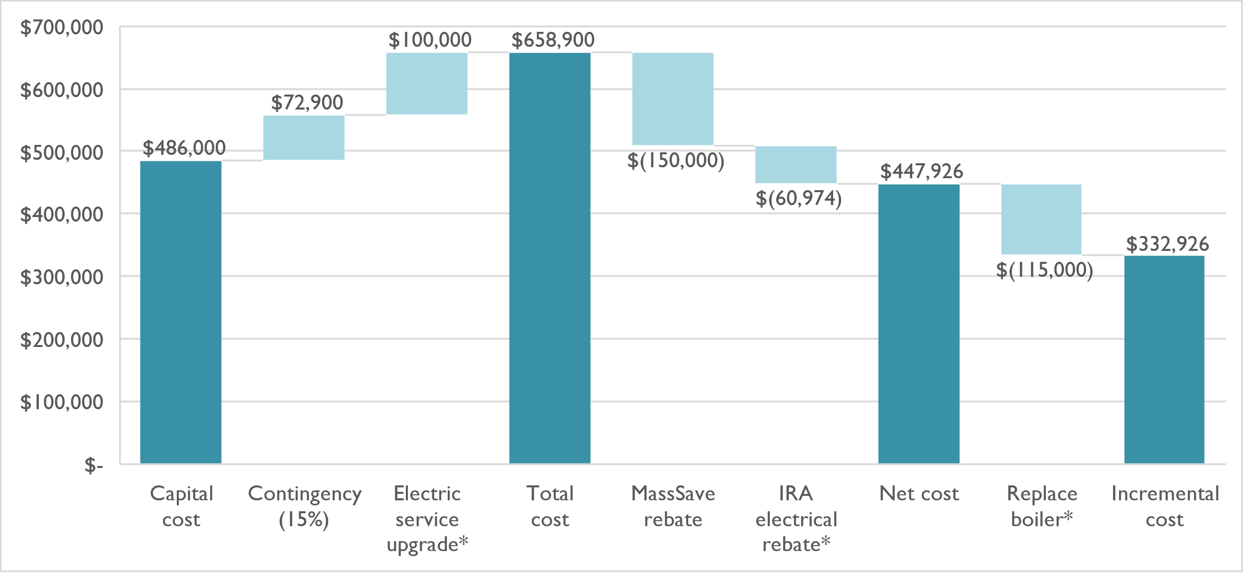
181 Lexington Street
Project Cost Detail
Incentives expected to reduce project costs by 32%
Firm contractor quotation and evaluation from Mass Save
Estimated costs: electric service upgrade, IRA rebate, boiler cost

Slide 20
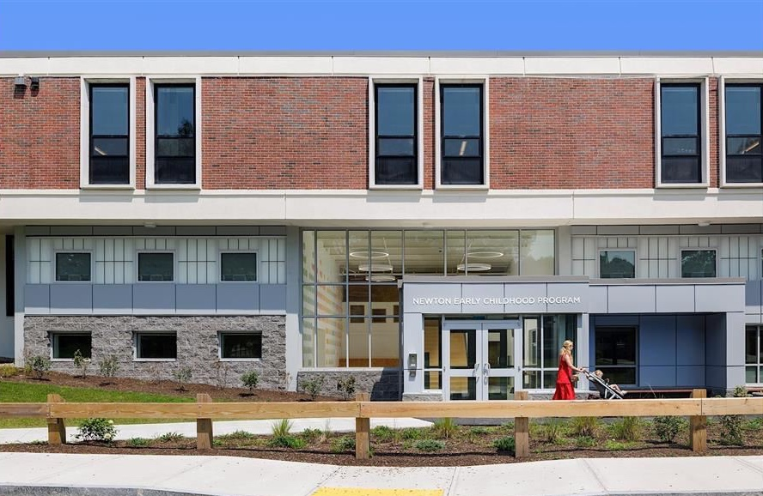
Newton Early Childhood Program
Location: Newton, MA
Sector: Education
Project size: 42,000 sq. ft.
Project cost: $1.5 million
Project completed FY2022
Fully decarbonized, zero direct emissions
Replace central boilers with all-electric VRF heat pump (lowest lifecycle cost option)
New roof with continuous insulation
Project cost
Total: $1,570,000 ($37 per sq. ft.)
Incremental: –$655,000 Compared to $2.2 million boiler and heating distribution replacement
NECP with retrofit scenario costs
HVAC System Type | Capital Cost | Annual Electric Costs | Annual Gas Costs | Annual Maint. Costs | Total Annual Costs
Standard efficiency gas boilers | $2,005,000 (estimate) | $46,379 | $26,731 | $15,875 | $88,985
High efficiency gas boiler | $2,225,000 (estimate) | $36,293 | $18,867 | $20,250 | $75,410
All-electric VRF heat pumps | $1,570,000 (actual) | $42,924 | $0 | $23,300 | $66,225

Slide 21
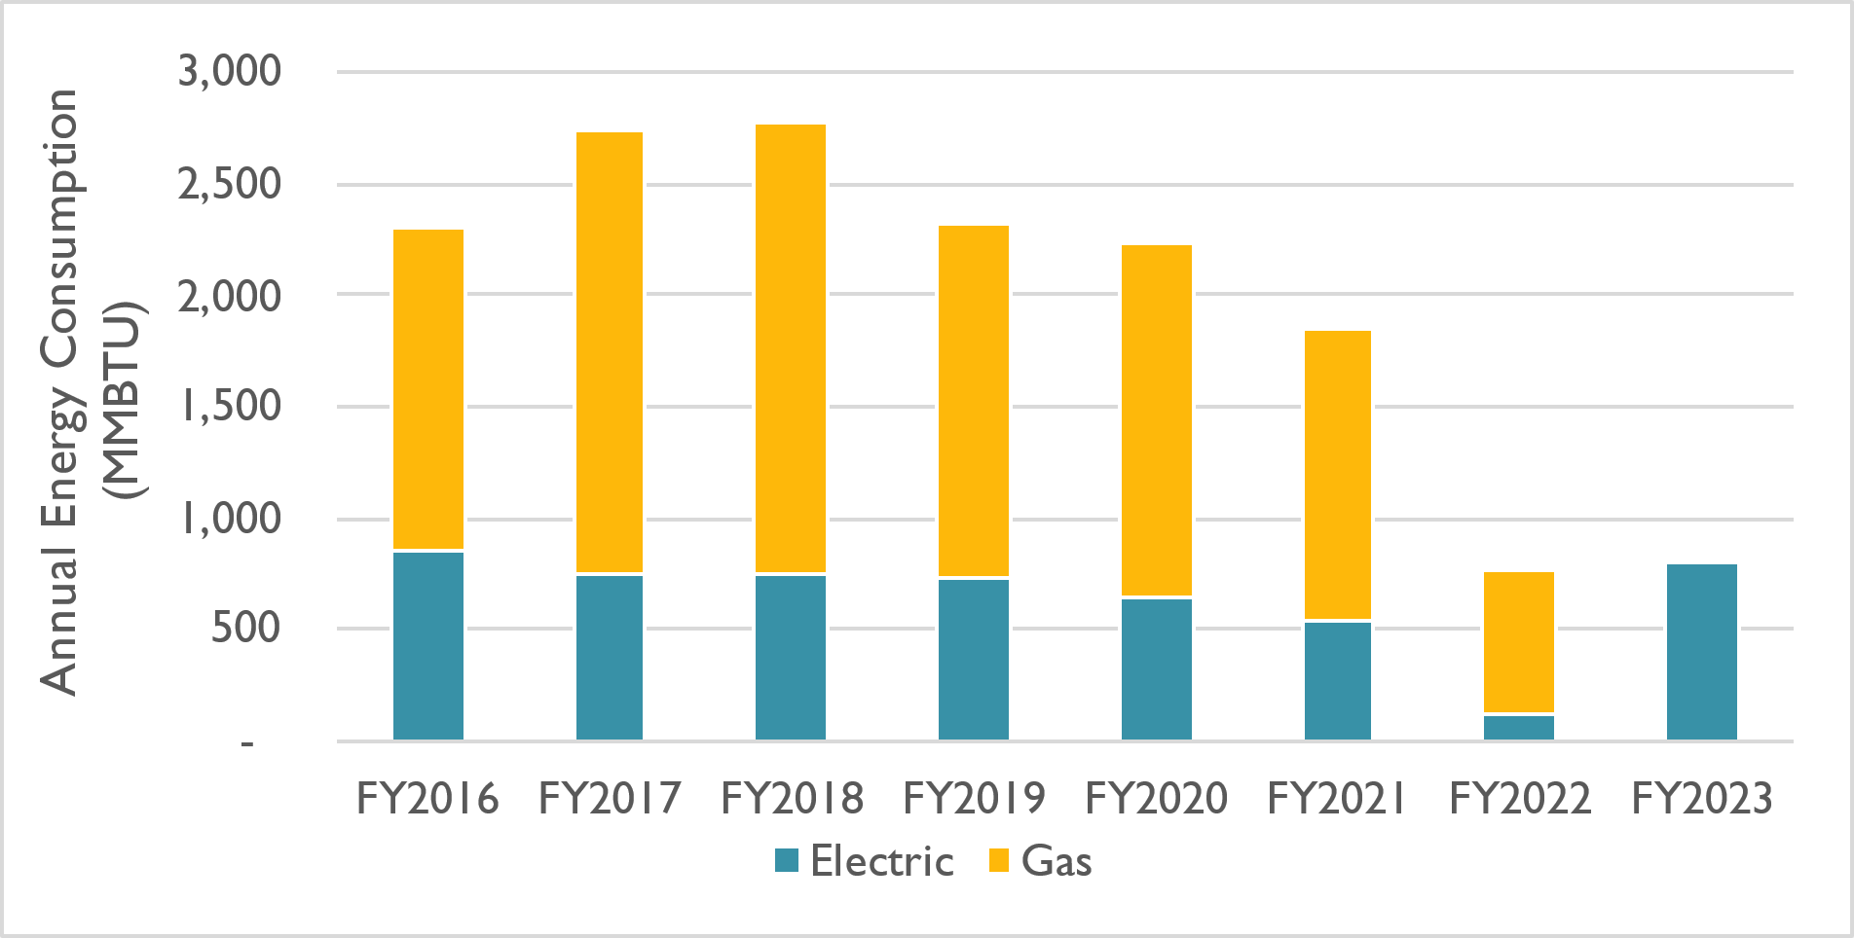
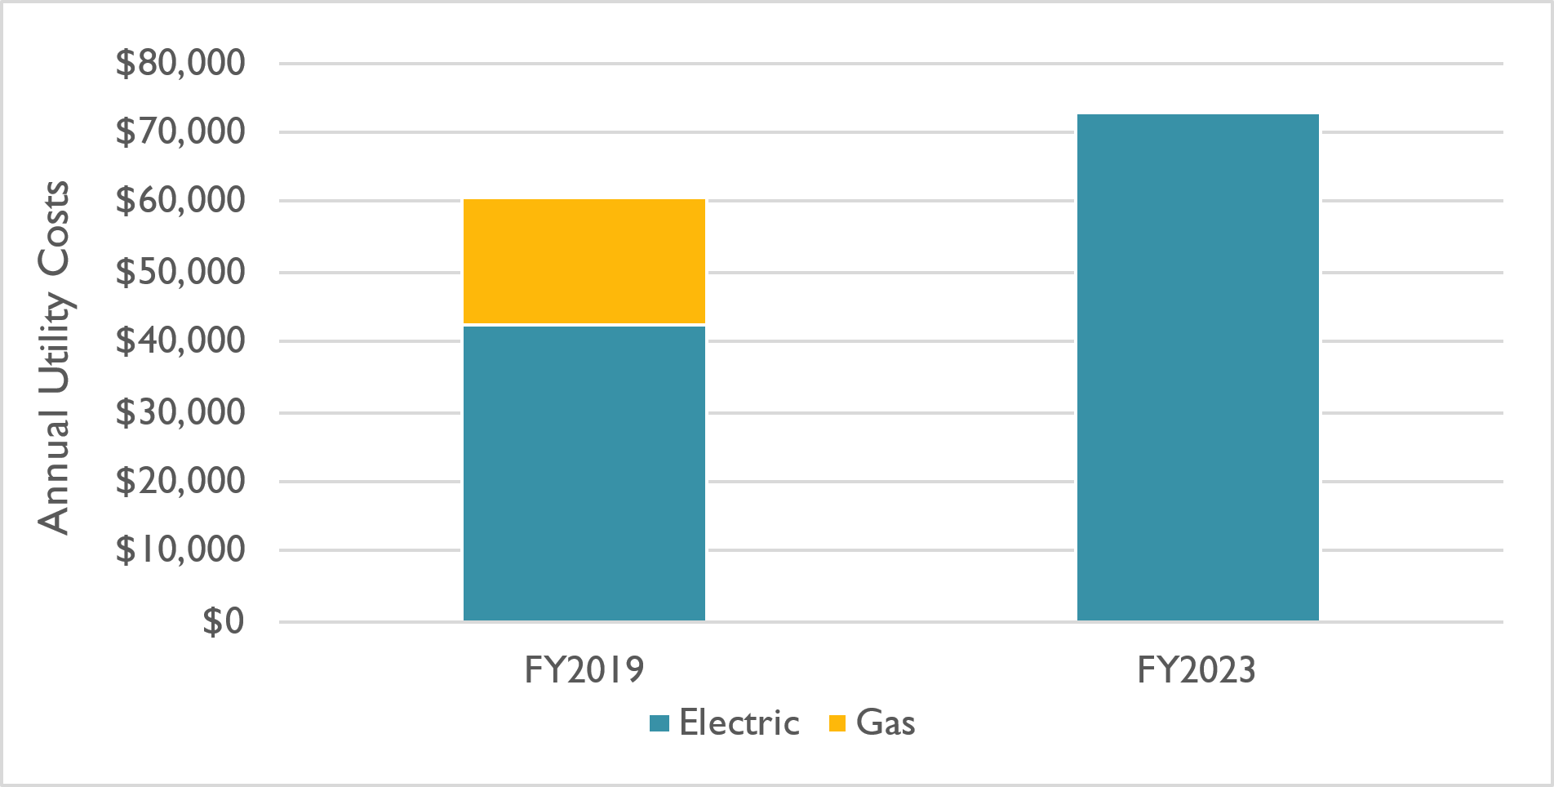
Newton Early Childhood Program
NECP utility data
Energy use reduced 65% (actual)
Energy costs rose 18%
Energy costs increased due to 55% electricity price increase
2019: $0.20/kWh
2023: $0.31/kWh
Energy costs would have been higher in 2023 with boiler

Slide 22
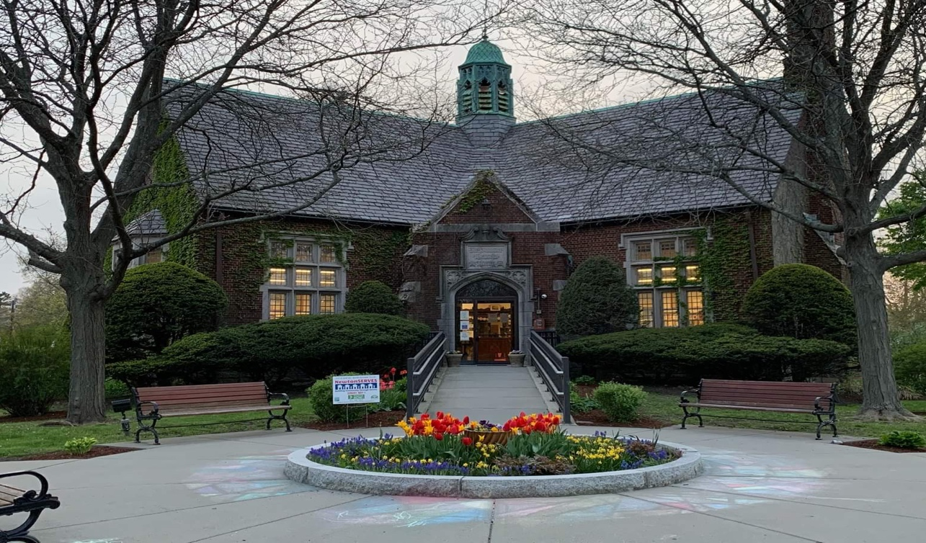
Auburndale Library
Location: Newton, MA
Project size: 5,484 sq. ft.
Project cost: $76,000
Historic building with architectural features
Project completed FY2020
Fully decarbonized, zero direct emissions
Air-source heat pumps
Attic insulation and air sealing
Project cost
Total: $76,000 ($14 per sq. ft.)
Would have been eligible for $22,000 in rebates under the current program
Auburndale Library with retrofit costs
Upgrade | Upgrade Cost | Cost per sq. ft.
Insulation and air sealing | $11,610 | $2
Air-source heat pumps | $64,800 | $13
Total cost | $76,410 | $14

Slide 23
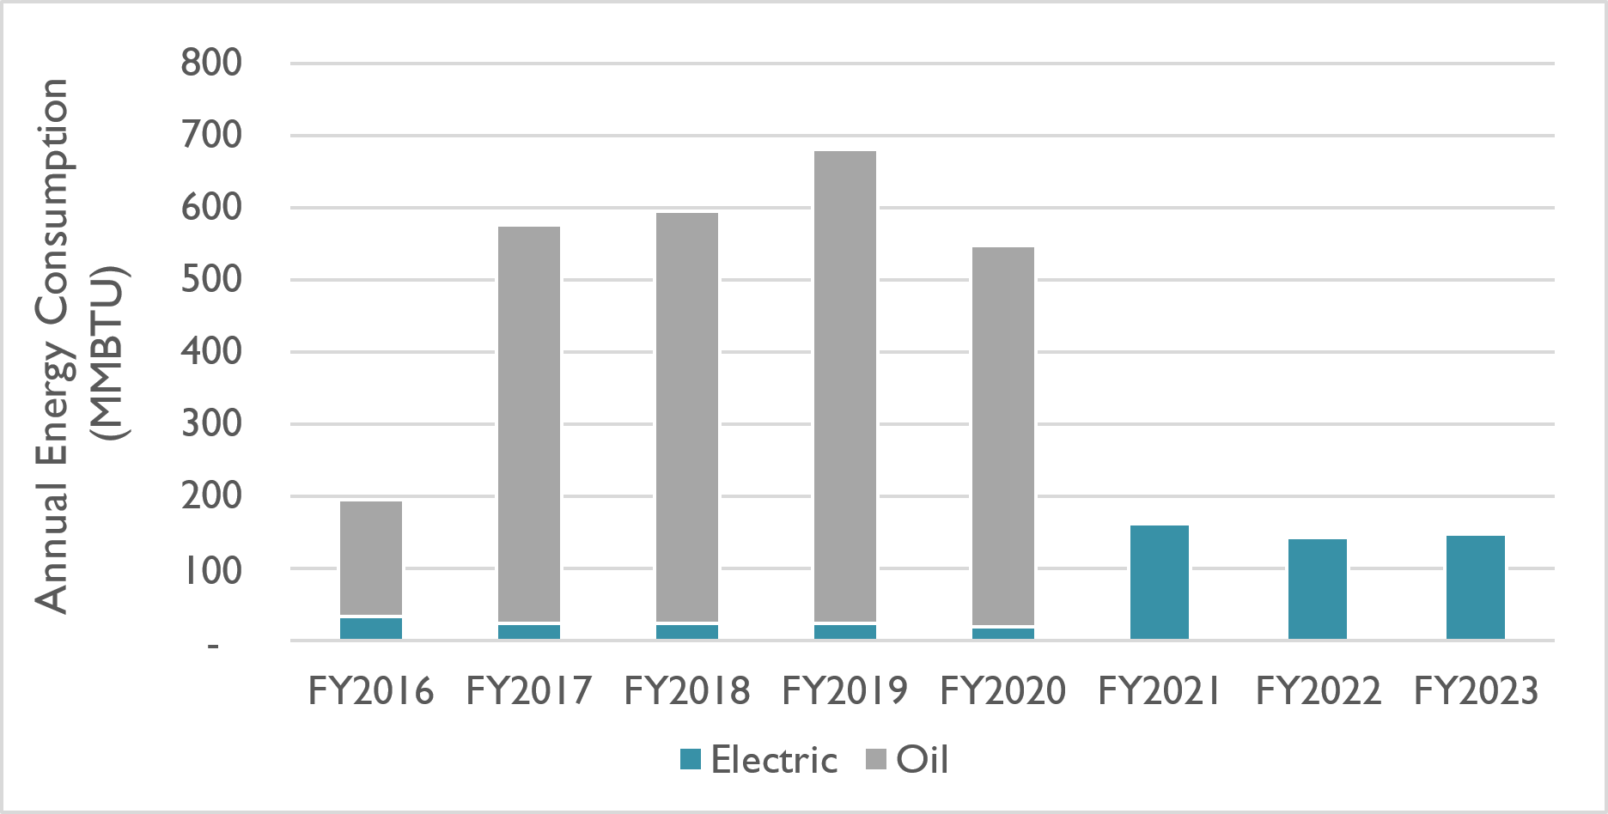
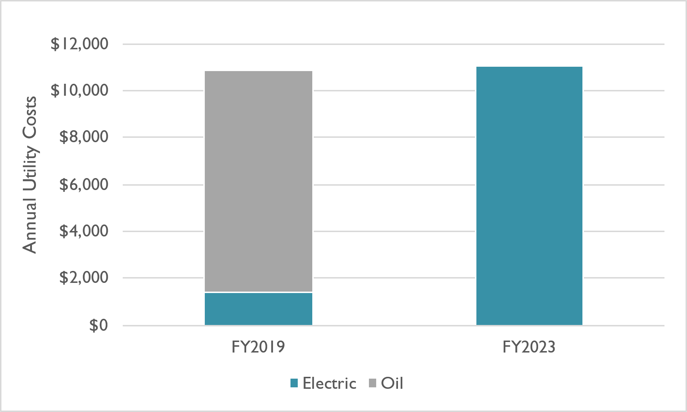
Auburndale Library
Auburndale Library utility data
Energy use reduced 76% (actual)
Energy costs unchanged despite 25% electricity price increase
2019: $0.20/kWh
2023: $0.25/kWh
Energy costs would have been higher in 2023 with boiler

Slide 24
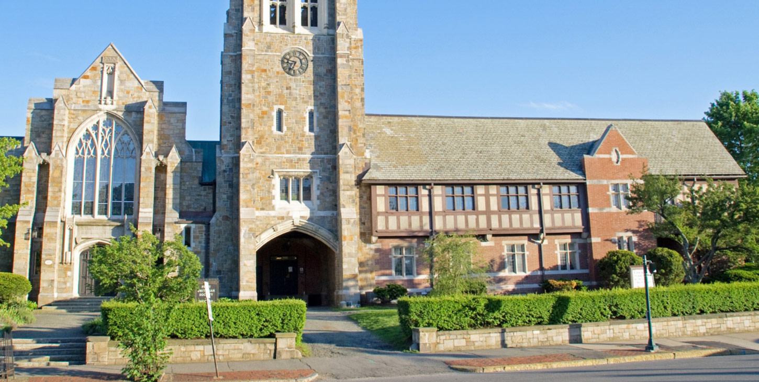
First Unitarian Universalist Society in Newton
Location: Newton, MA
Project size: 30,240 sq. ft.
Emission intensity: 2.0 kgCO2e per sq. ft.
Complies with BERDO until 2045
Phased decarbonization since late 1990s
Tracking energy in Portfolio Manager
Staged heating replacement
Steam with hot water
Failing AC condensers with heat pumps
Partitioned HVAC into 19 zones
Temperature setback in vacant rooms
Remote monitoring: equipment and energy
Example of non-profit house of worship voluntarily decarbonizing over time
Unitarian Universalist building
Keys to success
Expertise and commitment from members
Long-term planning
Adaptation over time
Efficiency plus electrification

Slide 25
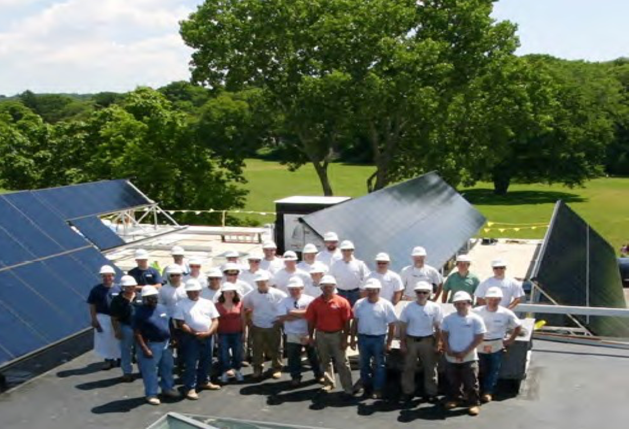
Chapman Construction and Design HQ
Location: Newton, MA
Building type: Office and retail
Project size: 19,000 sq. ft.
Phase 1 completed 2010 (LEED Platinum)
Solar PV, 47 kW
Solar thermal domestic hot water
Envelope: air sealing, roof insulation, wall insulation, window film
LED lighting with daylighting
Project cost:
$230,000 ($12 per sq. ft.)
$130,000 grant from Massachusetts Technology Council
Energy savings: $20,000 per year, 5-year simple payback
Chapman Construction and Design building
Phase 2 plan, 2027
Full decarbonization
Further improvements to building envelope
VRF heat pump
Energy recovery ventilation
Expansion of solar PV array

Slide 26
Technical Assistance and Support

Slide 27
Comparison to Boston Resources
Does the City have adequate staffing to help building owners comply?
Relative to the number of buildings, Newton has greater staffing than Boston
Newton reporting is simpler: no water, no district steam, no grid emissions, no tracking renewables
Newton emission requirements phase-in over 4 years
 | Boston BERDO | Newton BERDO (with residential)
Buildings | 5,717* | 293 (412)
Owners | 3,136 | 179 (261)
Staff | 9 FTE 635 buildings per FTE 348 owners per FTE | 1 FTE 293 (412) buildings per FTE 179 (261) owners per FTE
Annual Consulting Budget | $500,000 $87 per building | $165,000 $563 ($400) per building
*Note: Boston regulates at the parcel-level, so the number of buildings is greater than shown

Slide 28
City Assistance for Building Owners
What resources are available to help building owners comply?
City will offer public trainings and one-on-one assistance
Use of ENERGY STAR Portfolio Manager
Explanation of how to obtain energy use data
Developing a BERDO compliance plan
Flexibility measure options: Building Portfolios, Individual Compliance Schedules, Hardship Plans
City will host public seminars
Manufacturers and vendors: on technology solutions
Utilities: on available assistance and how to access it (technical assistance, rebates and incentives, financing options, aggregated energy use data)
Newton BERDO website: resource clearinghouse with detailed FAQ

Slide 29
State Assistance for Building Owners
What resources are available to help building owners comply?
MassCEC Building Performance Exchange for large building decarbonization
$4 million in state funding; pursuing $2 million in federal funds
Information and technical assistance to help comply with BERDO-like policies throughout Massachusetts
Centralized information on state policies, initiatives, and programs
Clearinghouse for financing, incentives, and qualified building professional registry
New offerings: tools, guidebooks, case studies, trainings, events, and seminars
Early rollout for communities with BERDO policies expected 2025/2026
MassCEC Building Electrification and Transformation Accelerator (BETA)
Portfolio of resources to help commercial and multifamily owners electrify
No cost, in-depth audits to develop decarbonization plan (pilot stage)

Slide 30
State Assistance for Building Owners
What resources are available to help building owners comply?
Large Building Energy Reporting (LBER) program
Requires utilities to report energy use for large buildings
DOER consultant assembling energy use and building information
First LBER reports issued October 2025, but utilities can request extensions
Key differences compared to BERDO
Does not require emissions reductions
Includes electricity emissions
Requires utilities to report natural gas and electricity, not building owners
BERDO Team is monitoring LBER closely to determine if it is useful for BERDO
BERDO ordinance language allows City to incorporate use of LBER via regulations “Owner…shall accurately report to the BERDO Administrator, via the Portfolio Manager or as required by the Regulations”
City submitting comments to DOER on draft regulations to align with BERDO

Slide 31
Utility Assistance for Building Owners
What resources are available to help building owners comply?
Mass Save 3-year plan (2025-2027)
Funded at $5 billion, including $3.5 billion for incentives
$437 million for multifamily and commercial customers of Eversource and National Grid
Install over 115,000 heat pumps
Reduce GHG emissions by 1.0 million metric tons CO₂e
Incentives for natural gas equipment phased out by law (more available for electrification)
Statewide customer call center
Equity: Main Streets program for downtowns, schools, $1 billion income-based incentives
Rebates and Incentives: insulation, air sealing, HVAC controls, heat pump water heaters, heat pump space heating
Low- or no-cost financing programs
Free scoping and technical assistance studies to help owners decarbonize buildings
Comprehensive building assessment, portfolio prioritization, decarbonization roadmap, existing building commissioning, and more

Slide 32
Reporting Energy Data

Slide 33
Setting up Portfolio Manager
How challenging is it to use Energy Star Portfolio Manager?
Free web-based tool, publicly available since 2000, already used for 25% of commercial building stock
Extensive training materials, including how-to guides
Steps:
Create account: https://portfoliomanager.energystar.gov/pm/signup
Obtain energy bills
Gas and electric: Bills for prior year (January bill includes 12 months prior)
Oil and propane: Delivery receipts for prior year
Tenant data: Available through utility portal and LBER reports; City will help
Identify building size (sq. ft.) and ID from the list on the City of Newton website: https://newtonma.gov/newtonBERDO
Enter building information and energy data into Portfolio Manager

Slide 34
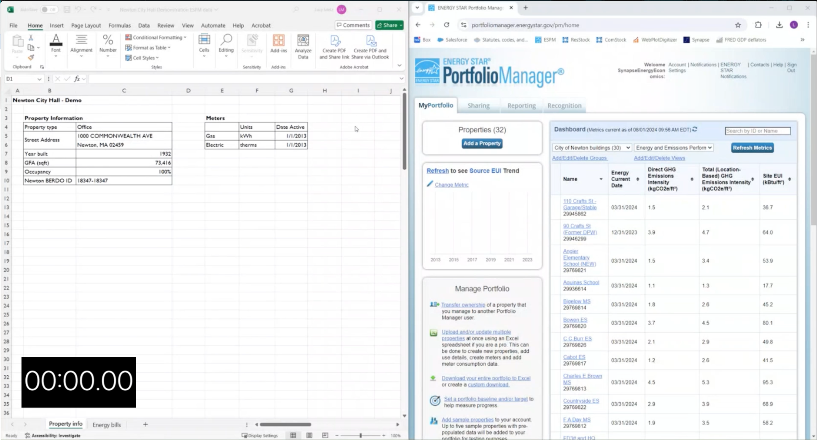
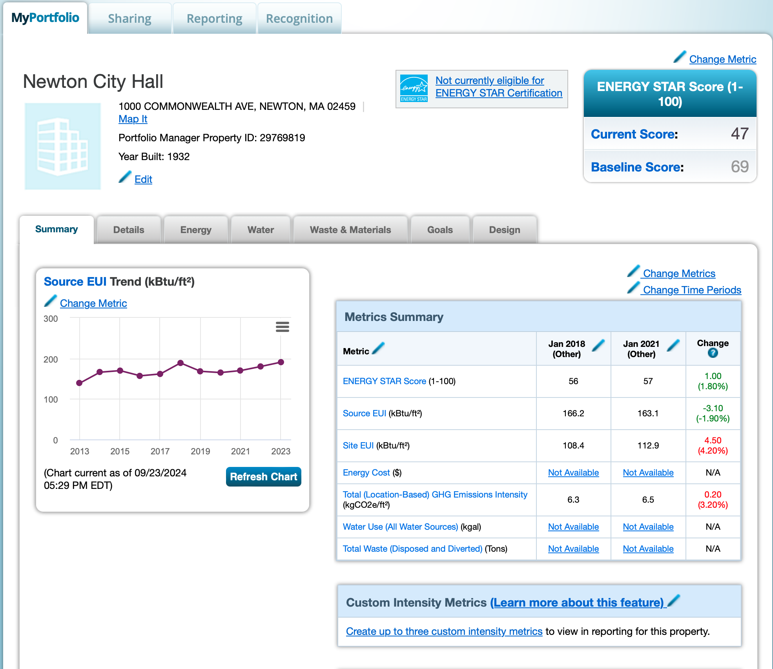
Setting up Portfolio Manager
How challenging is it to use Energy Star Portfolio Manager?
Junior staffer learned Portfolio Manager and reported 30 City buildings in 15 hours
Demo video: 2 minutes to enter Newton City Hall using collected data

Slide 35
Setting up Portfolio Manager
Has reporting been challenging in Boston? How will Newton be different?
Boston works with owners to resolve issues and has had nearly complete reporting (only 3.8% of 2022 reports are pending revisions)
Newton reporting is simpler
Fewer utilities: no water or district steam reporting
Electricity emissions excluded: no grid emissions, no solar metering, no tracking renewables, no changing emission factors
Single platform: streamlined reporting (Boston and Cambridge uses two)

Slide 36
Impacts of BERDO on Newton

Slide 37
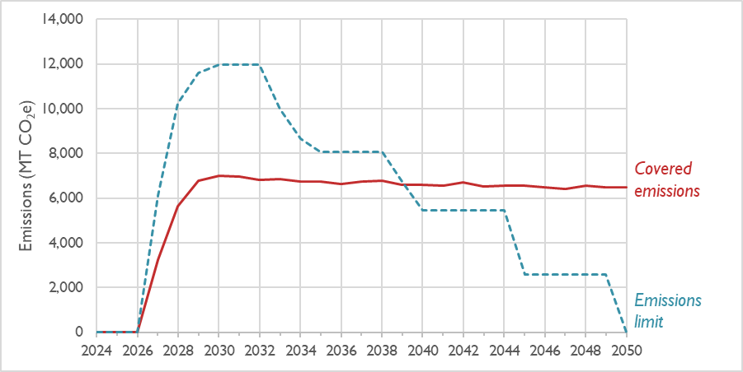
BERDO Administration Cost
What will BERDO cost taxpayers?
City of Newton will hire 1 full-time personnel to administer BERDO
City of Newton has an annual consultant budget of $165,000
Municipal facilities will comply with BERDO until 2040 → no cost
Total annual costs: up to $290,000 per year
Municipal facility emissions compared to BERDO Limit

Slide 38
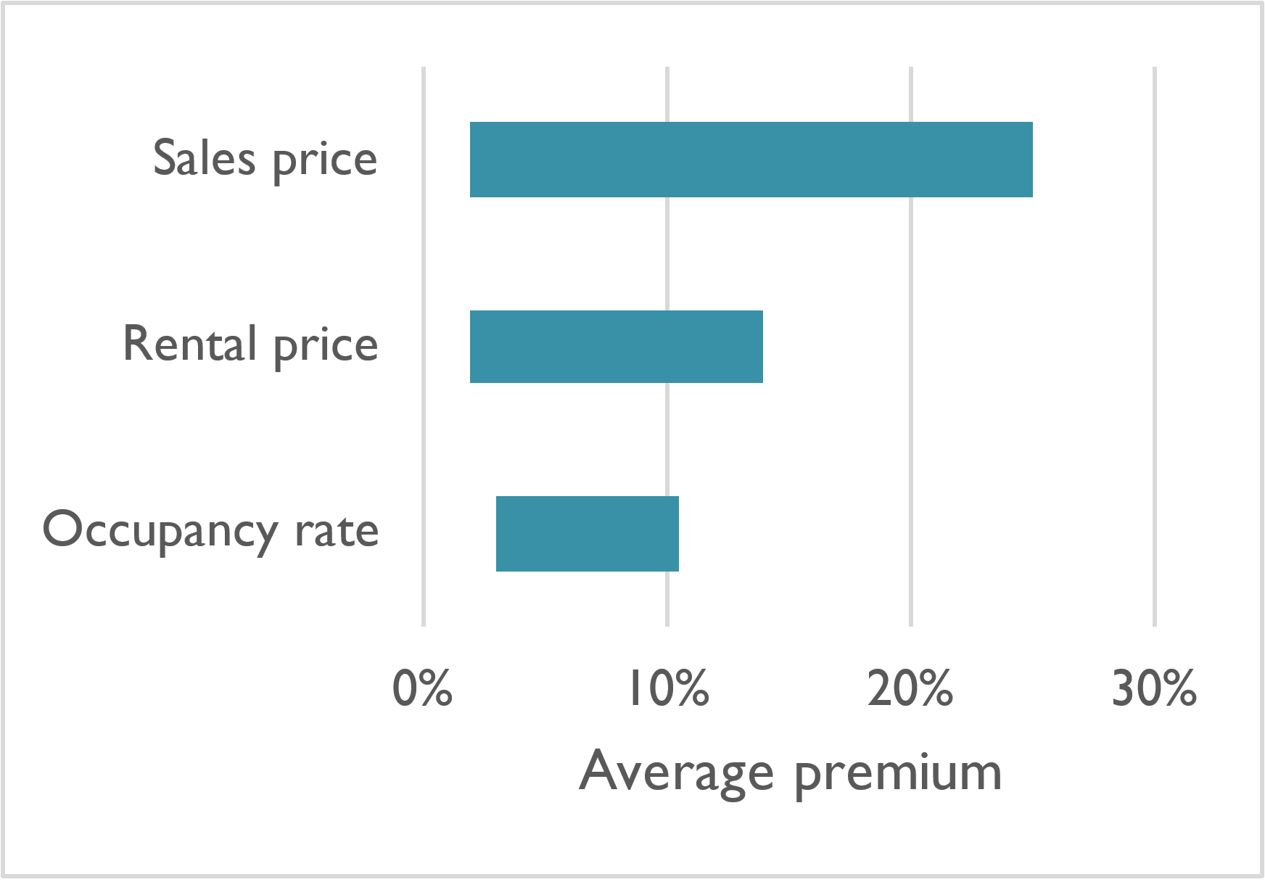
Economic Competitiveness
How will BERDO affect property values and Newton’s tax base?
Stakeholders question if BERDO will hurt Newton’s economic competitiveness
Seven peer-reviewed studies show high-performing buildings garner market premiums
Average sale price increase: 2–25%
Average rental price increase: 2–14%
Average occupancy rate increase: 3–11%
Added value of ENERGY STAR-labeled commercial buildings in the United States
Sources (research assembled by IMT): Devine and Kok 2015, Wiley et al. 2010, Fuerst and McAllister 2009/2011, Jackson 2009, Pivo and Fisher 2010, Kok et al. 2010

Slide 39
Thank you!
Philip Eash-Gates, PE, CEM
Principal Associate
617-453-7080
peash-gates@synapse-energy.com

