Slide 1
Presentation on Newton BERDO to BEA
February 6, 2025
Halina S. Brown and Michael Gevelber
Newton Citizens Commission on Energy
hbrown@clarku.edu gevelber@bu.edu

Slide 2
In December 24 member Newton City Council Unanimously adopted Building Energy Reduction and Disclosure Ordinance BERDO unanimous vote!

Slide 3
In December
24-member Newton City Council unanimously adopted
Building Energy Reduction and Disclosure Ordinance
BERDO

Slide 4
Key features of BERDO
385 Buildings over 20,000 s.f.
5 requirements:
Annual reporting of energy use and GHG emission intensity.
Compliance with pre-set emission intensity targets (kg GHG/s.ft.)
13 Targets for 13 different types of buildings
Targets decline every 5 years → Net zero in 2050
Energy use based on fuel use and electricity
Emissions calculated only from on-site fossil fuels. Electricity exempted
Alternative Compliance Payments (ACP): $234/Mton CO₂

Slide 5
Why BERDO in Newton?
Bldg. Performance Standards ---- Leading policy tool available to local governments for building decarbonization
Large impact, few buildings
38% emissions from 20,000+ residential buildings
28% from 395 large bldgs.
BUT
Benefits nationally and globally – Costs borne locally
Air pollution regulation: A new function for municipality
Requires new competences for municipal staff
Requires new competences for building owners

Slide 6
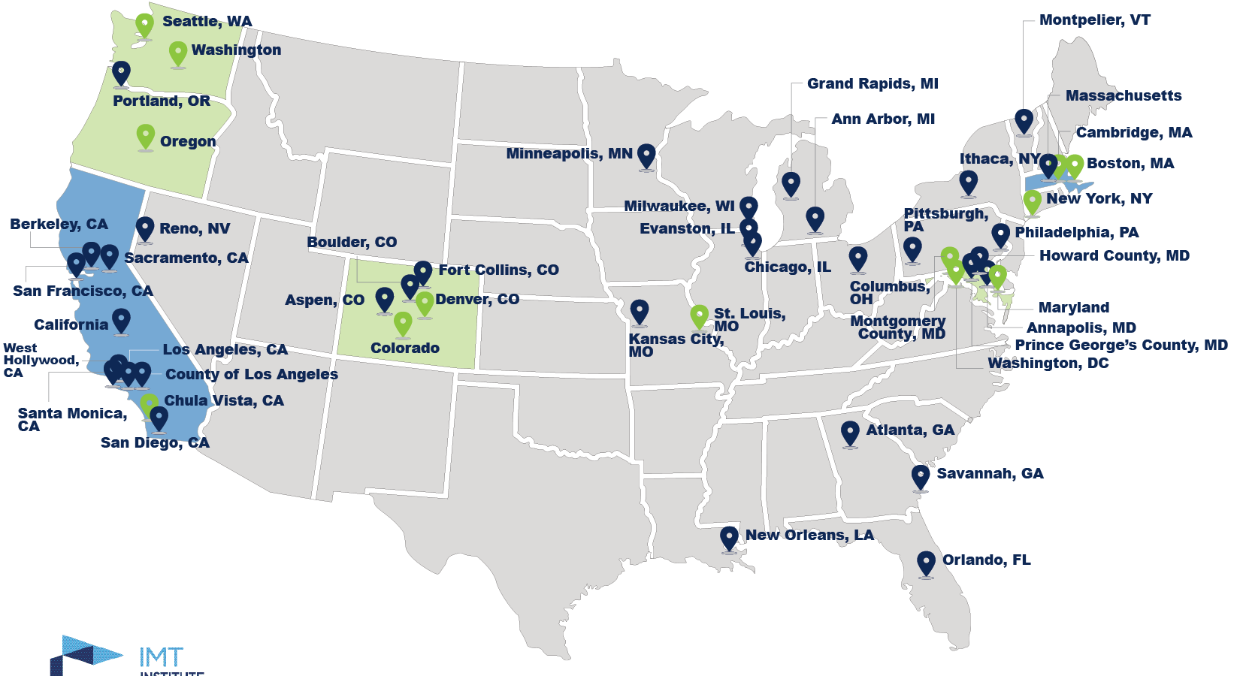
National Context: Building Performance Standards
14-17 jurisdictions + 35 more commitments by 2026
Sources: IMT, National BPS Coalition

Slide 7
Massachusetts Context: Idea whose time has come
Boston BERDO and Cambridge BEUDO
Wide range of financial incentives
State’s obligation: 2050 net zero GHG emissions
2022 Climate Law: Large Building Energy Use Reporting
Active legislature – several bills
S.2232 in 2023 BERDO-like state law for bldgs. >20,000
S.2144 in 2024 Lewis, Rausch, Cruz, Eldridge Emission… intensity targets for >20,000
S…… in 2024 Barrett, Rausch, Sabadosa, Eldridge Disclose… Home Energy Efficiency Rating
S…..in 2025: amended S.2144 underway

Slide 8
Newton Context
Progress made with New Construction → future
Specialized stretch code
10 communities pilot
2020 GHG Emission Inventory:
No progress with emission reductions in a decade
Enabling conditions:
Energy Commission: Commitment to analysis and policy development
Bill Ferguson, Co-director of Sustainability becomes a leader
The Mayor gives green light
Learning from others: Cambridge, Boston and Maryland
Political safety: 14 other programs nationally

Slide 9
Declining emission targets → Zero in 2050
Can discuss reasons
for why different than Boston
In the Q&A:
- no electricity
- Timing & reduction levels

Slide 10
Staggered implementation

Slide 11
The Process: First 2.5-years
6-member Working Group:
2 municipal, 3 Energy Commission, 1 Green Newton
Energy Commission
Technical analysis
Policy development
City
Inventory of 385 buildings
Learning from Boston, Cambridge, others
Lining up municipal funds for implementation
Communicating with Newton Housing Authority
16 Outreach sessions to building owners -- Website

Slide 12
The Process: 2.5 -- 3.5 years
Legal Department: text of the ordinance
Consultant engaged: Synapse
Educating city councilors – Zoning and Planning Committee ZAP
Estimating costs and timing of impacts on bldg. owners
Mobilizing supporters:
Green Newton
350.org
Mothers Out Front
League of Women Voters

Slide 13
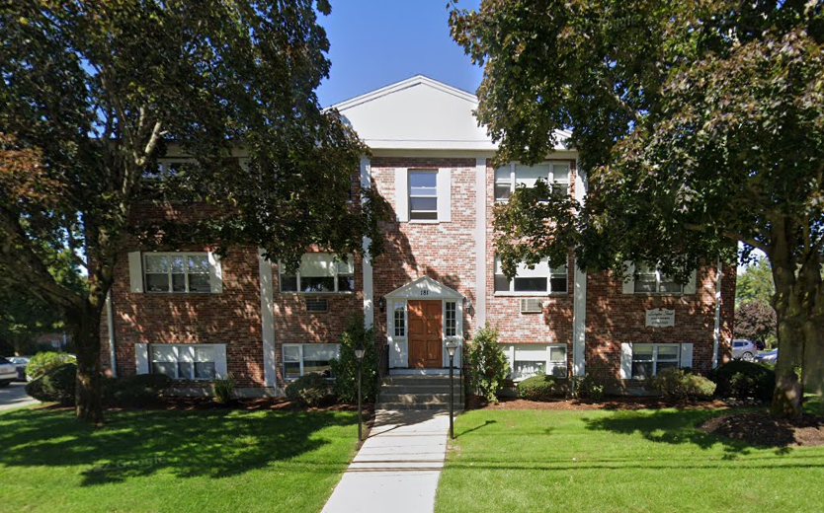
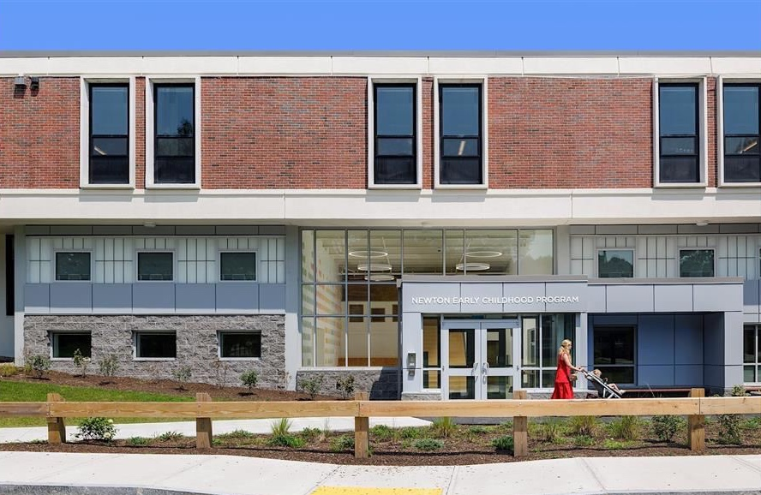
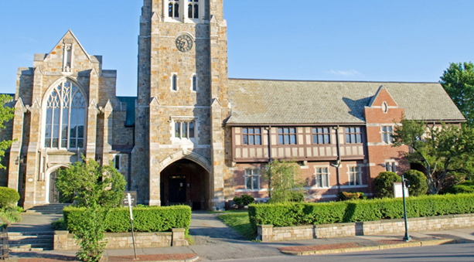
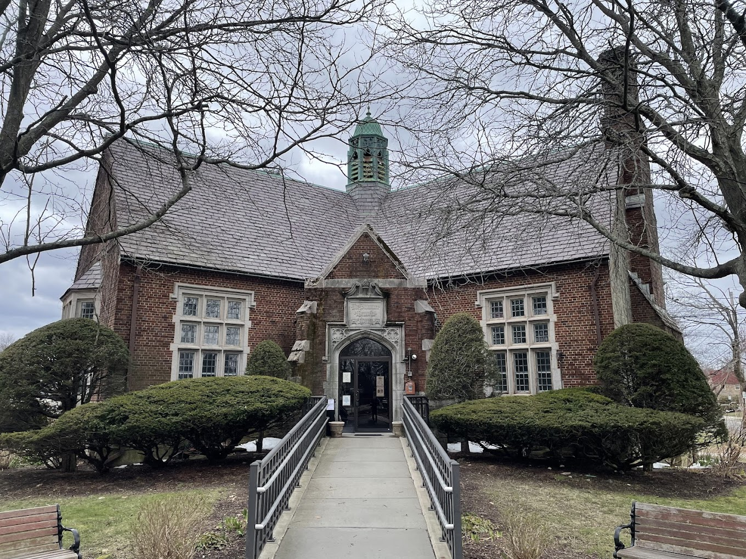
Costs
Administrative:
$290K/year for One FTE and consultant
Building owners—Before incentives
case studies
completed projects
published literature
contractor quotes
interviews with professionals
Commercial rent for offices: +2%
Multifamily rent in Newton: +2-4%
Incentives will reduce net costs

Slide 14
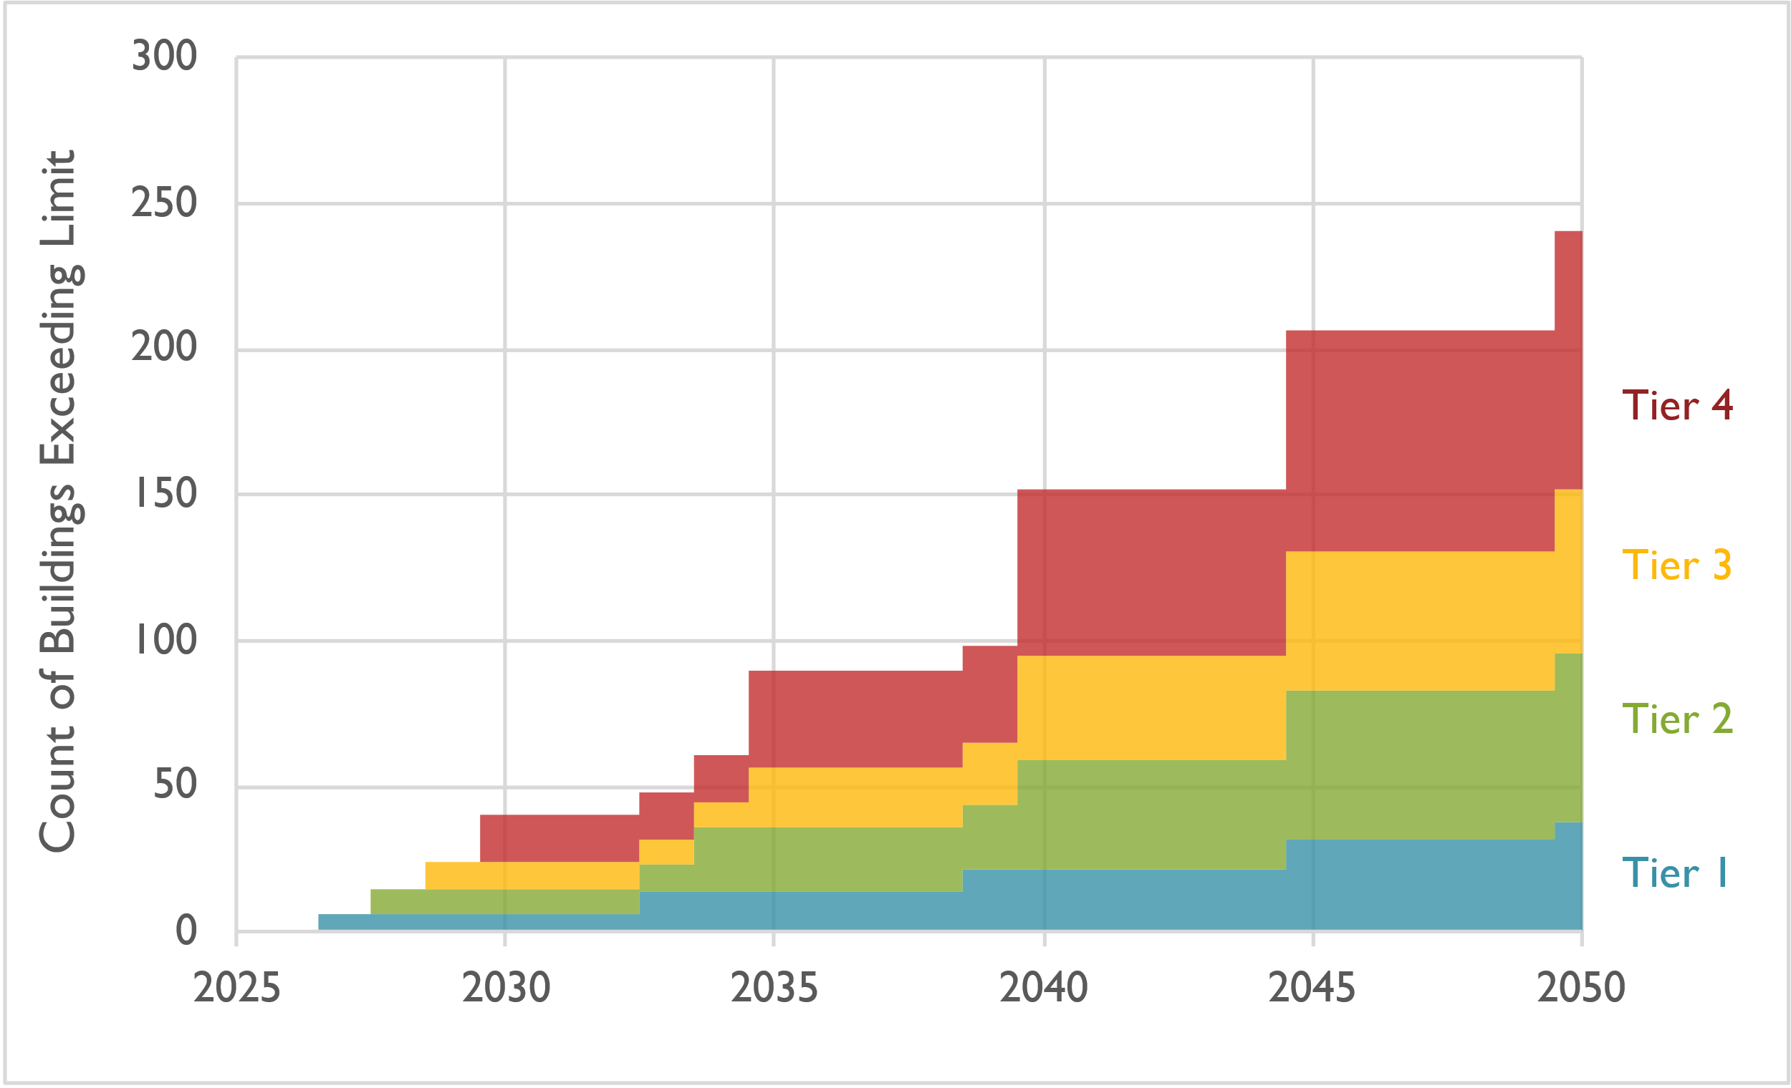
Administrative burden
About 10 bldgs each year; 40 buildings by 2030
Most (67%) in compliance until 2040
9 public and affordable housing in compliance until 2040
Count of buildings over BERDO limits (in absence of upgrades)
Notes:
Assumes Newton buildings have similar performance as Boston buildings of same type
Does not total to 293 buildings because all-electric buildings will not need to make changes.

Slide 15
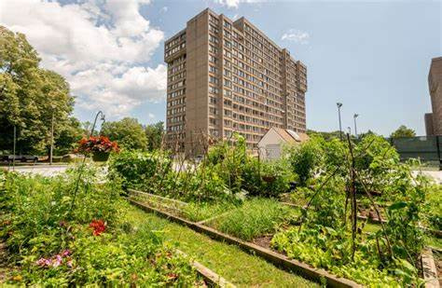
Opposition
From 1 owner of lower cost housing:
From 400+ residents of Chestnut Hill Towers
Cost of rent
Why us and not the residential sector with
its large houses?
Charles River Chamber backed opposition
Compromise: Multifamily buildings only report

Slide 16
Summary
Buildings are the key to progress
It can be done on a municipal level but it takes time and effort
It requires both carrots and sticks
It will be easier for the next municipality
Not knowing compliance costs is an impediment
that will improve over time

Slide 17
More details for Q&A

Slide 18
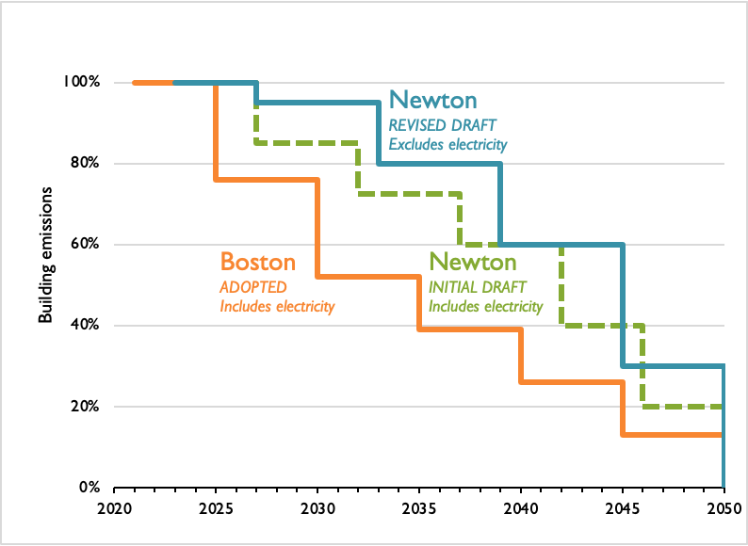
Proposed Rate of Emissions Reduction
Focus on replacement of on
site fossil emissions
Since significant CapX, delay
1st large drop to 2034.
1st reduction (8%) driven by energy
efficiency investments
For apartments, consider
DHW vs heating loads
Expect most buildings in
compliance until mid-late 2030’s
Notes:
Plotted lines represent both the individual compliance schedule and emission standard (Boston and Newton)

Slide 19
BERDO rent cost impact: ACP ($234/MT CO₂)
For the commercial office market, average net rental price data was used for metro west area as $32-36/sqft/yr (1). Heating utility emissions (therms used/sqft) are estimated to be 0.5 therms /sqft/year.
- Berdo max ACP cost would range from an increase in monthly rent of 1.6-1.8%.
- Relative to gross lease cost (which includes all rental expenses such as operating costs, property taxes, utilities), the Berdo ACP cost impact is ~1.3%.
For commercial apartments, analysis of 181 Lexington street, based on current total emissions for heat and domestic hot water to be an increase in rent of 2.8% if no electrification of heating & DHW were implemented. Assumes rental rate of $2200/month. For current listed rents for these apartments ($2600), this would be 2.4%. Note, higher apartment rents would decrease this max rental rate increase. Note, in 2040, this corresponds to a 1.3% increase in rent.

Slide 20
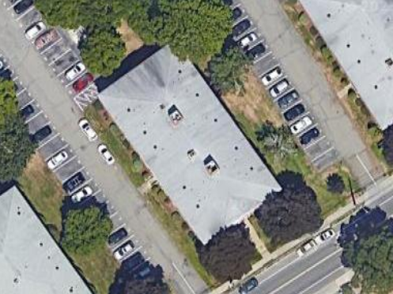
Newton Berdo residential case study
Energy source | Energy use | Energy use intensity | Emissions | Emissions intensity
 | kBtu | kBtu/sqft | kg CO2e | kg CO2e/sqft
Electricity | 248,117 | 10.1 | 7,242 | 0.29
Natural gas | 1,437,811 | 58.5 | 76,362 | 3.11
Total | 1,685,928 | 68.6 | 83,605 | 3.40

Slide 22
Newton Large Buildings (Including Residential Condos)
Some complexes are likely composed of multiple smaller buildings.
These buildings represent 28% of total GHG in Newton.
Tier | Description | Count of Buildings | Number of Owners | Total GFA (sq ft) | Emissions (metric tons CO₂e)
1 | Non-residential, ≥100,000 sq ft | 47 | 29 | 8,631,279 | 77,774 | 38%
2 | Non-residential, 50,000–99,999 sq ft | 70 | 41 | 4,948,885 | 42,246 | 21%
3 | Non-residential, 35,000–49,999 sq ft Residential, ≥50,000 sq ft | 67 38 | 15 1,580 | 2,825,059 5,101,710 | 23,480 24,201 | 12% 12%
4 | Non-residential, 20,000–34,999 sq ft | 107 | 88 | 2,848,581 | 23,678 | 12%
5 | Residential, 20,000–49,999 sq ft | 83 | 675 | 2,356,977 | 11,427 | 6%
Total | All covered buildings | 412 | 2,380* | 26,712,491 | 202,805 | 100%
*Note that the total number of covered building owners is less than the sum of the rows, because some building owners appear in multiple tiers.
Notes:
Lucy – note 4/6/23 -- table now contains non-residential condos
Philip (4/11/23): updated to capture 1 missed condo

Slide 23
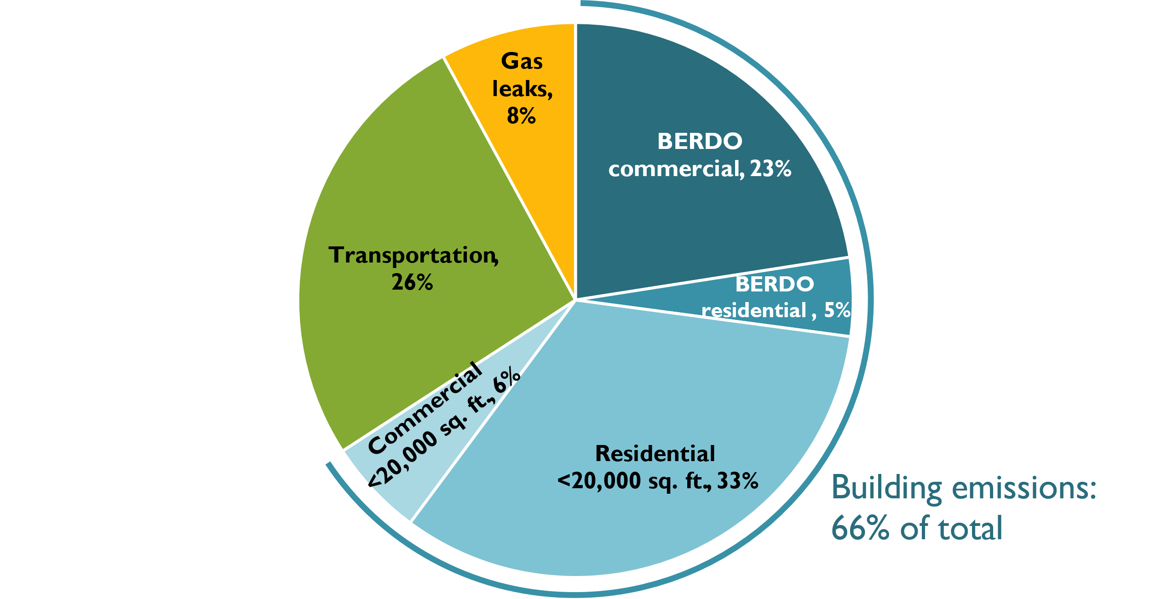
Why BERDO?
Newton’s GHG emissions:
City goal of carbon neutral by 2050
Address through National Grid
Address through BERDO now:
292 buildings (179 owners)
Address through BERDO in 2025:
120 buildings
(94 owners)
20,000+ buildings:
Note: “Commercial” includes institutional and industrial buildings

Slide 24
Emission targets for 13 different types of buildings
Gradually decline until net zero in 2050.
Table 1: CO₂e Emissions Standards by Building Use
Building use | Emission standards (kgCO₂e/sq. ft.)
 | Period 1 | Period 2 | Period 3 | Period 4 | Period 5
Assembly | 6.1 | 3.7 | 2.3 | 1.1 | 0.0
College/University | 9.5 | 5.7 | 3.5 | 1.5 | 0.0
Education | 4.1 | 2.8 | 1.9 | 0.9 | 0.0
Food Sales & Service | 6.8 | 4.4 | 3.2 | 1.5 | 0.0
Healthcare | 14.3 | 9.2 | 6.5 | 3.2 | 0.0
Lodging | 4.6 | 3.1 | 2.1 | 1.0 | 0.0
Manufacturing/Industrial | 3.9 | 2.9 | 2.2 | 1.0 | 0.0
Office | 3.1 | 2.0 | 1.2 | 0.5 | 0.0
Retail | 3.4 | 2.3 | 1.4 | 0.6 | 0.0
Services | 6.5 | 4.2 | 2.9 | 1.4 | 0.0
Storage | 2.5 | 1.8 | 1.3 | 0.6 | 0.0
Technology/Science | 14.6 | 10.7 | 6.7 | 2.8 | 0.0
Includes direct GHG emissions only (electricity emissions excluded)

Slide 25
Boston as a Model: Proposed Differences
Since 2013 Boston has had a building energy reporting requirement
In 2021 Boston adopted an emissions standard because the reporting requirement was not achieving energy savings
Newton BERDO is based on Boston’s with key exceptions:
Building types: Initially, Newton excludes residential (apartments and condos)
Unit of regulation: Newton regulates individual buildings (vs. parcels in Boston)
Scope: Newton includes direct emissions only; excludes electricity-related emissions
Timeline: Emissions reductions start in 2027 for Tier 1 (vs. 2025 in Boston)
Compliance periods: longer in Newton; aligned with capital planning cycles
Stringency: emission reductions are gradual at first

